Slide 1
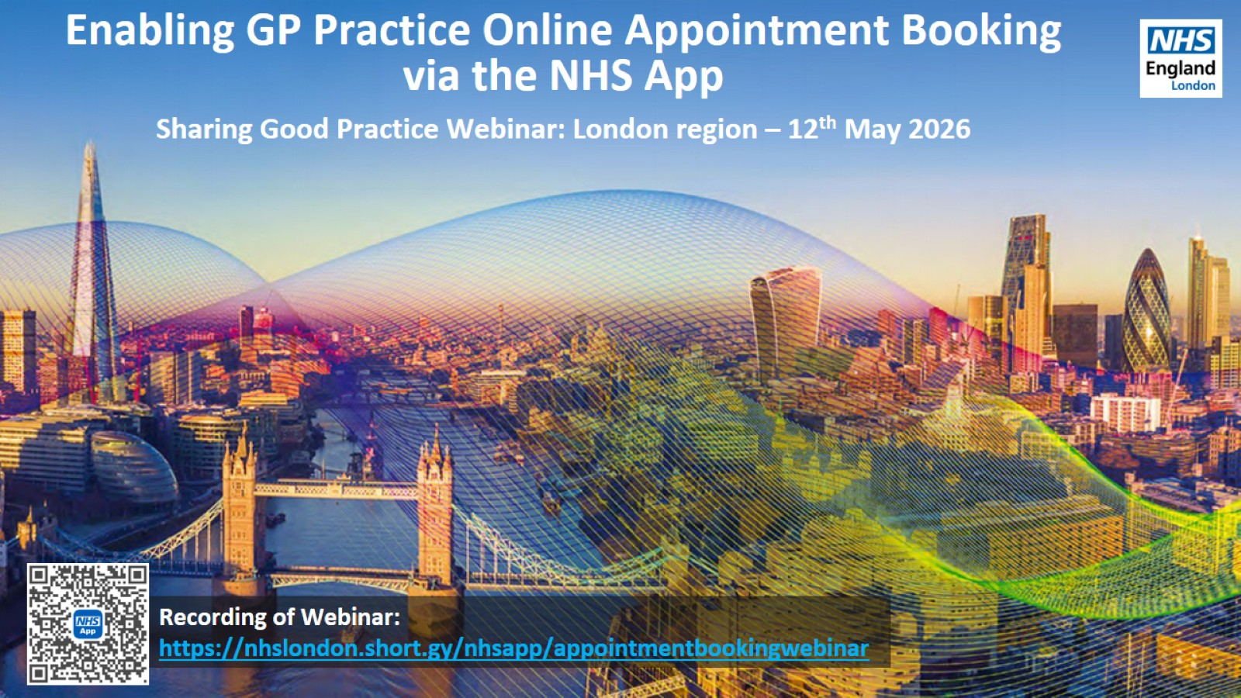

Slide 2
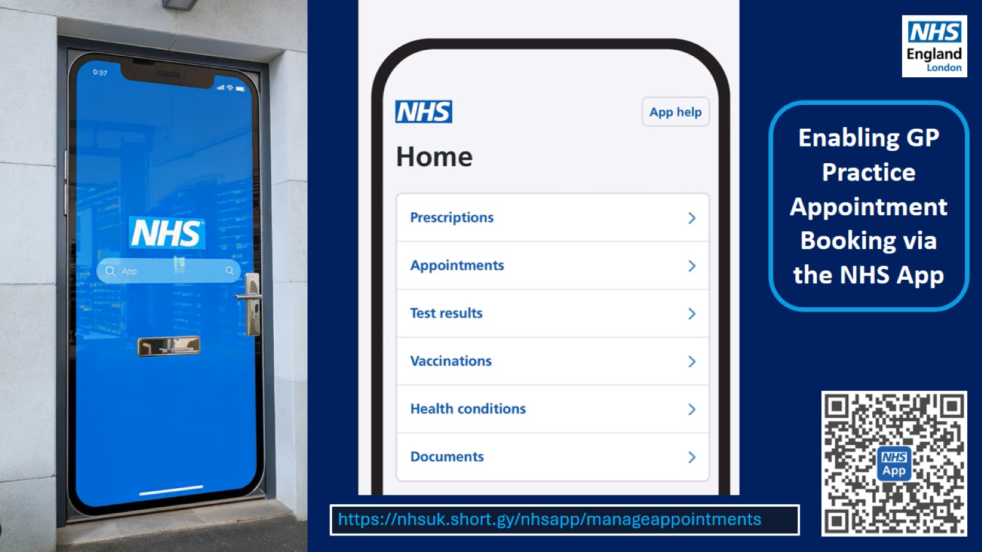

Slide 3
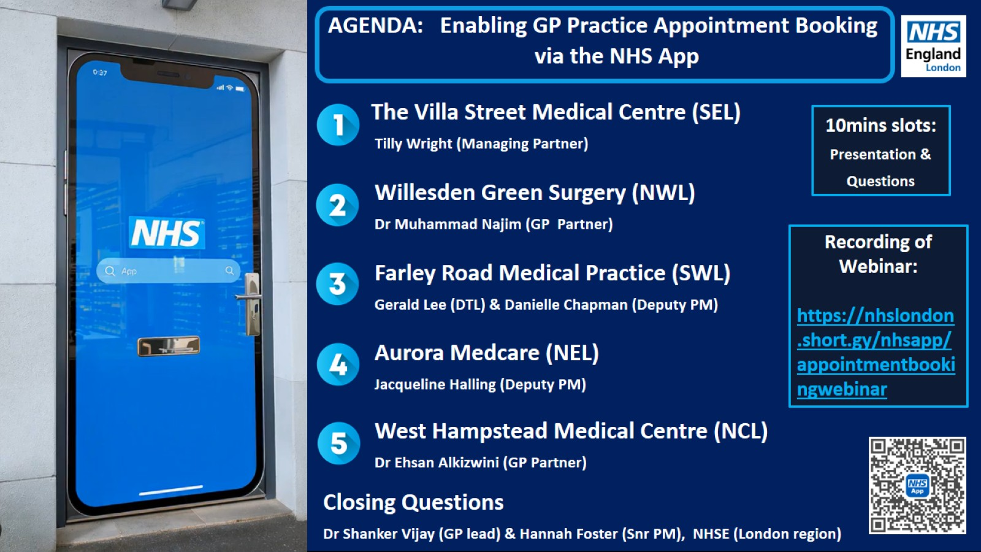

Slide 4

Villa Street Surgery Appointment Model
Efficient scheduling system for patient appointments
Notes:
---

Slide 5
Overview of the Appointment Model
Notes:
Principles and Objectives

Slide 6

Principles and Objectives
Continuity of Care
  The model prioritises patient continuity with the same clinician to support better long-term health outcomes and trust.
Responsiveness to Urgency
  Clear routes ensure patients with urgent needs get timely access to the right clinician and care method.
Flexibility and Choice
  Staggered appointment release and multiple booking windows enable patients to plan care around their lifestyles.
Notes:
The Villa Street Surgery appointment model is designed to balance timely access to care, continuity with a preferred clinician, and clinical safety. At its core, the model encourages patients to plan routine, non-urgent health care in advance wherever possible. This approach supports better long-term health outcomes, particularly for patients with ongoing or complex conditions, by enabling them to see the same clinician over time. Continuity of care is prioritised because it improves understanding of patient history, strengthens therapeutic relationships, and reduces unnecessary duplication of consultations.
A second key principle of the model is responsiveness to urgency. While planned care is encouraged, the practice recognises that acute health problems can arise unexpectedly. For this reason, the model includes clear and reliable routes for patients with urgent and clinically urgent needs to access appropriate care without delay. These routes are structured to ensure that patients are assessed by the right clinician, at the right time, using the most appropriate method.
Finally, the model is built to offer flexibility and choice. By staggering the release of appointments and offering multiple booking windows, patients can plan around work, caring responsibilities, and personal preferences. At the same time, the model allows the practice to manage demand safely and sustainably, ensuring that same-day capacity is protected for those who need it most. Overall, the appointment model aims to deliver a fair, transparent, and patient-centred system that works for both patients and the clinical team.

Slide 7
Planned and Routine Care
Notes:
Non-Urgent and Follow-Up Appointments

Slide 8
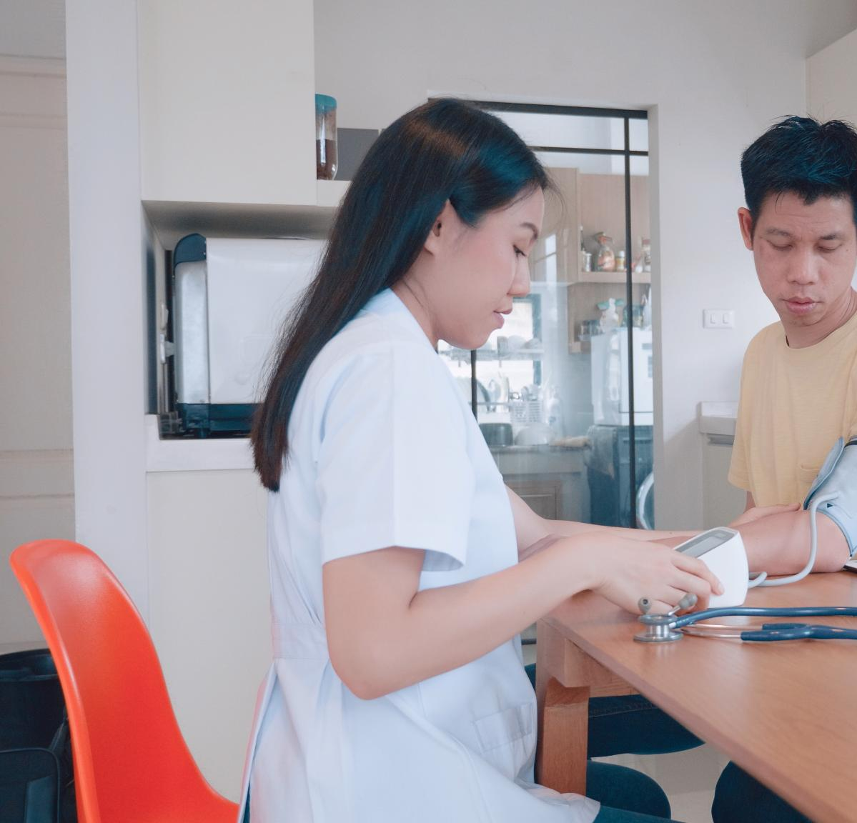
Non-Urgent and Follow-Up Appointments
Encouraging Planned Care
  Planning routine and non-urgent appointments helps patients secure preferred clinicians and enhances quality of care.
Continuity of Care Benefits
  Seeing the same clinician improves understanding, reduces repeated information, and supports shared decision-making.
Efficient Practice Management
  Advanced appointment scheduling helps manage workload and reserves urgent care for acute patient needs.
Notes:
Villa Street Surgery actively encourages patients to plan their routine and non-urgent health care in advance. Routine appointments include follow-ups, ongoing condition reviews, medication reviews, and other planned aspects of care that do not require immediate attention. By planning ahead, patients are more likely to secure appointments with their preferred clinician, which supports continuity and improves the quality of care.
This approach is particularly important for patients who attend frequently, those with multiple long-term conditions, and patients who may be vulnerable, frail, or have complex health and social needs. Seeing the same GP or clinician consistently allows for a deeper understanding of the patient’s circumstances, reduces the need for patients to repeat information, and supports shared decision-making. Continuity is associated with better health outcomes and improved patient satisfaction.
By making appointments available several weeks in advance, the practice enables patients to organise their care around their daily lives. Planned care also helps the practice to manage workload more effectively, ensuring that urgent capacity is preserved for patients with acute or clinically urgent needs. Overall, encouraging planned routine care benefits both patients and the practice by creating a more predictable, efficient, and person-centred system.

Slide 9
Urgent and Clinically Urgent Care
Notes:
Next Working Day and Same-Day Access

Slide 10
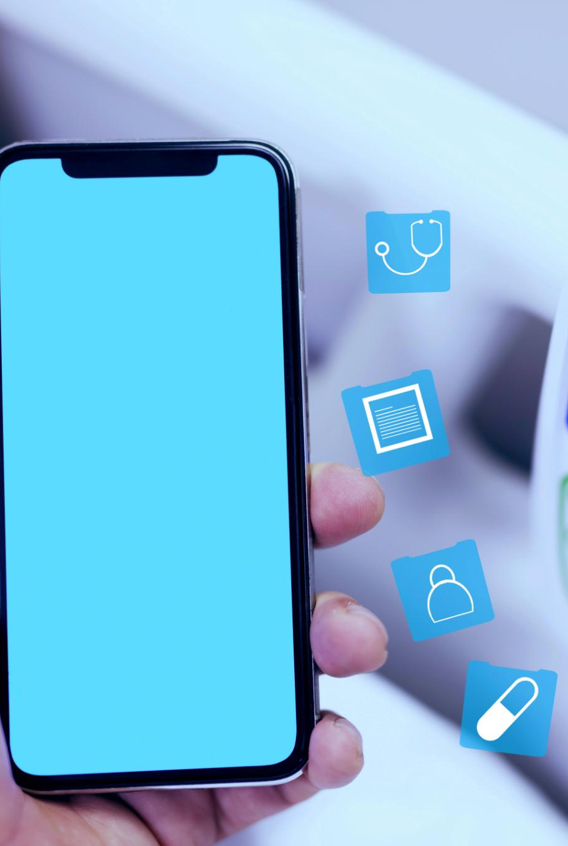
Next Working Day and Same-Day Access
Next Working Day Appointments
  Patients with acute health issues can access next working day appointments across the clinical team for prompt assessment.
GP-led Same-Day Triage
  A morning triage callback service allows patients to speak with a GP who assesses urgency and determines next steps.
Priority Based Appointment Allocation
  Same-day appointments are reserved for urgent cases, ensuring fair allocation based on clinical need, not booking speed.
Continuity of Care
  Where possible, patients are booked with their usual clinician on the same day to maintain continuity even in urgent cases.
Notes:
For patients with more urgent acute health issues, Villa Street Surgery provides next working day appointments across the wider clinical team. This ensures that patients with new or worsening problems can be assessed promptly without needing to wait long periods for care. Wherever possible, patients can still request to see their preferred clinician, supporting continuity even in more urgent situations.
For issues that patients feel are clinically urgent and require same-day input, the practice operates a morning GP-led triage callback service. This service allows patients to speak directly with a GP, who can assess the urgency and nature of the problem. During the triage call, the GP works collaboratively with the patient to agree the most appropriate next steps. These steps may include self-care advice, further investigation, referral to another service, or booking a same-day appointment.
Same-day appointments are reserved specifically for clinically urgent cases and are not available for online booking. This protects capacity and ensures that appointments are allocated based on clinical need rather than speed of access. Where appropriate and possible, the triage GP will aim to book the patient with their usual clinician on the same day, maintaining continuity even in urgent situations. This structured approach ensures safety, fairness, and efficient use of clinical resources.

Slide 11
Appointment Scheduling in EMIS
Notes:
Adding and Managing Clinical Sessions

Slide 12
Adding and Managing Clinical Sessions
Advance Session Scheduling
Scheduling GP and Nurse sessions six weeks ahead ensures consistent appointment availability for patients.
Structured Appointment Release
A six-week scheduling window supports controlled release of appointments, aiding staggered booking and workforce planning.
Tailored Access Management
EMIS allows tailoring of appointment availability to clinical roles and patient needs, ensuring cohesive care delivery.
Notes:
Villa Street Surgery adds GP and Nurse clinical sessions to EMIS six weeks in advance. This forward planning is a key element of the appointment model, as it ensures that appointments are consistently available for patients to book ahead. Adding sessions in advance supports both online booking and reception-led booking, creating a clear and predictable system for access.
The six-week scheduling window allows the practice to release appointments in a structured and controlled way, aligning with the staggered booking approach used for GP appointments. It also supports workforce planning, enabling the practice to manage part-time working patterns, annual leave, and expected levels of demand. From the patient perspective, it provides reassurance that appointments will be available over time rather than being released unpredictably.
By using EMIS effectively, the practice can tailor appointment availability to different clinical roles and patient needs. This approach underpins the wider appointment model, allowing for planned routine care, short-term urgent access, and same-day triage capacity to coexist within a single, coherent system.

Slide 13
Staggered Release of GP Appointments
Notes:
30%, 50%, and 20% Appointment Allocation

Slide 14
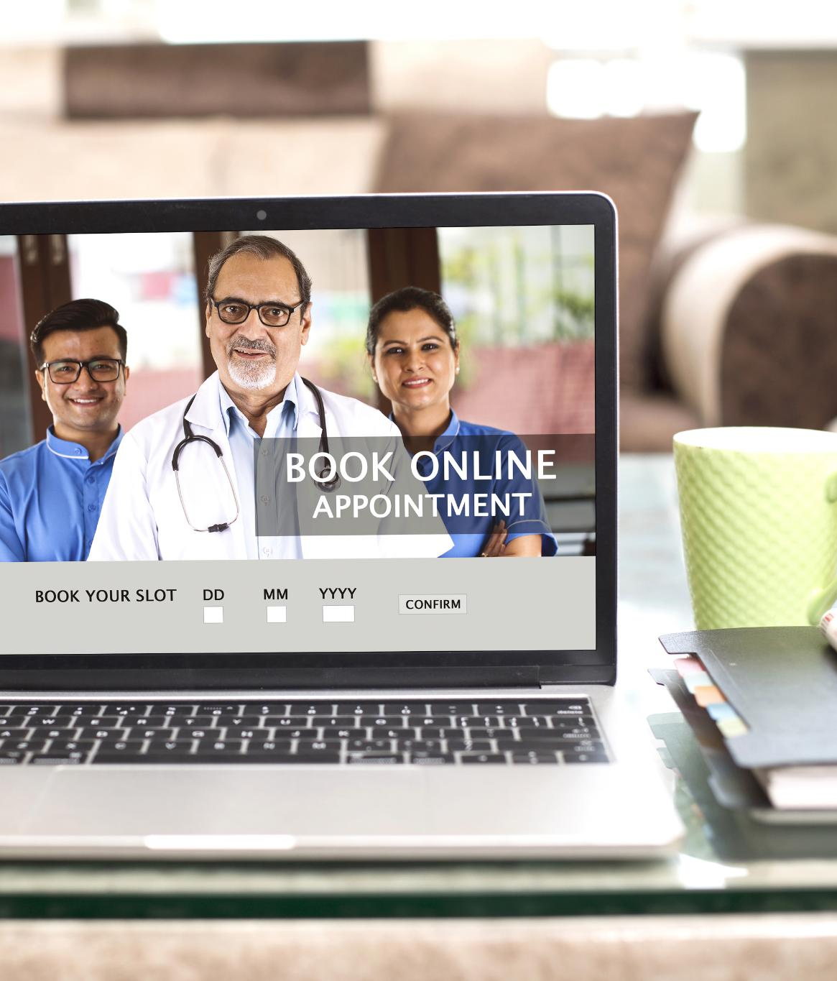
30%, 50%, and 20% Appointment Allocation
Advance Online Booking (30%)
  Thirty percent of GP appointments are available online for booking three to six weeks ahead, ideal for routine care and follow-ups.
Short-Term Booking (50%)
  Fifty percent of appointments release one to two days prior, accommodating patients with semi-urgent needs and supporting part-time clinician continuity.
Same-Day Urgent Appointments (20%)
  Twenty percent of appointments are reserved for same-day urgent cases managed exclusively by the triage GP to ensure clinical safety.
Notes:
GP appointments at Villa Street Surgery are released in a staggered way to balance advance planning, urgent access, and clinical safety. Thirty percent of GP appointments are made available to book online as soon as sessions are added to EMIS. This means there are always appointments available to book three to six weeks in advance. These appointments are intended for follow-ups, non-urgent issues, and routine care, and they strongly support continuity with a preferred clinician.
Fifty percent of GP appointments are released one and two working days in advance. This provides access for patients with more pressing concerns that cannot wait several weeks but do not require same-day assessment. This booking window also helps patients plan around work and personal commitments and supports continuity with part-time clinicians who may not be available every day.
The remaining twenty percent of GP appointments are reserved exclusively for same-day use by the triage GP. These appointments are protected for clinically urgent cases and cannot be booked online. This ensures that patients with the most urgent needs are prioritised and assessed safely. Together, this staggered release system creates a fair and structured approach to access, matching appointments to differing levels of clinical need.

Slide 15
Nurse Appointments and Access
Notes:
Booking and Call & Recall Systems

Slide 16
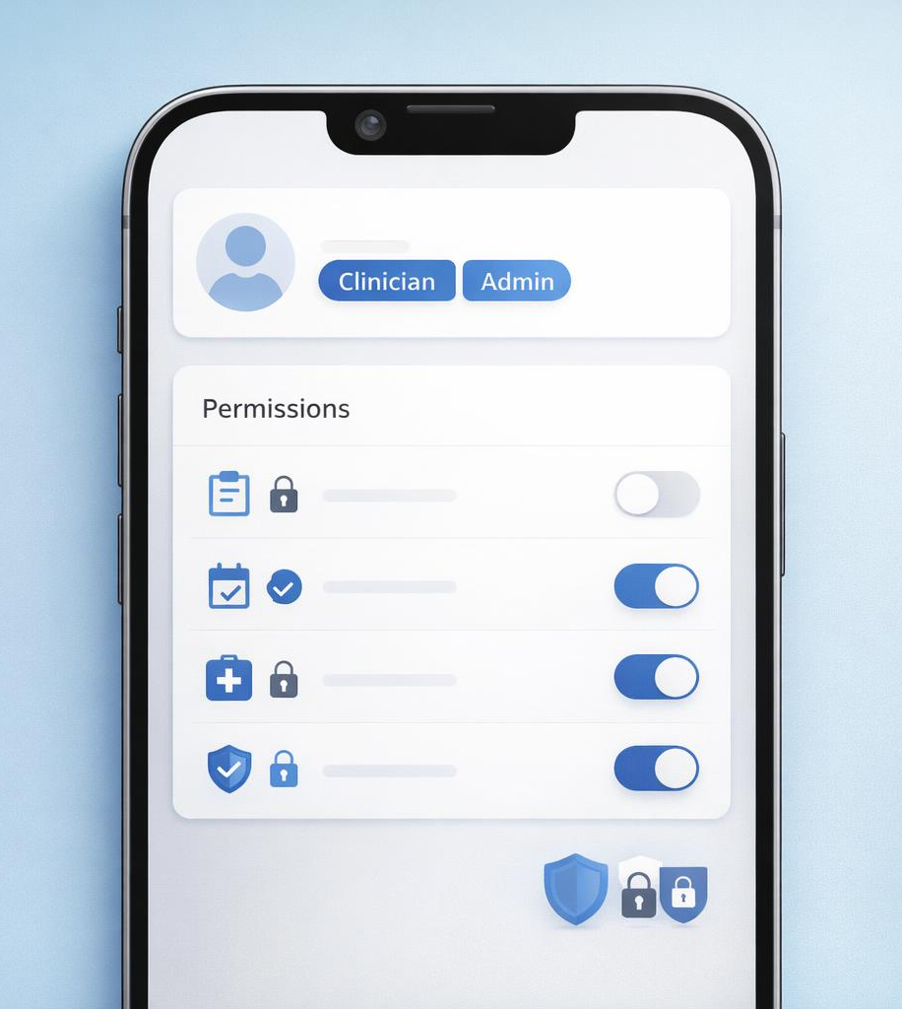

Booking and Call & Recall Systems
Managed Nurse Appointment Booking
  Nurse appointments are scheduled six weeks ahead to align with GP sessions, ensuring visible nursing capacity for forward booking.
Selective Online Booking Access
  Only cervical smear test appointments are available online to match patient needs with nurse specialisms and competencies.
Batch Text Messaging for Recall
  Targeted call and recall messages with booking links help improve appointment uptake and support proactive care.
Notes:
All Nurse appointments at Villa Street Surgery are added to EMIS six weeks in advance, in line with GP session planning. This ensures that nursing capacity is visible and available for forward booking. While all nurse appointments can be booked through the practice team, only cervical smear test appointments are made available for online booking.
This restriction reflects the fact that nurses within the team have different specialisms and competencies. Making all nurse appointments available for open online booking could lead to mismatches between patient need and clinician skill set. By controlling online access, the practice ensures that patients are booked with the most appropriate nurse for their specific clinical requirement.
To support preventative care and long-term condition management, the practice makes use of batch text messaging for call and recall. These targeted messages include booking links that allow patients to book directly into specific, appropriate appointments. This approach improves uptake, supports proactive care, and ensures that patients are guided into the right appointments efficiently and safely.

Slide 17
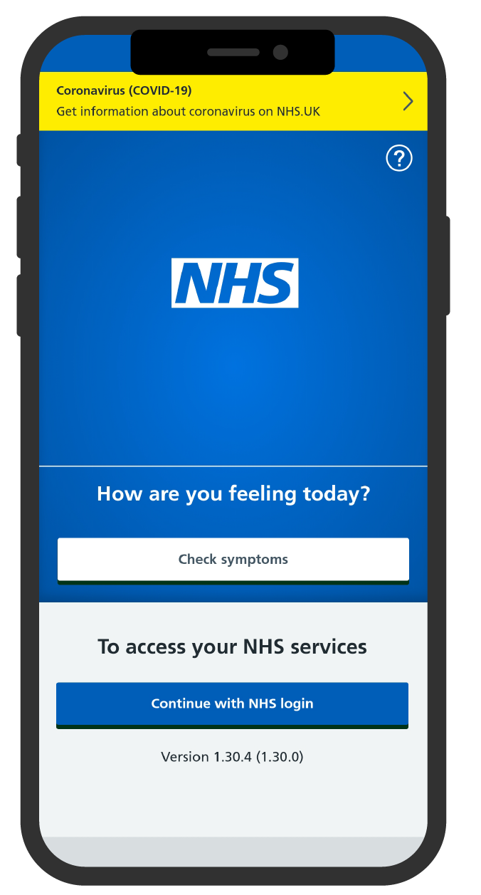
NHS App
Appointment
Booking
Dr Muhammad Najim
Brent IT and Digital Lead

Slide 18



Contents
NHS App Appointment Dashboard
Patient and GP Appt Functionality
Benefits and Limitations

Slide 19
Contents
NHS App Appointment Dashboard
Patient and GP App Functionality
Benefits and Limitations

Slide 20
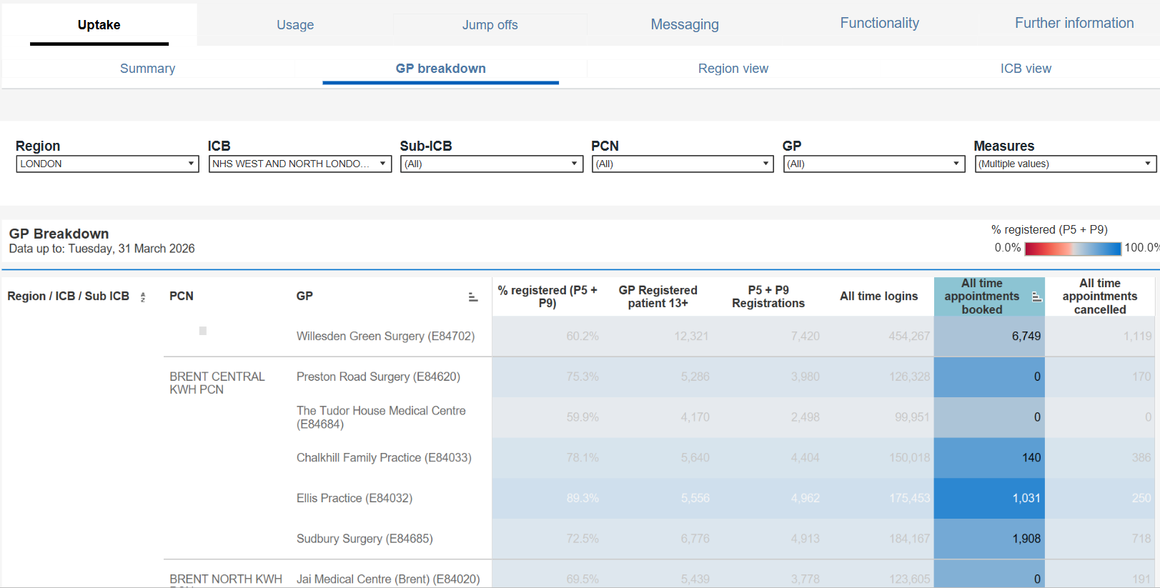
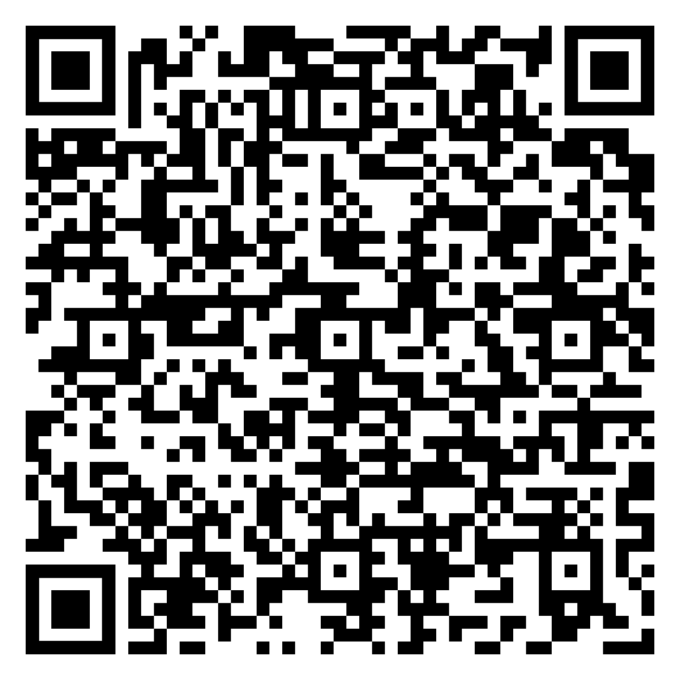
NHS App Appointments Dashboard
NHS App Dashboard

Slide 21
Contents
NHS App Appointment Dashboard
Patient and GP Appt Functionality
Benefits and Limitations

Slide 22
Benefits and Limitations of NHS App Appointment Booking
Benefits
More convenient and better access for patients
Appointments via the app can be time embargoed and capped
Increased NHS App usage – lower DNA rate and high EPS rate ordered via app
  Frees up reception time
Our experience is that patients use it appropriately
It can be deactivated for patients using it inappropriately
Limitations
No total triage, but can be usage alongside Online Consultations
Lists can only be put up under a clinicians name
Access that is ‘too good’
Only in English but NHS App used via a mobile web browser can be multi-language.

Slide 23
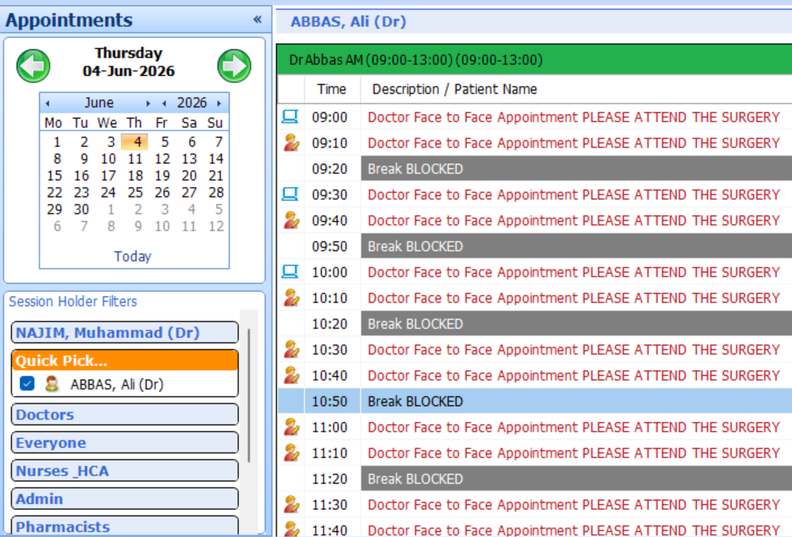
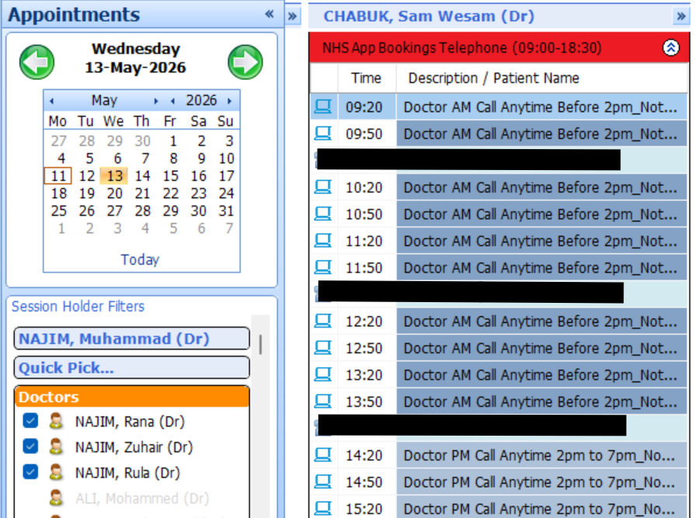
NHS App Appointments – GP Side

Slide 24
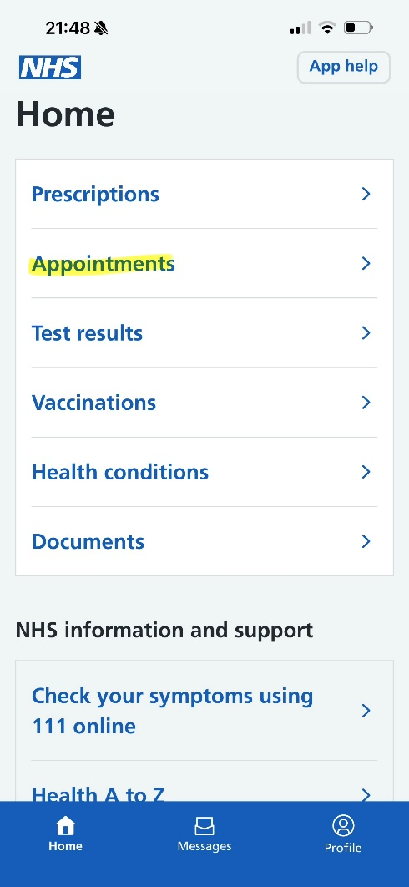
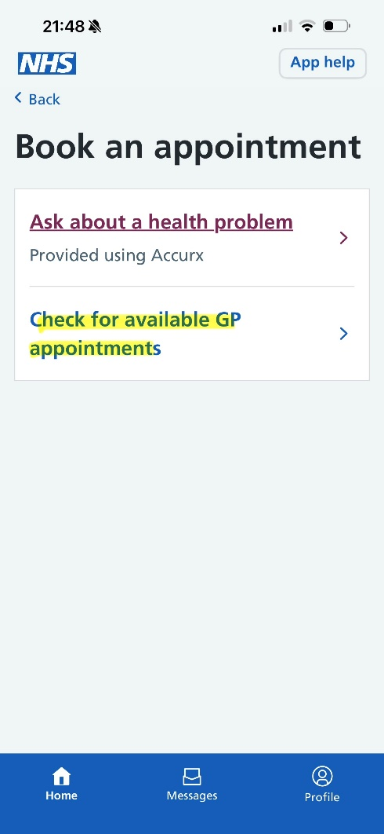
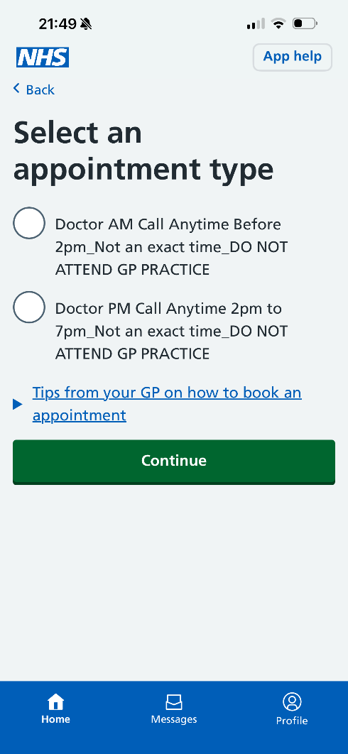
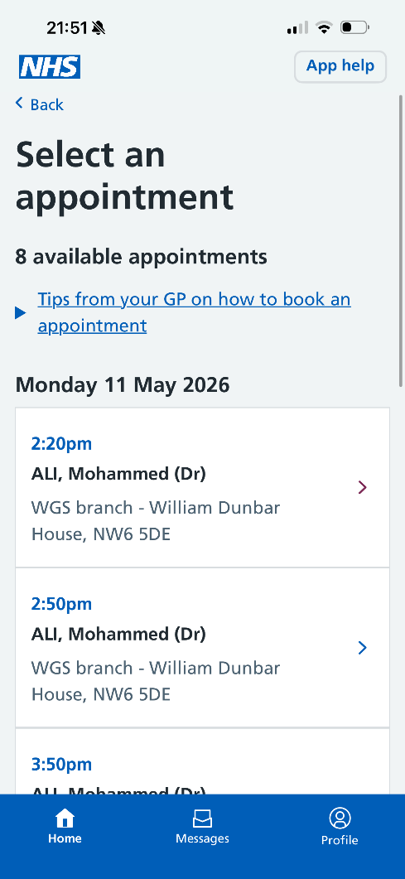
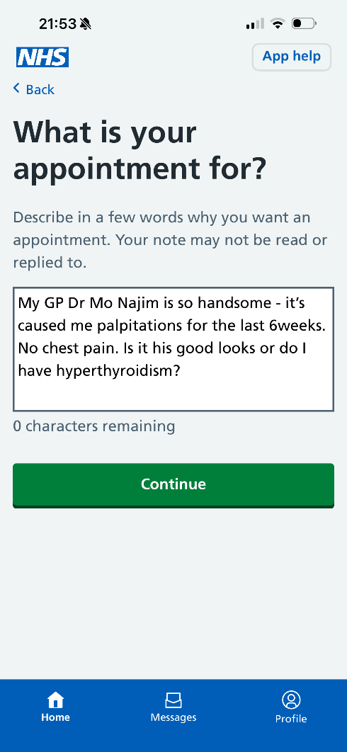
NHS App Appointments – Patient Side

Slide 25
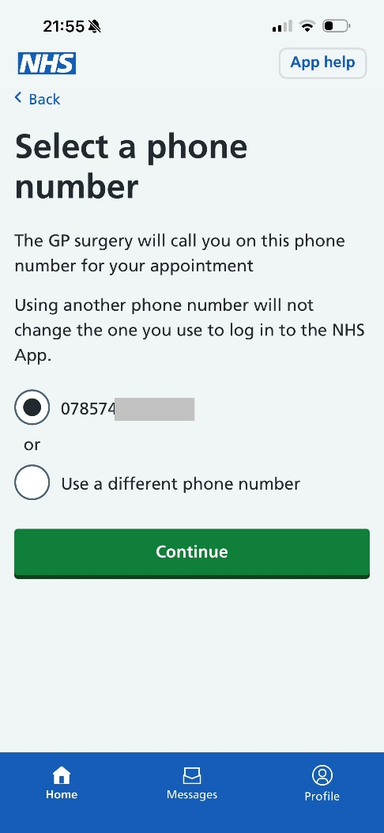
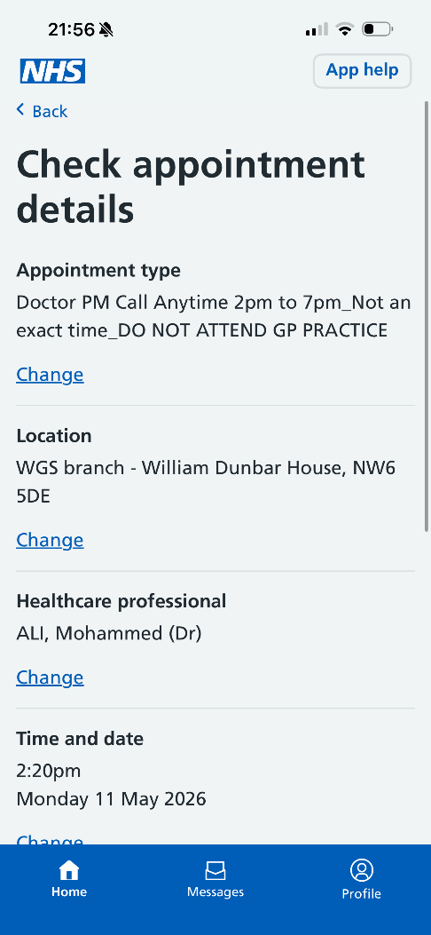
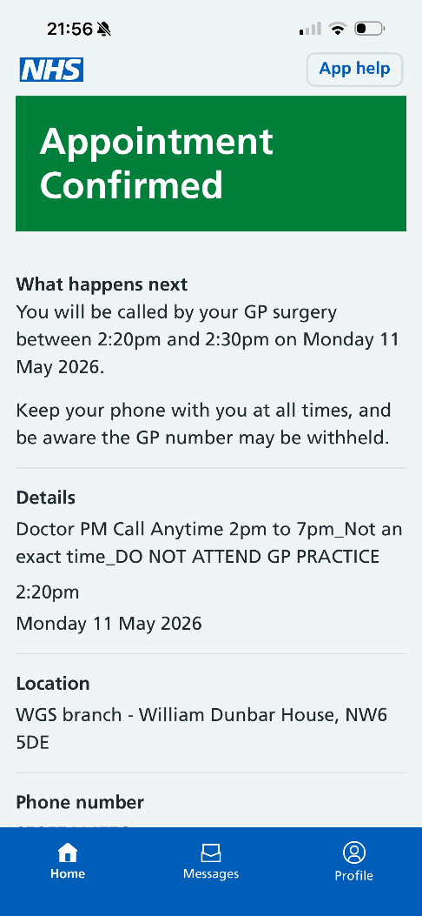
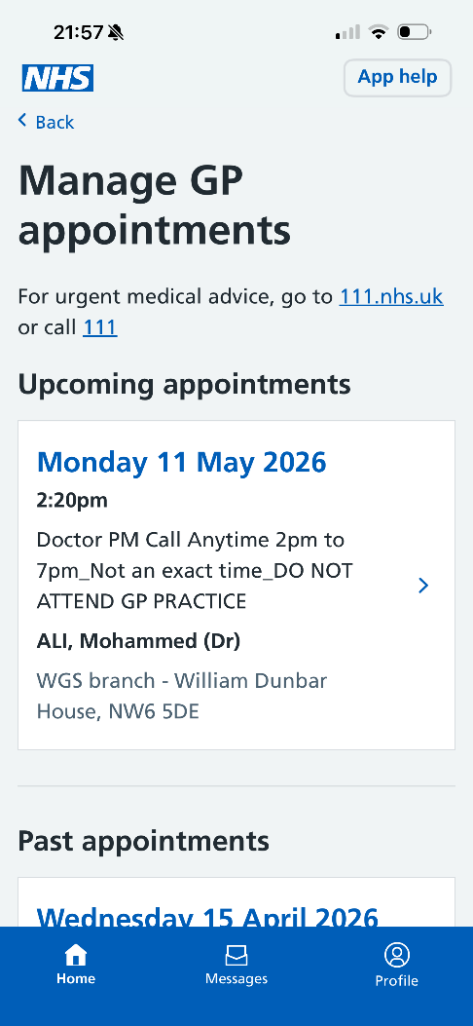
NHS App Appointments – Patient Side

Slide 26
Contents
NHS App Appointment Dashboard
Patient and GP Appt Functionality
Benefits and Limitations

Slide 27
Benefits and Limitations of NHS App Appointment Booking
Benefits
More convenient and better access for patients
Appointments via the app can be time embargoed and capped
Increased NHS App usage – lower DNA rate and high EPS rate ordered via app
  Frees up reception time
Our experience is that patients use it appropriately
It can be deactivated for patients using it inappropriately
Limitations
No total triage, but can be usage alongside Online Consultations
Lists can only be put up under a clinicians name
Access that is ‘too good’
Only in English but NHS App used via a mobile web browser can be multi-language.

Slide 28
Questions?
NHS App appointments

Slide 29
SELNASH PCN
NHS APP Data & Best Practice

Slide 30
Promotion of the NHS App Digital Tool to Patients
Developed Demand & Capacity Improvement Documents for all 4 SELNASH PCN Practices
Reviewed current digital processes and how we could improve on these process
Reviewed and aligned the practices promotion and communications of the NHS App Digital Tool to patients, by updating websites, surgery flyers and text messages
Provided patients with MS Forms links to provide valuable feedback on their experience of the NHS App

Slide 31
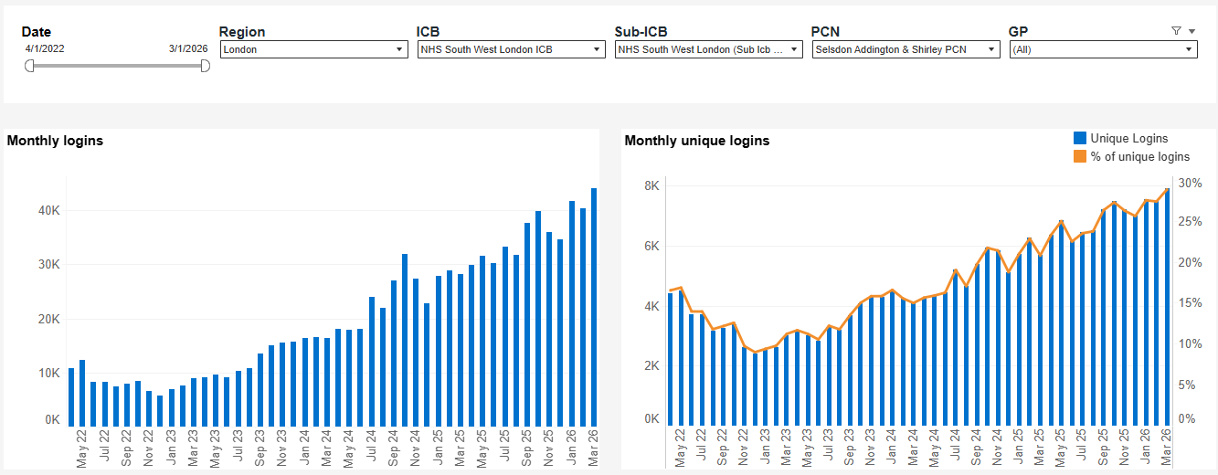
NHS App Logins – SELNASH PCN
Apr 2022 – 10,753 logins
March 2026 – 44,048 logins
Rise = 31,720 (310% increase) on average a 6.5 % rise in logins each month

Slide 32
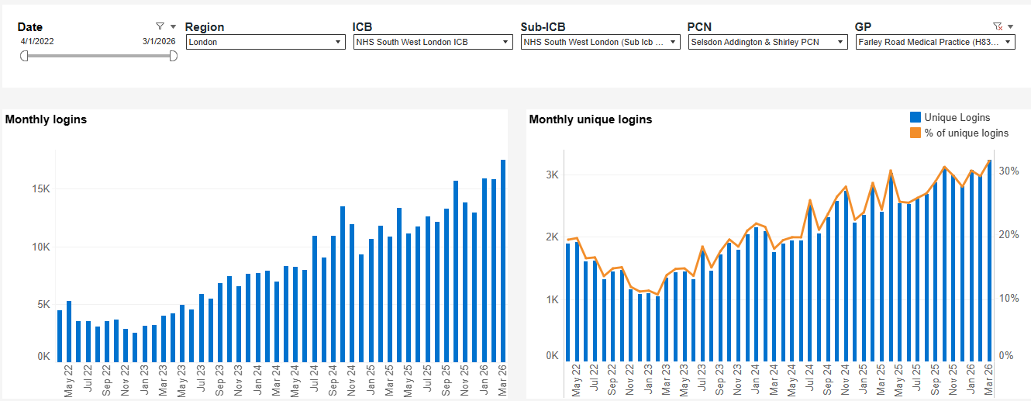
NHS App Logins – Farley Road Medical Practice
April 2022 – 4,481 logins
March 2026 – 17,470 logins
Rise = 12,989 (290% increase [over 48 months]) on average a 6% rise in logins each month

Slide 33
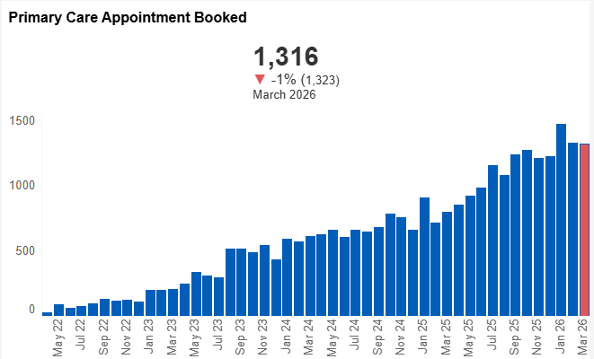
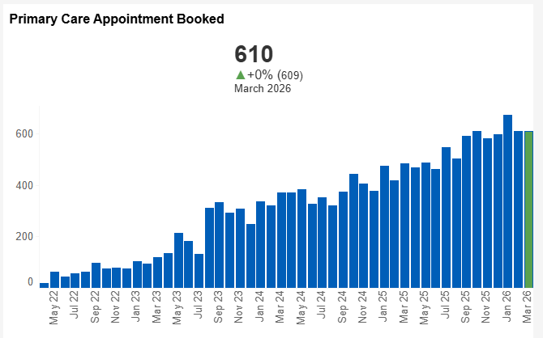
NHS App Appointments Booked
SELNASH PCN & Farley Road Medical Practice
SELNASH PCN
Apr 2022 – 27 Appointments Booked
March 2026 – 1,316 Appointments Booked
Rise = 1,289 (4,774% increase [over 48 months]) on average a 99.5% rise in Appointments Booked each month
Farley Road Medical Practice
Apr 2022 – 19 Appointments Booked
March 2026 – 610 Appointments Booked
Rise = 591 (3,110% increase [over 48 months]) on average a 64.8% rise in Appointments Booked each month

Slide 34
Percentage of NHS App Appointments Booked at
Farley Road Medical Practice
March 2023
Total Appointments Booked: 5,533 (Optum’s Apex Data)
Total NHS App Appointments Booked: 369 (NHS App Data)
NHS App % of Total Appointments Booked: 6.7%
March 2026
Total Appointments Booked: 4,904 (Optum’s Apex Data)
Total NHS App Appointments Booked: 610 (NHS App Data)
NHS App % of Total Appointments Booked: 12.4%

Slide 35
NHS App - Practice Staff and Patient’s
Positive Feedback, or Issues
Positives
Patients generally seem willing to download the app. As a practice we strongly encourage its use both through the reception team and our ambassador who champions the use of the NHS App and other digital tools in primary care
The practices results department also promotes the NHS App, especially when patients call for blood test results or other information
Patients are now less confused with how to make an online appointment, whereas before, in addition to the NHS App, the practice actively promoted MyGP and Sensely’s Ask First
Negatives
At our practice patients are currently only able to book GP appointments online. Previously, nursing appointments were also available to book; however, this resulted in inappropriate appointments being booked with the wrong clinicians
The practice experienced a number of issues following an NHS App update. Patient appointments were incorrectly displaying the wrong GP and location due to the practice operating across two sites

Slide 36
Any Questions

Slide 37
West Hampstead Medical Centre
Dr Ehsan Alkizwini

Slide 38
Model of real patient choice but underpinned with an emphasis on face to face.
GP in WANL
Consistently good performance (QOF, LCS, DES, PH) inc. vaccinations, medicines management, smears, hypertension, LD checks.
Consistently good patient satisfaction and feedback (national survey, FFT, Iwantgreatcare and Google).
Once one of the highest online access nationally (prior to covid)
Second highest online bookable appointments.
One of the lowest prescribing practices nationally including antibiotics.
One of the lowest locally A&E admissions.

Slide 39
Model
Service:
1. 24/7 eConsult unlimited for simple straightforward issues
2. 24/7 can do administrative tasks online or in person
3. F2F released online only
4. F2F can be changed to telephone by patient request – if appropriate
Ways to access our service:
1.Telephone (telephone and face to face appointments released 8pm, 8.30am and 2pm, with duty doctor overflow)
2.Econsult (clinical/administrative requests)
3. In-person (admin, telephone and face to face appointments released 8pm, 8.30am and 2pm, with duty doctor overflow)
4. NHS app/other patient facing app (to book appointments, request meds, submit eConsult)
5. Website (signpost to eConsult, appointments guidance, admin requests)

Slide 40
Benefits
Avoids duplication and frustration i.e. eConsult, call then seen, essentially 3 encounters for one episode
Much safer to see someone even for mental health issues – better rapport, empathy, can examine appropriately and be more thorough – save lives
More reassurance can be given so may save appointments
More opportunity to opportunistically pick up on things and opportunity to do more personalised interventions including check BP, weight etc
Less over prescribing (tendency to be more cautious)
Less A&E referrals (similar to previous) and more appropriate A&E referral
Patients can choose continuity
Patients can have more choice of suitable appointment times.
Better for those socially isolated

Slide 41
Risks
Often Longer appointments
Often multiple issues raised
Means commuting for patients, may be more late
Sometimes inappropriate conditions seen (NHS app appointment advice information is optional and slot type maybe not be read) or chasing referrals
By offering eConsult and telephone (even with caveats) means often these appointments are wasted as they are inappropriately booked by patients
Very costly, so for sustainability needs a practice to be large to be able to offer choice
Sometimes lonely patients book just to speak to someone
Can have unlimited appointments that may be abused i.e. some very frequent attenders!
Patients may not value missing the appointments as easy come, easy go!
Not suitable for those requiring generally longer appointments i.e. interpreter/BSL/complex
Slot type alert/advice optional

Slide 42
