Slide 1


Guidance on how to use “Gloves Off” launch slides
These slides have been compiled to assist you with the launch of the “Gloves Off” project in your work area.
You may wish to add slides or delete slides to suit the area that you work in.
Notes accompany the slides to assist you in how to use the slides and provide additional information that you may wish to use.

Slide 2
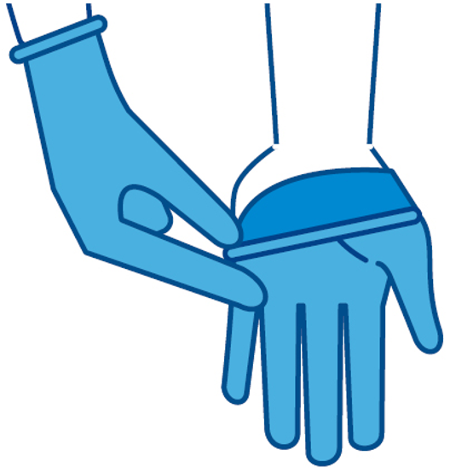
Gloves Off!
Make one change
Insert your name and/or work area here
Notes:
Thank staff for attending the presentation and for completing the staff questionnaire regarding our glove use and for taking an interest in reducing our glove use to improve patient safety and to reduce our carbon footprint. We must also take care of our hands to prevent the risk of skin irritations (e.g. dermatitis) associated with glove use.

Slide 3
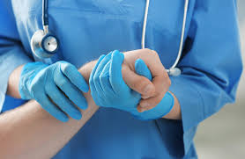
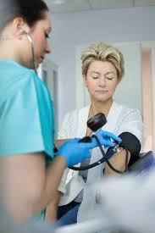
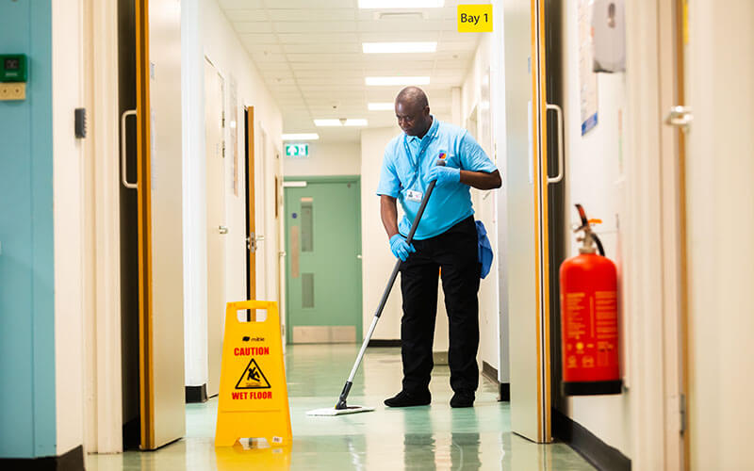

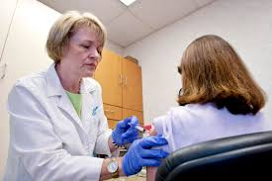

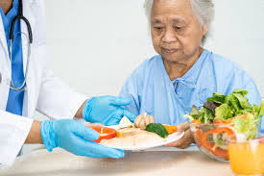
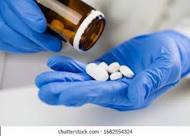
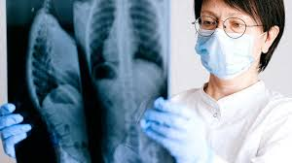
Are these images familiar in our work environment?
Notes:
Since the COVID 19 pandemic, our wearing of PPE has significantly increased and there is a perception that it is a symbol of giving good care. But is this true?. Inappropriate wearing of PPE can do more harm to the patient and our environment. Glove misuse is associated with the transmission of healthcare associated infections and is not a substitute for hand hygiene. We need to support staff, patients and their relatives in their understanding of the role of PPE in delivering care.

Slide 4
Results of Staff Questionnaire
Insert results from staff baseline questionnaire that was carried out in your work area.
Include how many staff participated.
What were the outcomes?.
Were there any unexpected results?.
Did it identify any staff concerns regarding glove use and how will we address them?.
You may wish to use graphs or diagrams or additional slides.

Slide 5
Our glove usage and financial costs over the past year
An excess of 1.4 billion boxes of non-sterile gloves are purchased annually by the NHS at a cost of £35 million.
In 2021,and during the pandemic this increased to a staggering 5.5 billion gloves.
Insert information received from procurement regarding the number of gloves consumed in your work environment over the past financial year and associated costs.
If the data is not available, inform staff that you have requested it, and you will update them with this information when it is available.

Slide 6

Royal College of Nursing
https://youtu.be/1mIcJJr0Izg
Notes:
Since 2018, the RCN has launched Glove Awareness campaigns to increase our awareness of glove use and to reduce our glove use in our work environment. This video released in 2022, as part of their Gloves Awareness campaign, is a good introduction to appropriate glove use and the effects upon our patients and the environment.. The link for the video is provided. It is approximately 2 minutes long. If you don’t have internet access when presenting to staff, the power point presentation can be shared with staff later, in order that they can view the video.

Slide 7
Glove Use:- Impact on patient safety
Gloves often acquire pathogens by touch in the same way as bare hands and misuse has been shown to be a contributing factor in the transmission of Healthcare-Associated Infections(HCAIs) and outbreaks in healthcare settings.
Donning (putting on) gloves too soon or doffing (removing) them too late, can result in contaminating patients or surfaces in the environment when carrying out further tasks.
Inappropriate wearing of gloves has been found to increase the risk of cross-contamination due to missed moments of hand hygiene.
Not performing hand hygiene immediately before and after gloves are worn can contribute to the transmission of infection.
Notes:
This slide provides key facts about glove use and their impact on patient safety. This is a good opportunity to emphasise the purpose of the project- to increase our awareness of glove use and to reduce the number of gloves we wear, to improve patient and staff safety and improve our environmental impact/carbon footprint.. Highlight the important of hand hygiene and that gloves are not a substitute for hand hygiene.

Slide 8

Glove Use:- Impact on the Environment
Gloves have a significant impact on our environment in their manufacture, supply and disposal.
An excess of 1.4 billion gloves are used across the NHS each year and about a third of those are used for activities that are not needed.
In the UK, the NHS alone contributes to 4-5% of the country’s emissions, and plastic gloves, made using fossil fuels, are one of the most common, single-use, non-recyclable, plastic items in healthcare.
A recent study indicates that the global warming impact of a single glove is 26 grammes of CO2 equivalent.
On this basis, every box of 100 gloves is equivalent to driving 20 miles in a standard petrol car.
Notes:
Reducing our glove use by wearing gloves appropriately will reduce our carbon footprint.

Slide 9

The patient’s experience
Wearing gloves and PPE appropriately will facilitate improved personal interactions with our patients.
Since the COVID-19 pandemic, there is an expectation from patients and their relatives that we wear gloves and PPE.
We need to consider what conversations we will have with them to assure them that not wearing gloves for all care interventions is safe.
Notes:
Discuss what we will tell our patients and their relatives if they ask why we are not wearing gloves or if they ask us to wear gloves. We need to be able to explain the rationale for not wearing gloves and the importance of hand hygiene. A patient information leaflet will be provided to support staff with this.

Slide 10
When should I wear gloves?
Each time that you reach for a pair of gloves, perform your own risk assessment.
Stop and think, am I at risk?
The risks to staff in the workplace that require you to wear gloves are: -
If contact with blood, bodily fluids, mucous membranes or non-intact skin is likely.
If caring for a patient under isolation precautions.
If contact with chemical hazards is likely.
Remember be glove aware and only wear them when you need to.
Notes:
Highlight the importance of risk assessment. Am I at risk? Be glove aware, only wear them when you need to.

Slide 11
Gloves are not needed when:-
Touching a patient.
Washing a patient.
Changing a patient’s bed linen (unless visibly soiled).
Taking a patient’s blood pressure or temperature.
Dispensing medication to a patient.
Administering IM/SC injections or vaccinations.
Pushing a chair, trolley or bed and mobilising the patient.
Handing out or collecting meal trays.
Making and handing out cold or hot drinks.
Assisting patients with eating.
Using a phone or computer.
Remember to regularly wash your hands!
Notes:
This is not an exhaustive list hence the importance of carrying out your own risk assessment before reaching for a pair of gloves. Remember that wearing gloves is not a substitute for hand hygiene. Regularly wash your hands.

Slide 12

Be skin aware
No risk = No glove
93% of nurses have reported having a skin condition (RCN, 2020).
Damaged or non-intact skin on the hands places both the patient and the health worker at risk because it prevents effective hand hygiene.

Slide 13
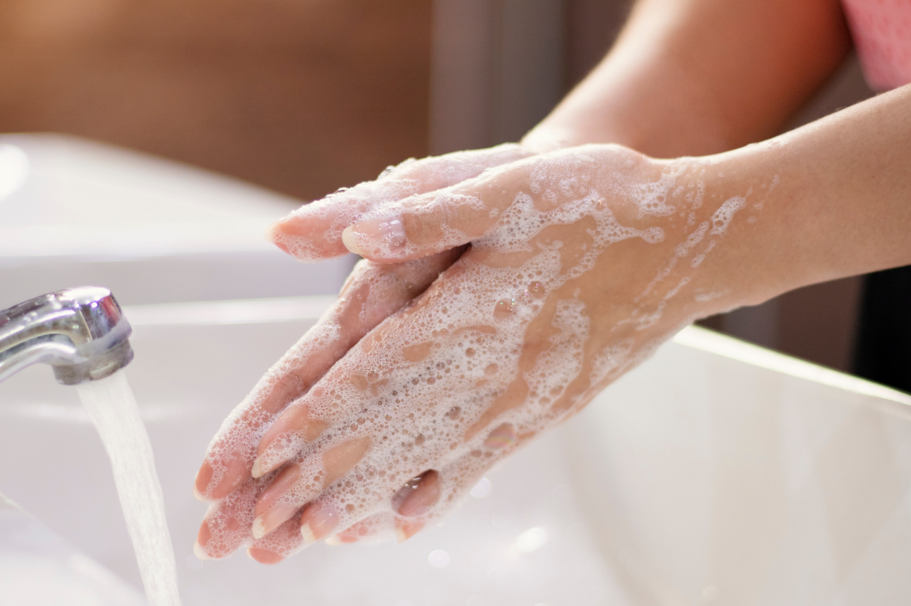
Simple steps to prevent and manage work-related contact dermatitis
Always wet your hands thoroughly before applying soap.
Ensure that you rinse and dry hands thoroughly.
Regularly apply hand moisturising cream (containing emollients).
Check skin regularly for the first signs of itchy, dry or red skin.
Remember that wearing gloves is not an alternative to carrying out effective hand hygiene procedures.
Consider the use of latex free gloves or gloves that are free from accelerators known to cause contact dermatitis.
If you are having skin problems, seek help and advice from either your Occupational health service or GP.
Notes:
Useful tip is to apply hand cream containing emollients when on meal breaks to allow it to absorb and after every shift. Cite your local policy for reporting work-related skin conditions.

Slide 14
Remember
Carry out your own risk assessment before reaching for a pair of gloves.
No risk = No glove.
Be glove aware, only wear them when you need to.
Wearing gloves is not a substitute for hand hygiene.
Regularly wash your hands.
Inappropriate glove use contributes to environmental and skin damage and results in missed opportunities to wash our hands.

Slide 15
Any Questions?

