Slide 1

asthma
Zara Deith & Dr Eliza Magnusen

Slide 2
Referral Criteria
Any child or young person living within Waltham Forest, between the age of 1-16 years who has had:
2 or more ED attendances with wheeze/asthma within a year
2 or more Hospital admissions with wheeze/asthma within a year
2 or more courses of oral steroids within a year
HDU or PICU admission with wheeze/asthma
Chronically poorly controlled asthma i.e. missing school, using salbutamol ++ (GP must have reviewed)

Slide 3
Secondary Care Team

Slide 4
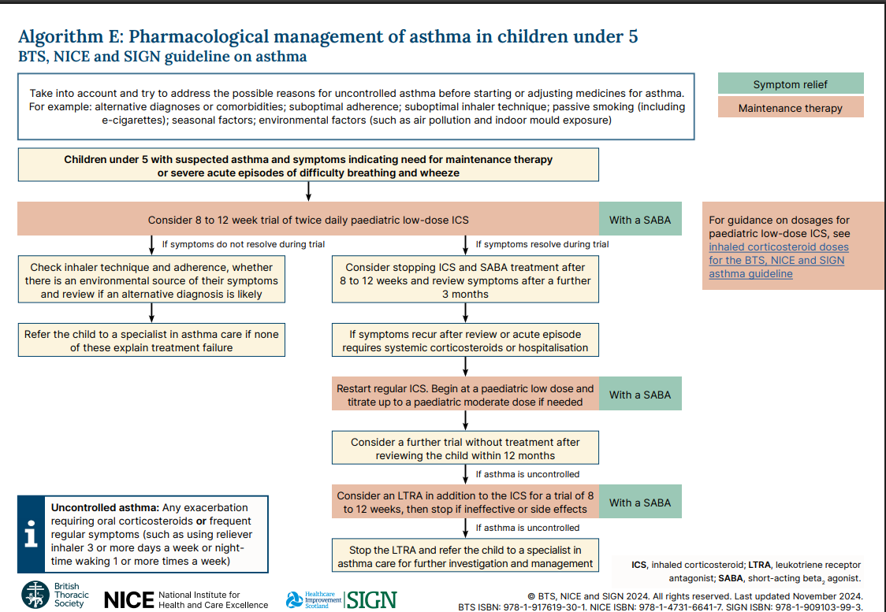

Slide 5
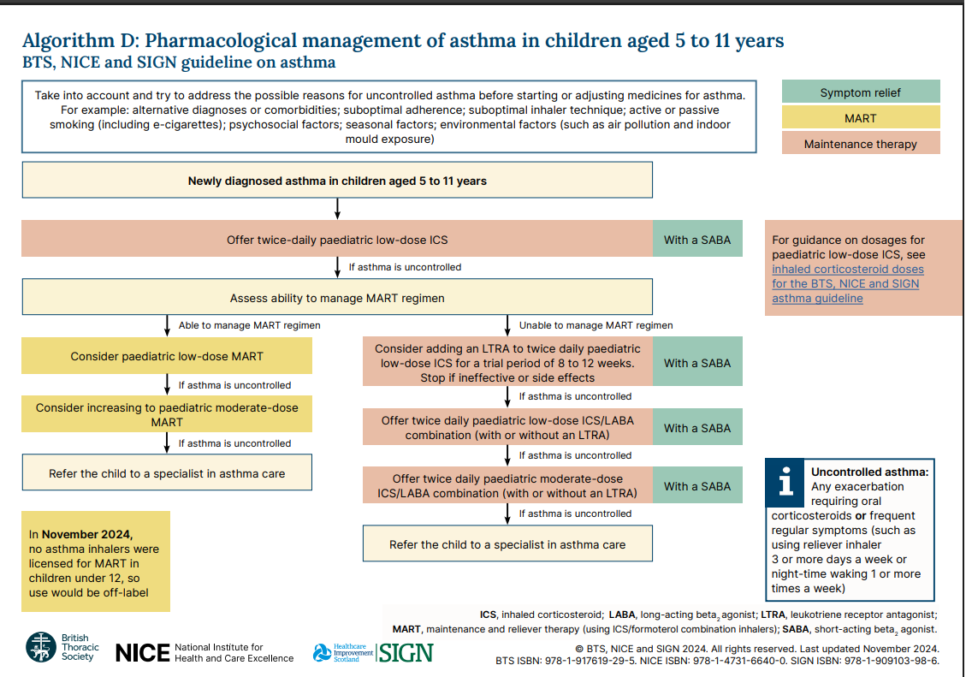

Slide 6
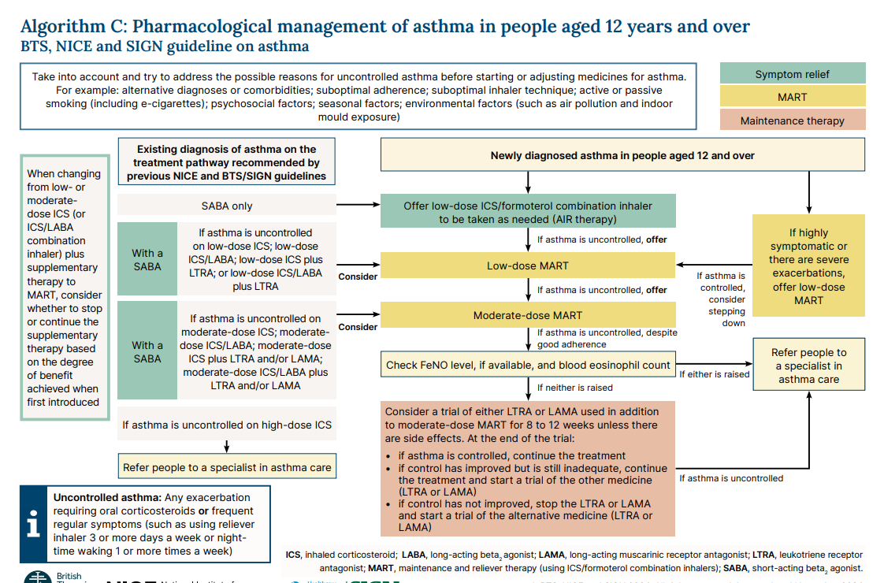

Slide 7
How can we improve our services?
Knowing what asthma is
Knowing what is normal
Knowing the risk factors
Knowing current guidance
Changing attitudes towards asthma

Slide 8
Asthma is the most common lung condition in children BUT it is still a life-threatening condition and should be treated as such.
Our perception of asthma needs to change
A child in the UK dies from asthma once every four weeks
The UK has the worst child asthma rate death in the whole of Europe.
ASTHMA DEATHS ARE PREVENTABLE
.

Slide 9
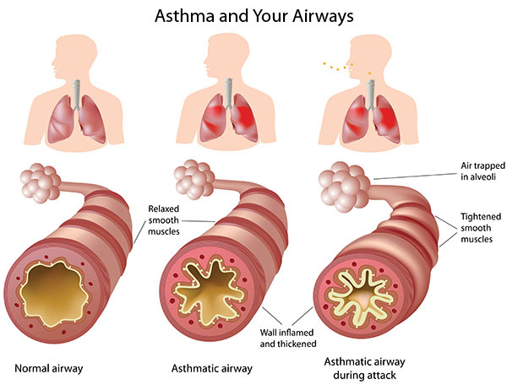
Notes:
Asthma is a chronic lung disease characterized by inflammation and muscle tightening around the airways, making it difficult to breathe. It can cause symptoms such as coughing, wheezing, shortness of breath, and chest tightness. Asthma affects people of all ages and can range from mild to severe. While there is no cure, asthma can be managed effectively

Slide 10
Poor asthma control
Poor School Attendance.
Poor concentration in class.
Feeling tired/falling asleep as school.
Unable to keep up with peers.
Nocturnal symptoms
Using reliever inhaler three times a week
Exercise Induced Symptoms

Slide 11
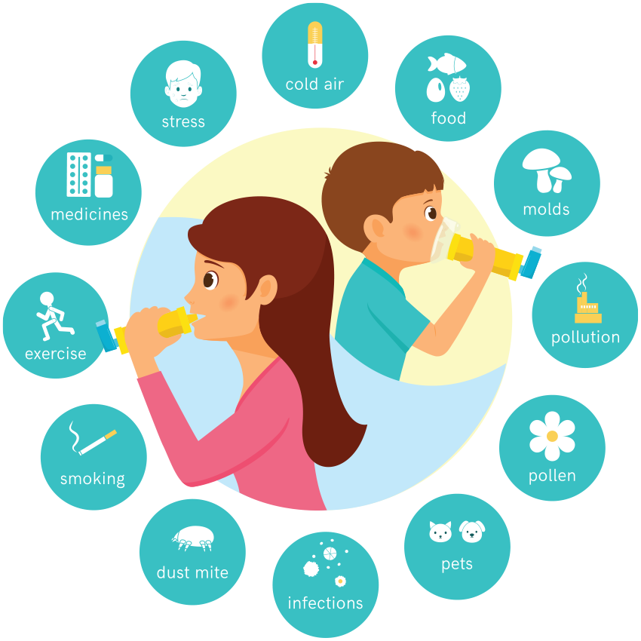
Triggers
Notes:
Avoiding asthma triggers is key because they inflame and narrow the airways, causing symptoms and leading to severe asthma attacks.
Identifying and steering clear of triggers, such as aeroallergens, smoke and air pollution can reduce inflammation, lessen symptoms like wheezing and coughing, and decrease the frequency of emergency visits, hospitalisations, and the need for rescue medications.

Slide 12
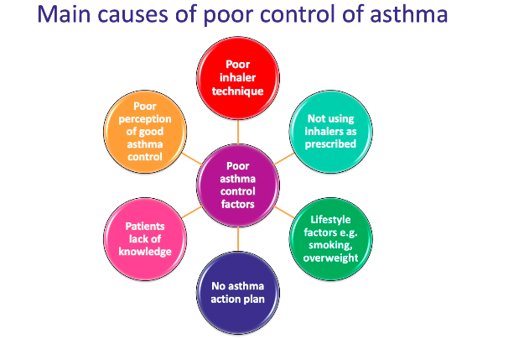

Slide 13
Current BTS/NICE Guidelines 2024
Now one guideline instead of two separate guidelines. No more contradicting guidance.
GINA (Global Initiative for Asthma) - annually updated, evidence-based strategy report on the optimal prevention and management of asthma for use by healthcare professionals. Not a guideline but frequently referred to.

Slide 14
Recent Changes in Asthma Care
The most significant change is to stop prescribing short-acting beta-agonists (SABAs) alone.
Anyone with a blue should have a brown/grey/purple!!
Anti-inflammatory Reliever Therapy (AIR) – for those with less frequent symptoms.
MART for newly diagnosed over 12years.
No such thing as a salbutamol weaning plan

Slide 15
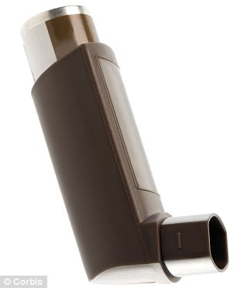
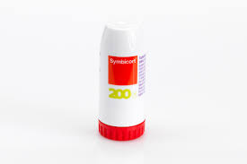
Inhalers
Pressurised metered dose inhalers (pMDIs) which give the medicine in a spray form (aerosol). This is the one you use with a spacer.
Dry powder inhalers (DPIs) which give the medicine in a dry powder instead of a spray.

Slide 16
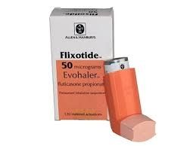
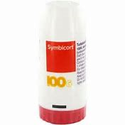
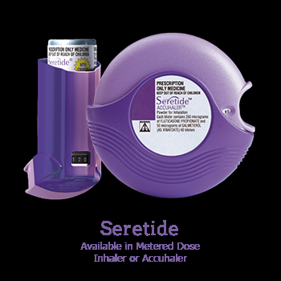
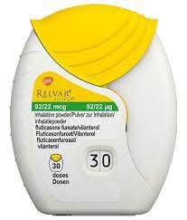
Asthma medication
Preventers:

Slide 17
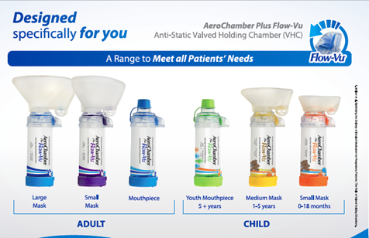
Spacers
Spacers enable the medicine to go straight into the lungs and get the most out of the inhaler
They are quick and easy to use in an emergency
Reduce side effects caused by absorption in the wrong place
Notes:
In a recent study of 6304 HCP, only 15.5% could demonstrate correct inhaler technique – that’s approx. 977/6304
92% of patients do not use inhalers correctly
Up to 40% of patients use an empty inhaler
Empty inhalers can expel propellent up to 80 times.

Slide 18
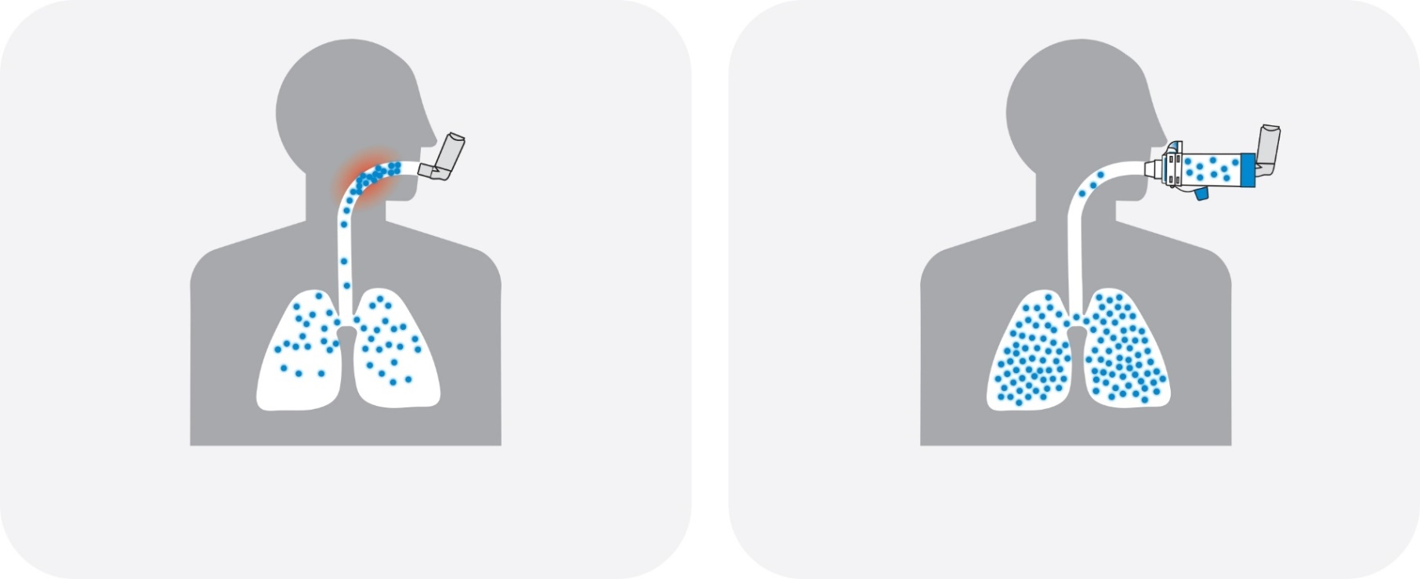

Slide 19
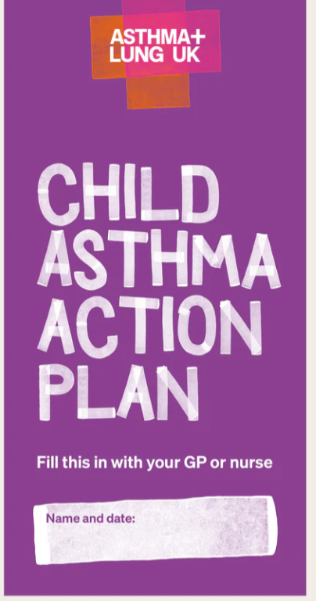
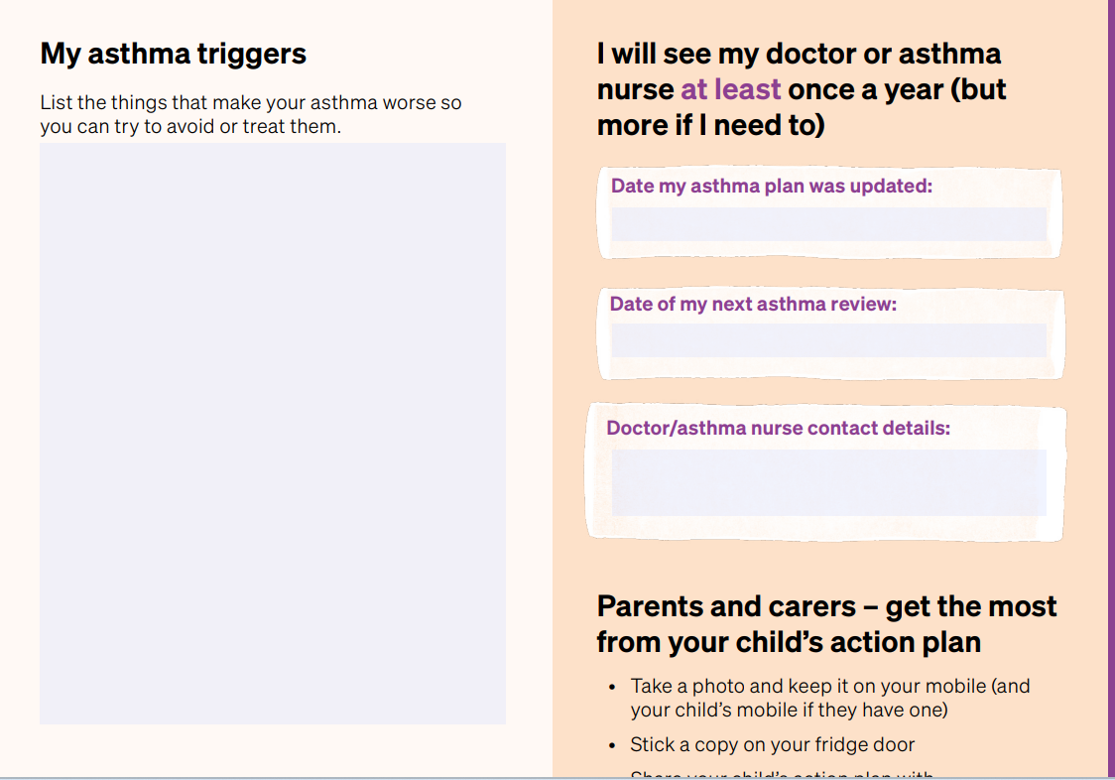

Slide 20
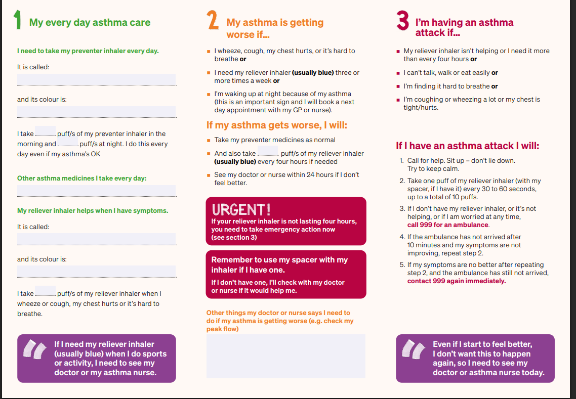

Slide 21
Changing Attitudes Towards Asthma
We need to view asthma as not only an acute condition. Untreated asthma can lead to progressive lung damage.
This lung damage can happen as early as teenage years.
Adequate treatment is needed even in the absence of exacerbations.
Patients and parents think exercise induced symptoms and using the blue inhaler is normal and part of daily life
We need to educate that this is not normal.

Slide 22
Use of terms such as ‘mild asthma’ or ‘intermittent asthma’ are no longer encouraged because the patients are still at risk of severe asthma episodes
• Assumes that these patients would not benefit from inhaled corticosteroids (ICS)
• Also, assumes if mild, that they are not at risk of an asthma attack.

Slide 23
Asthma Tidbits
Smoking reduces the efficacy of ICS
No such thing as hypoallergenic pets – allergen is contained in skin and saliva in animal allergies
Obesity makes ICS less effective
Female hormones increase airway inflammation
Children on regular Piriton dropped one grade between mock exams and real exams

Slide 24
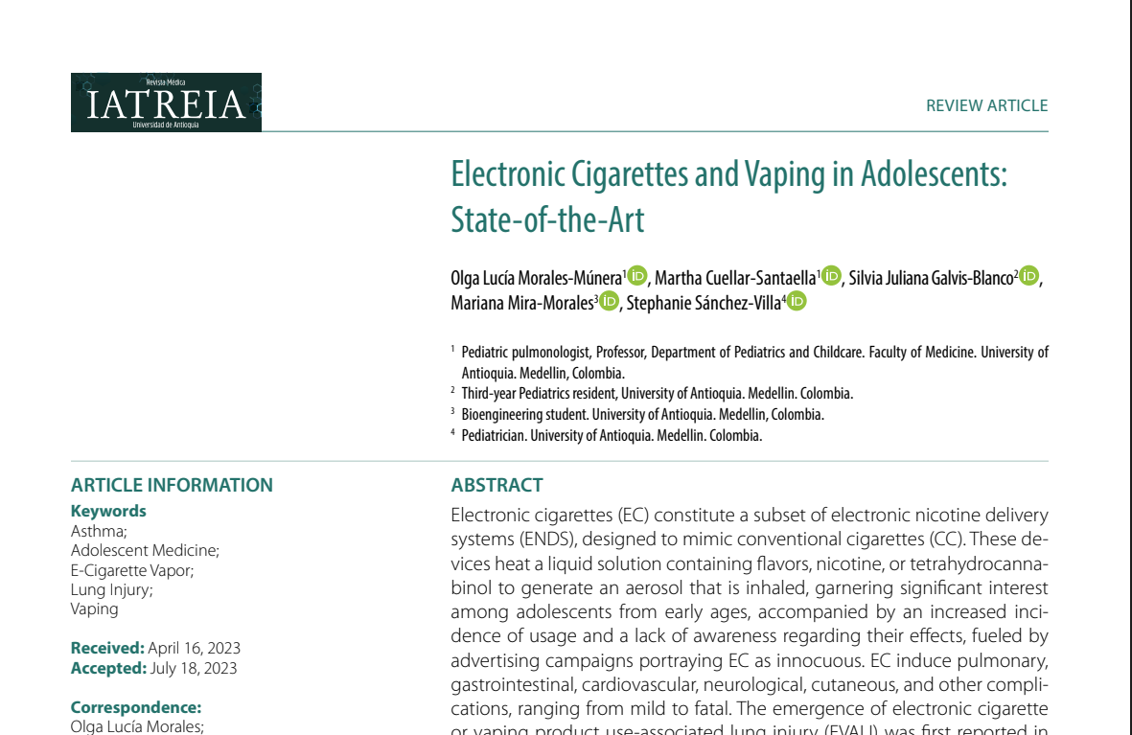
Vaping Is Smoking…

Slide 25

One course of oral steroids is the equivalent of taking ICS for a year

