Slide 1
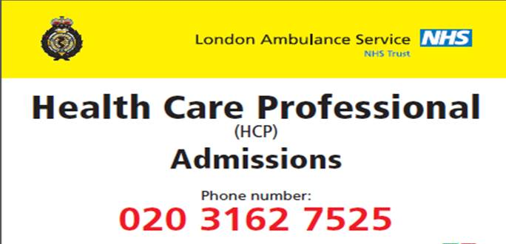
Doctors – do you use the HCP referral line?
Designed for clinicians
Enables you to triage and request the appropriate response for your patient
The referral should be made by a clinician who understands the clinical scenario, who can discuss the case and negotiate a safe and appropriate response for the patient, and take clinical responsibility for the response time chosen
Key clarification points:
Does your patient need clinical assessment and management or just conveyance ? If conveyance, consider suitable alternatives such as the Non-Emergency Transport Service or taxi
Always consider whether the patient can make their own way or has anyone who can take them to hospital
If you are unsure what response is required for your patient this can be discussed with our EOC/CHUB
You will be asked to confirm location and contact details twice, it is very important that we dispatch to the correct location and can call back if the call is terminated for any reason

Slide 2
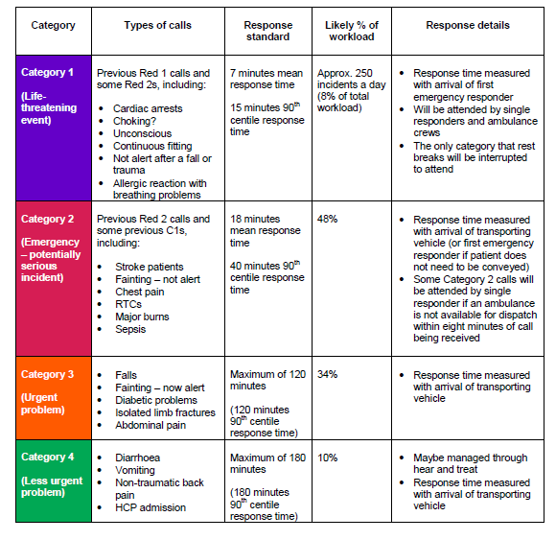
Ambulance Response Programme

