Slide 1


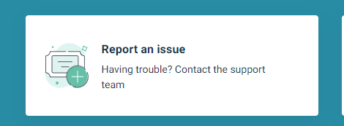
Requesting your NEL PHM Optum Account
via the London HDS Service Desk
To request access to the NEL Optum platform, you’ll need a London HDS account.
Please follow the steps in this guide to create your account
If you already have a LHDS account, you can request Optum access by clicking here to complete the form or going to slide 5
Optum PHM Dashboard Request LondonHDS
Before you start:
Make sure you have booked, attended or watched the NEL Optum PHM Introductory Training. Contact nelondonicb.phm.nel@nhs.net
If you experience any issues, please log a request via the London HDS portal.

Slide 2
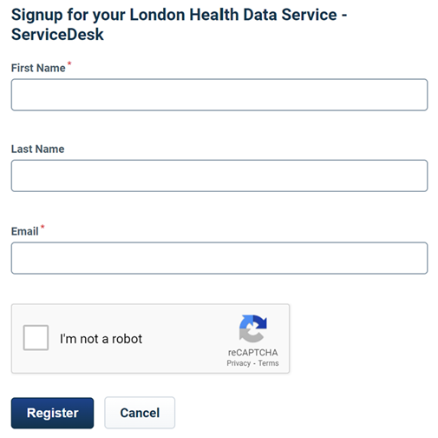
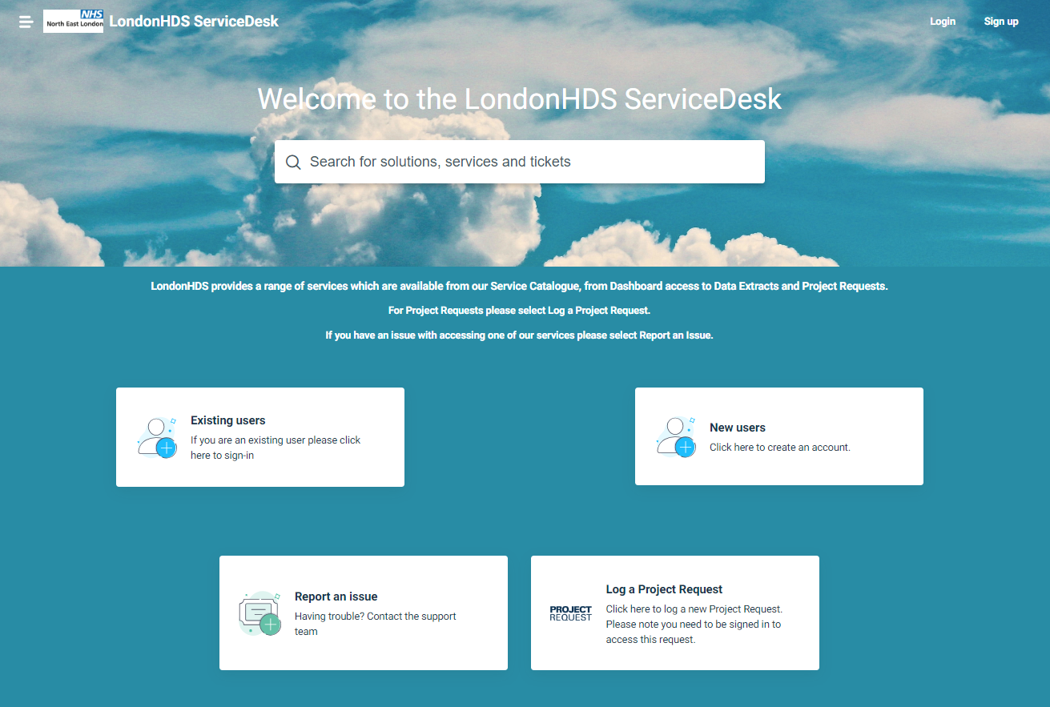
Logging in or registering an account with London HDS
If this is the first time you have visited the London HDS Service Desk, please follow the instructions below to register and log into the Portal.
You need to create a London HDS Service Desk account to access the NEL PHM Optum Account Request form.
STEP 1
Visit https://sd.londonhds.nhs.uk/
From here, either login by selecting Existing users or create an account, by clicking on New users.
STEP 2
Enter First Name
Enter Last Name
Enter your e-Mail Address
Tick I’m not a robot check box
Click on Register

Slide 3
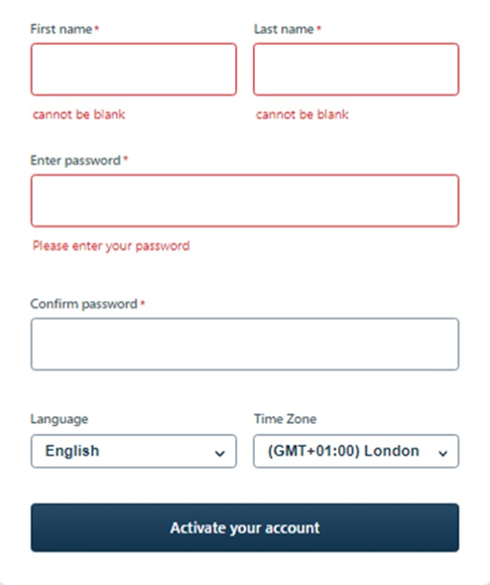
Logging in or registering an account with London HDS
​
STEP 3:
An email like the one below will be sent from the Service Desk to the Email address you entered
PLEASE CHECK YOUR JUNK/SPAM FOLDER IF THIS IS NOT RECEIVED IN YOUR INBOX
STEP 4:
Click on the link in the email to finish setting up the account
This will take you to the Sign in page
Complete the fields
Click on 'Activate your account' to continue setup

Slide 4
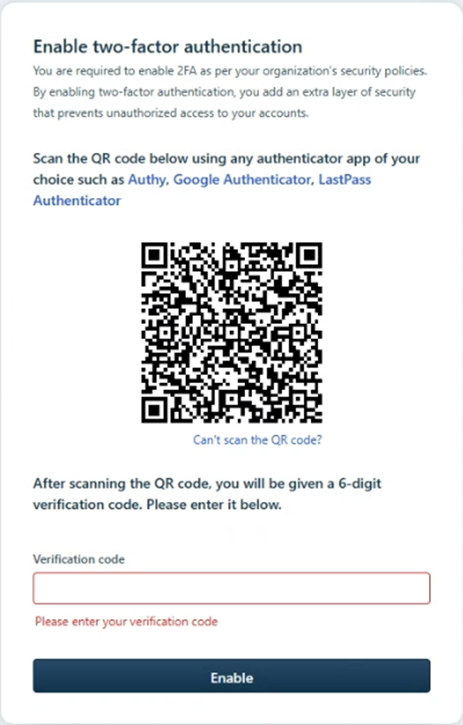
Logging in or registering an account with London HDS
STEP 5
Enable two factor authentication (2FA)
Open the Microsoft authenticator app on your phone - if you already have this installed you can use this app to create your 2FA account. If you do not have this installed, please see link below to help guide you through the process
Download and install the Microsoft Authenticator app - Microsoft Support
You will see a set of two factor recovery codes -Please download and save to a secure location of your choice. These are one-time codes.
STEP 6
When prompted enter the verification code and click on Enable to complete the setup of your LHDS Service Desk user account.

Slide 5
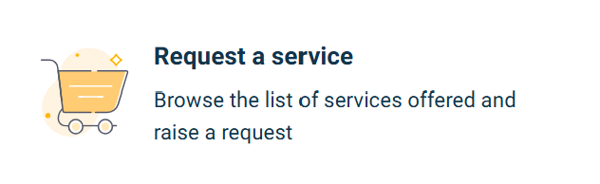
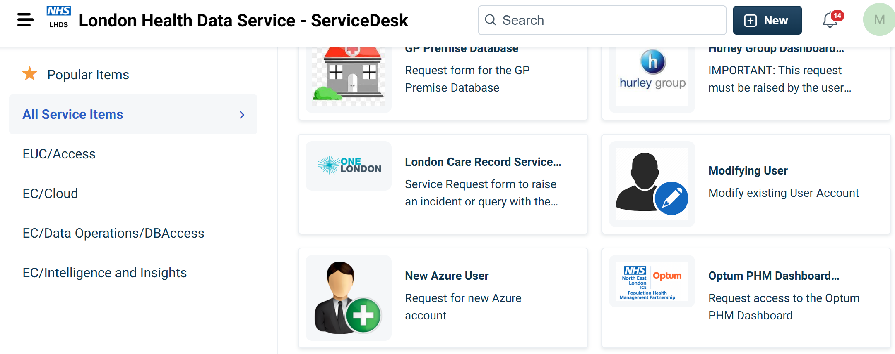
Requesting access to NEL PHM Optum Pathfinder
Once you have logged into the London HDS Portal successfully, please follow the steps below to log your Ortum access Request.
STEP 1. Request a Service
STEP 1: Select Request a service:
STEP 2. Select ALL Service Items
STEP 3. Select Dashboards - Optum PHM Dashboard

Slide 6
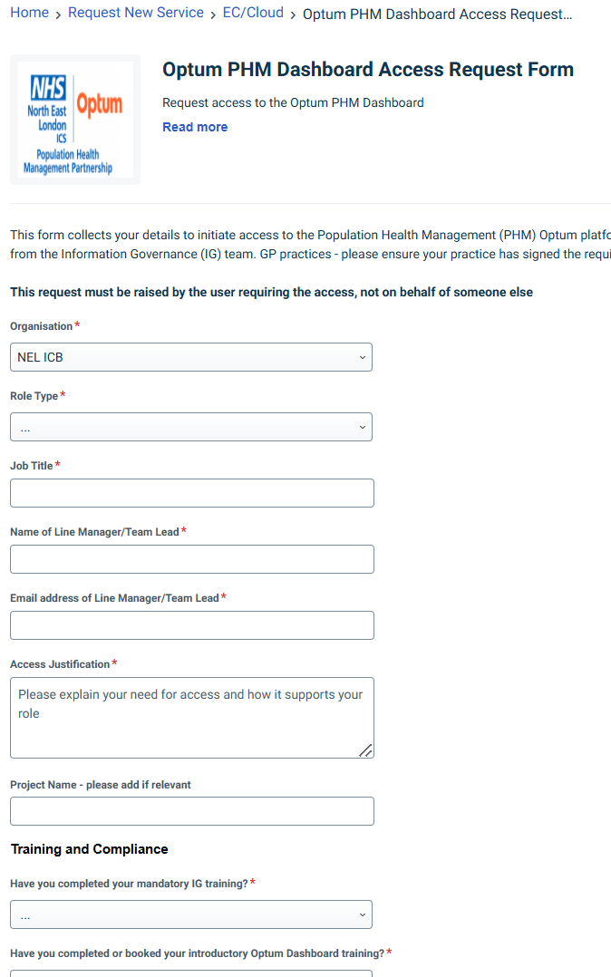
Completing the NEL Optum access request form
PLEASE NOTE ONE REQUEST PER form and you can only request access for yourself, not on behalf of others
Complete all the fields which are mix of drop down and free text
Once complete, please confirm you have read and agreed to the Terms and Conditions, and click 'Place Request' to submit your Request.
Make sure you have booked, attended or watched ‘How to use Pathfinder' training before requesting an account. Email nelondonicb.phm.nel@nhs.net
Role Types
By selecting Direct Care /Re-ID role based access, you are confirming that:
You have the appropriate authorisation from the Lead GP Partner (or equivalent responsible clinician) to access patient-level data for your own practice/patients.
You are authorised to use Re-Identification (Re-ID) for purposes, where required.
You will comply with all applicable data protection, confidentiality, and organisational policies when accessing patient information.
For secondary or non-GP clinicians, authorisation should be obtained from the relevant responsible clinician or practice lead, as appropriate.

Slide 7
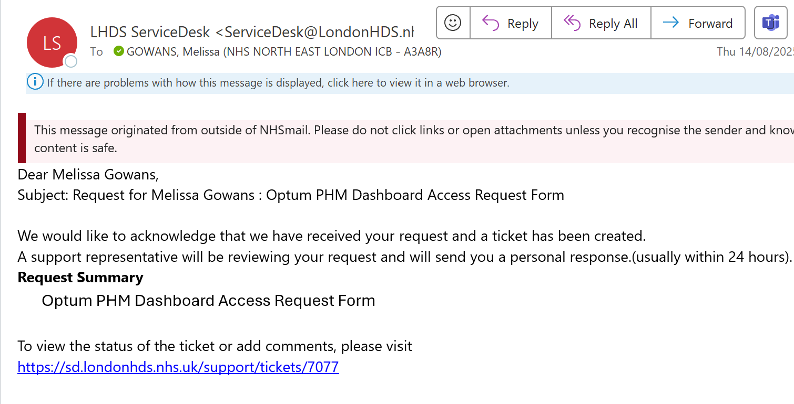
Request Submitted
Once you have submitted the request, you will receive an automatic email response from LHDS. This is a confirmation that the request is received and will be reviewed and sent to Optum..

Slide 8
Activating your Pathfinder access
Receiving your login from Optum and basic navigation of Pathfinder

Slide 9
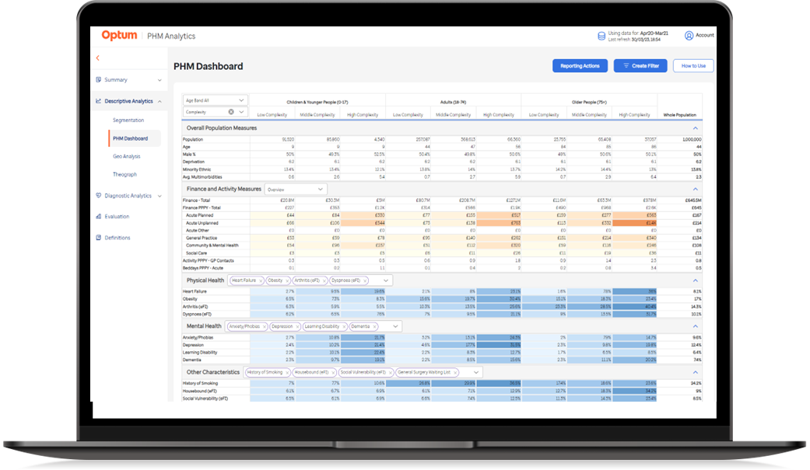






A full 'How To' user guide is also available!
Pathfinder Set Up
You will receive an email with your log in details from UHGUKAZURE Microsoft email
Click the “Accept Invitation” button.
You must do this on your NHS device, logged into your email account
Accept the standard permissions review from Microsoft.
This will link your email account to the Optum MS Azure account automatically
For any issues please contact:
Email: customerserviceuk@optum.com
Telephone: 02476 214 700
Please click on this link to access Pathfinder
https://pathfinder.optum.co.uk
You will be asked by Microsoft to complete some additional steps to add Multi Factor Authentication.
Use the Microsoft Authenticator app or an authenticator app of your choosing. The screens will guide you through this process, and in future when logging in you will need to enter an MFA code

Slide 10
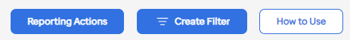




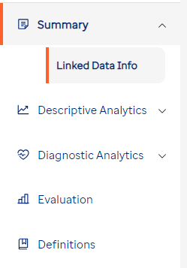
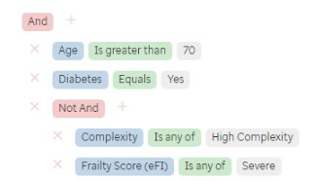
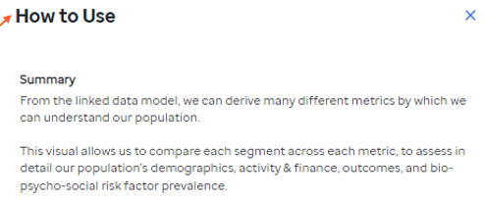
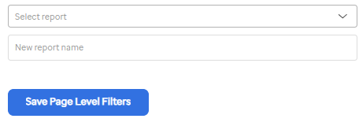
Pathfinder Quick Start
Navigation
Reporting Actions
Create Filter
How to Use
Use the navigation side panel to access different domains and pages
You can save your report by entering a report name and clicking 'Save Page Level Filters'
The filter builder allows you to configure the data you can see on screen
The How to Use button provides information about the page you are viewing

Slide 11
Contacts
Issues with London HDS accounts https://sd.londonhds.nhs.uk/ and select 'Report an issue'
Issues with Optum accounts and pathfinder customerserviceuk@optum.com
For general PHM enquiries including training please contact the NEL ICB PHM team nelondonicb.phm.nel@nhs.net
Keep up to date on all NEL PHM news NEL Population Health Management | Community | Microsoft Teams
Join ‘How to use Pathfinder’ Training Webinar
Wednesday 12th November – 3 - 4pm Join the meeting now or email nelondonicb.phm.nel@nhs.net

