Slide 1

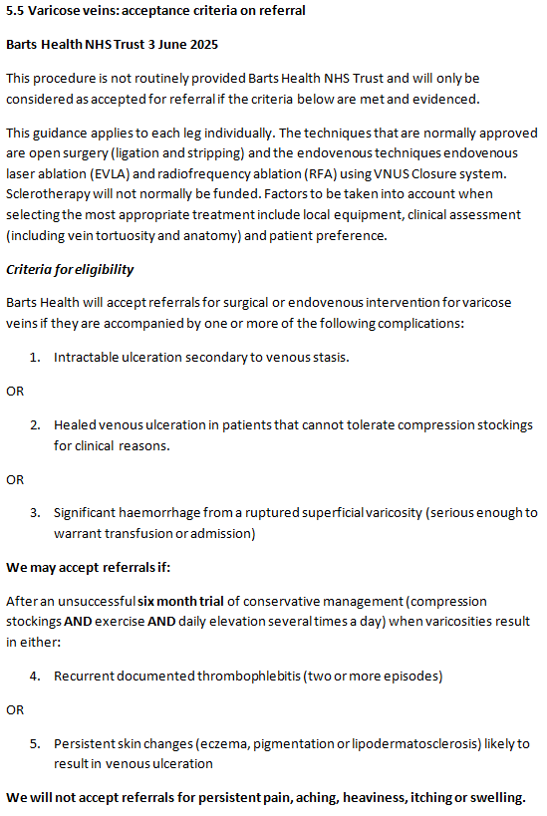
Barts Health Varicose Veins Referral Criteria

