Slide 1
Tower Hamlets
Dynamic Support Register (DSR) and Keyworking Service for Children and Young People (CYP)
Awareness Raising Training
Jasmin Begum
Commissioning and Project Manager - Tower Hamlets CYP Mental Health and Learning Disability
North East London ICB

Slide 2
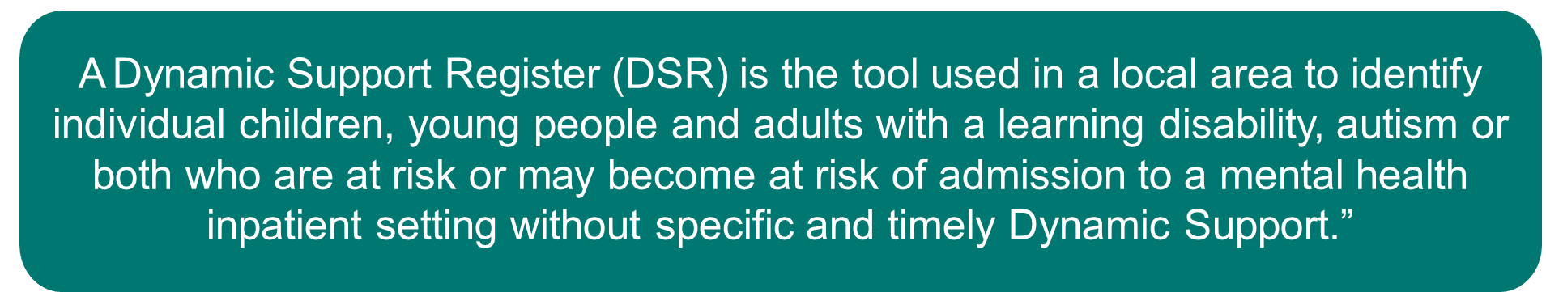
What is a Dynamic Support Register?
Prevent admission where possible
Early identification
Partnership working to review the needs of each individual registered on the DSR
Mobilising the right support

Slide 3
Dynamic Support Register (DSR) Criteria and Referrals
A child/young person can be added to the DSR if they have a diagnosis of autism and/or learning disabilities and are at risk of the following:
Risk of admission to a tier 4 unit
If there is a risk of placement breakdown either at home or in a residential placement.
Professionals can refer for an individual to be added to the register by
e-mailing ‘nelondonicb.dsr.thcypmhewb@nhs.net’ with a referral form.
Families can also self-refer, an online form is available on the Local Offer page.

Slide 4
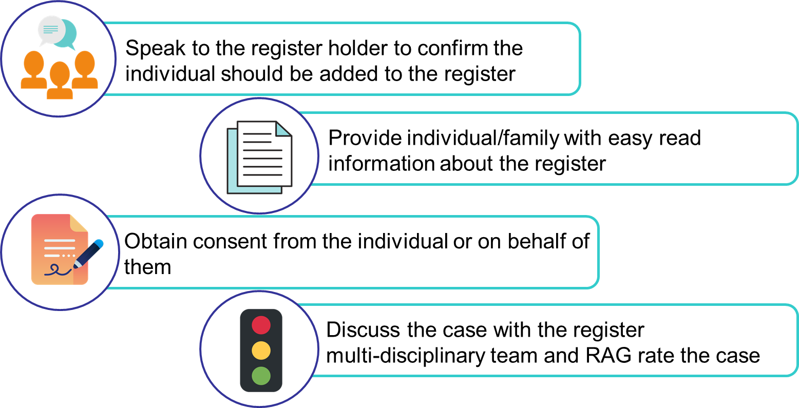
Referral Process

Slide 5

Consent
The individual must be supported to make a decision about consent by people who know them well and understand their communication needs
The consent form covers DSR and Keyworker Service
Once signed, sent to nelondonicb.dsr.thcypmhewb@nhs.net’
Information is only shared with Health, Social Care, and Education
Consent can be withdrawn at any time.

Slide 6
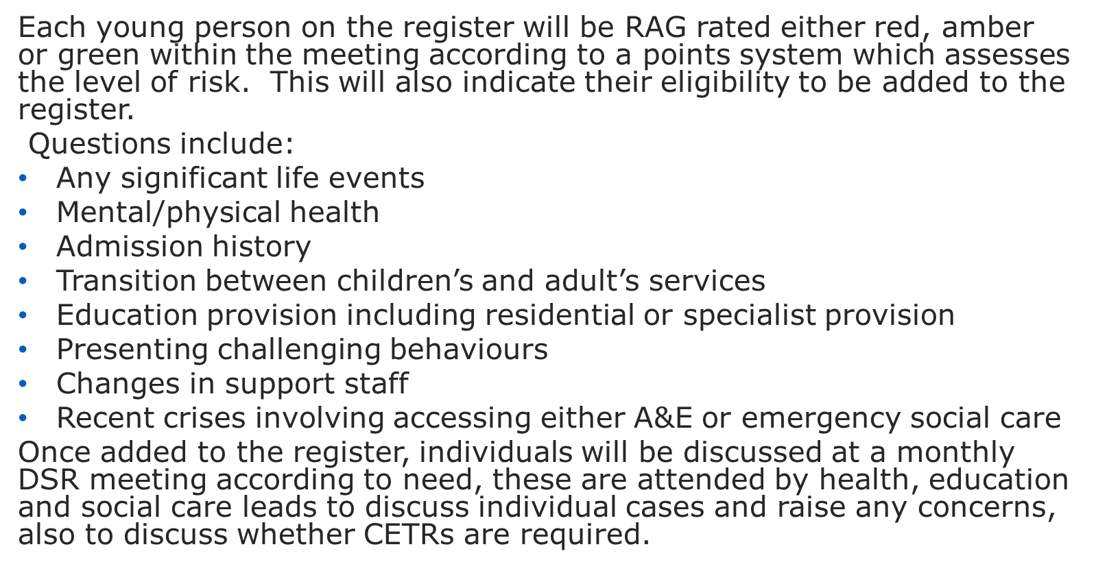
Monthly DSR meeting and RAG rating process​

Slide 7
If it’s an Emergency
Sometimes you may become aware of a case in crisis, or someone may escalate very quickly, and they are in imminent risk of admission.
Signs of this may be:
Individual is presenting a serious risk of harm to themselves or others
Individual is repeatedly presenting at A&E or local teams in crisis
Placement has broken down to the point where it is irretrievable
In these circumstances, contact your register holder immediately to request a LAEP or community CETR and agree any interim action.

Slide 8
Local Area Emergency Protocol
This is raised when an individual with learning disabilities and/or autism has been or is likely to be recommended for inpatient admission with little or no notice meaning a community CETR has not taken place.
A LAEP is designed to identify barriers preventing the individual from remaining in the community and to provide clear, constructive recommendations for overcoming these barriers through collaborative efforts and creative resource use.
Protocol Steps:
• Share the current situation.
• Identify the needs and wishes of the individual, including input from them directly and, if appropriate, their family, relevant carers, and clinicians.
• Assess the current risks.
• Consider care, education, and treatment needs.
• Identify current and potential resources.
• Make decisions and agree on a support plan, assigning responsibilities for follow-up.

Slide 9
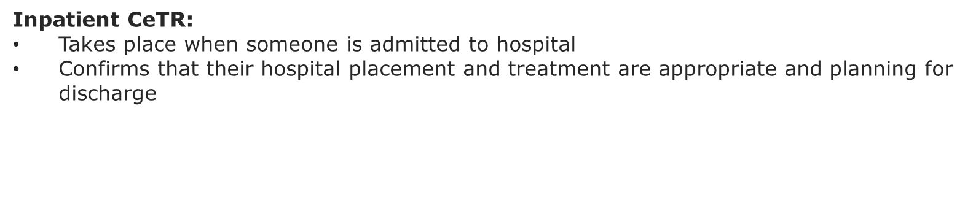
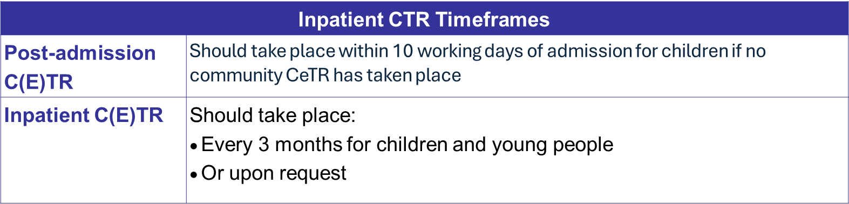
Community and inpatient CETRs
Community CeTR:
Takes place when someone is at risk of being admitted into hospital
Looks at alternatives to admission and community support
Can be called to provide early intervention if somebody may be on a longer term pathway that may increase their risks

Slide 10
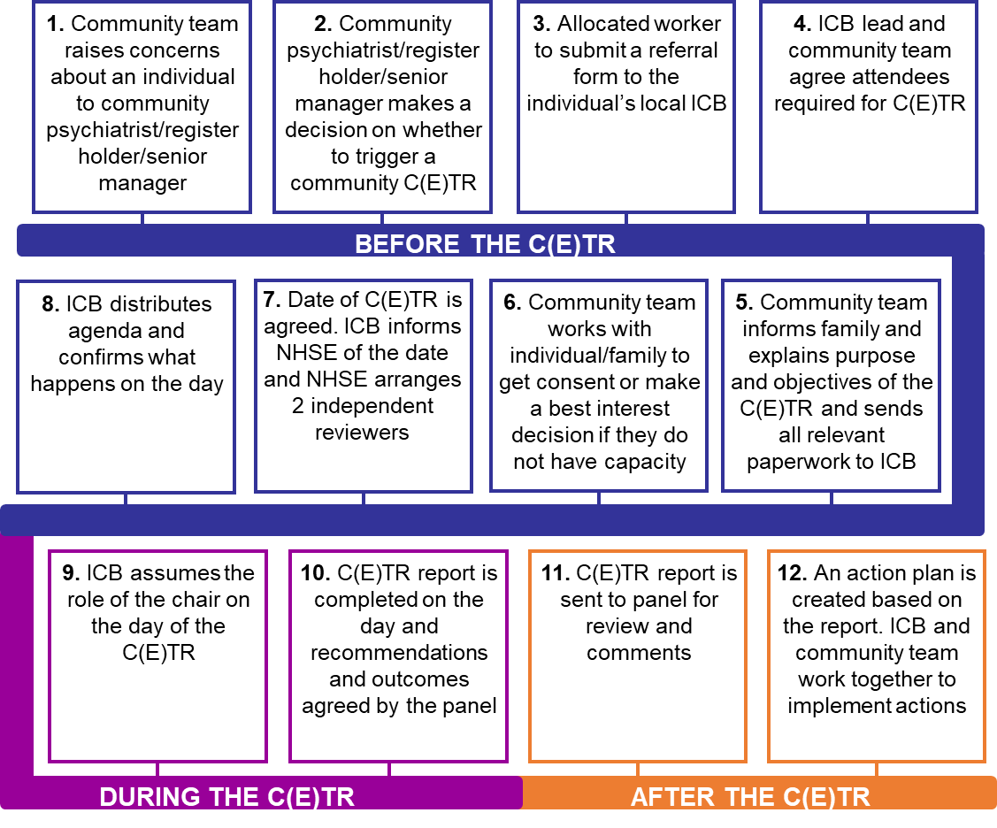
Community CETR Process

Slide 11
Benefits of CETRs
Help improve the quality of care people receive within the community or in hospital
Reduce the amount of time people spend in hospital
Help find solutions for problems that may be stopping them from leaving hospital
Help people stay in their home and community with extra support where possible
Empower people to be in control of their care and treatment by being involved in decision making
Brings health and social care teams together to work collaboratively
Specialist services available through the DSR/CETR pathway
Individual referrals for assessments outside of routinely commissioned services, e.g. functional behaviour assessment, sensory assessment
The NEL key working service will be available for those aged 0-25.

Slide 12
Further information
Jasmin Begum – TH DSR Holder, NEL ICB
E-mail- Jasmin.begum10@nhs.net
Generic e-mail – nelondonicb.dsr.thcypmhewb@nhs.net

Slide 13


