Slide 1
Inter-seasonal Vaccination Offer for Newly Immunosuppressed individuals

Slide 2
COVID-19 Vaccination of Newly Immunosuppressed during the inter-seasonal period
People aged 6 months and over who have a health condition or are receiving treatment that severely weakens their immune system (Boxes 1 and 2 of the Greenbook chapter 14a) may be considered for a COVID-19 vaccine, regardless of the time of year. Stem cell and CAR-T therapy: Check the Green Book for the latest advice on dosing schedules for this patient group
Covid-19 vaccine will continue to be available for the newly immunosuppressed in the inter-seasonal period (the period between 1st February 2025 and the commencement of the spring campaign). This will be delivered at 4 sites across NEL.
Specialist clinicians managing the care of patients commencing immunosuppressive treatment will identify newly severely immunosuppressed and determine whether they require a COVID-19 vaccination during the inter-seasonal period. Individuals that require immunisation will be provided with a letter which must be taken to the vaccination appointment.
The vaccines in use are Comirnaty 30 JN1, Comirnaty 10 JN1 and Comirnaty 3 JN1. They will be administered via a Patient Specific Direction (PSD) and will require a prescriber (e.g. a Doctor or NMP) to assess and prescribe the COVID-19 vaccines. There are no National Protocols (NP) or Patient Group Directions (PGD) to cover this period.
This final slide of this document lists the vaccination sites in North East London that will provide Covid-19 vaccine. Anyone requiring immunisation should be referred to these sites.

Slide 3
Legal mechanism and access pathways
COVID-19 vaccinations for the year-round pathway must take place under a prescriber model, tailored to the individual. There are no Patient Group Directions (PGD) or National Protocols (NP) for these doses.
Anyone recommended for additional protection will require a Patient Specific Direction (PSD). The national template referral letter can be used to refer individuals to vaccination services, a PSD will be required.
Specialists/GPs should support individuals to access a local vaccination offer. See slide 5 for contact details.
There is no access for year-round doses through the National Booking Service or by phoning 119. Do not signpost individuals to these services outside of seasonal campaigns.

Slide 4
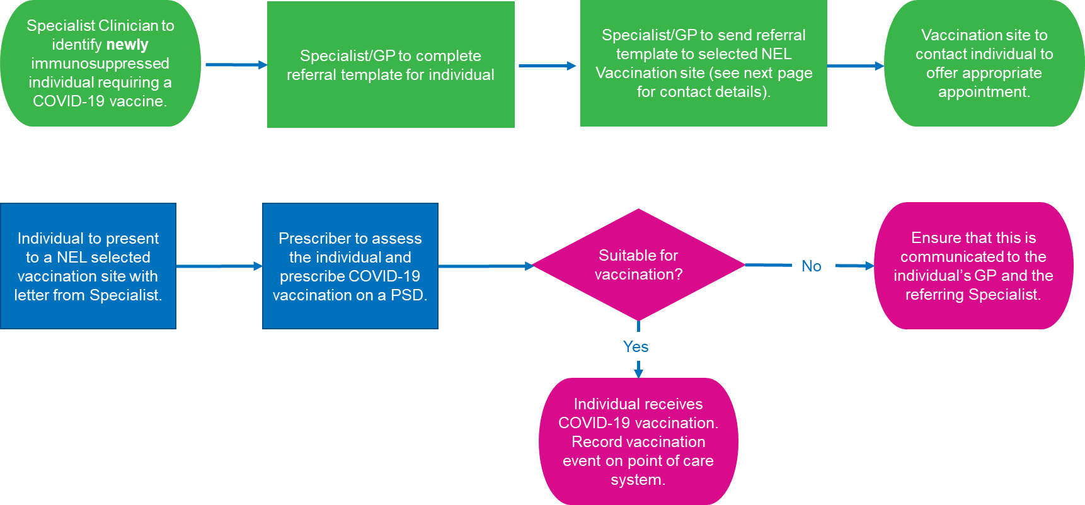
COVID-19 Vaccination pathway of Newly Immunosuppressed during the inter-seasonal period

Slide 5
Contact details for vaccination sites offering COVID-19 vaccinations for immunosuppressed individuals during the inter-seasonal period
Assured providers for inter-seasonal vaccination offer:
1. Woodgrange Medical Practice, 40 Woodgrange Road, E7 0QH, call the designated Covid Vaccination number on 02082213127 or email woodgrange.noreply@nhs.net ​
2. Doctors House Surgery, 40 Cameron Road, Seven Kings, Ilford, IG3 8LF, call the designated Covid vaccination number on 02085101148 or email sk.covidvaccinations@nhs.net​
3. Richmond Road Medical Centre, 136 Malvern Road, London, E8 3HN email - mahmuda.begum4@nhs.net ​
4. Highgrove Surgery, Barking Community Hospital, Upney Lane, London IG11 9LX email Shazia.khan6@nhs.net

