Slide 1

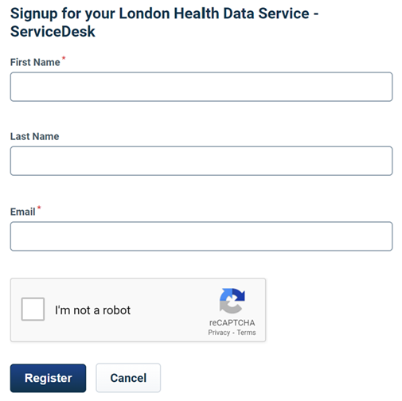
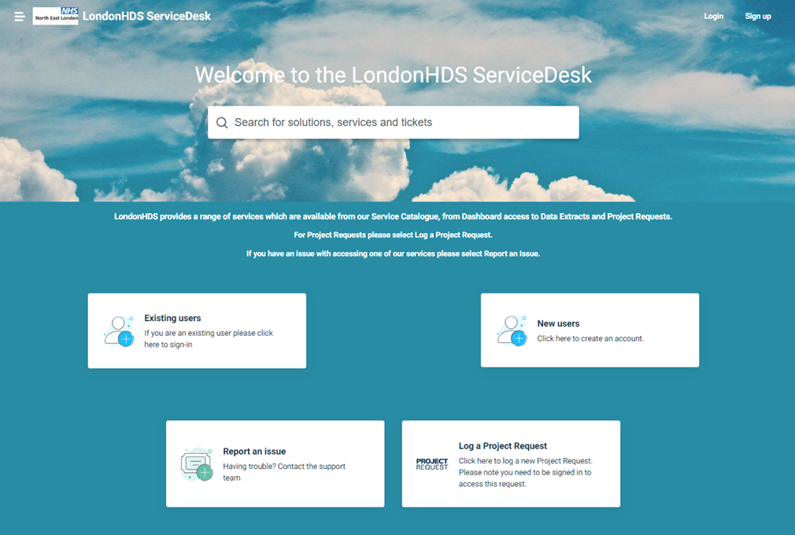
Quick Guide to Requesting Access to a Dashboard
If this is the first time you have visited the LondonHDS Service Desk, please follow the instructions below to register and log into the Portal. You need to create a LondonHDS Service Desk account to access the Dashboard Access Request Form.
Creating a new Requestor account
A Requestor can visit the LHDS Service Desk on the web via:
https://sd.londonhds.nhs.uk/
From here the requestor can either login or for first time use create an account, by clicking on New users:
STEP 1: Click on New users
STEP 2:
Enter the First Name
Enter the Last Name
Enter your e-Mail Address
Tick the I’m not a robot check box
Click on Register

Slide 2
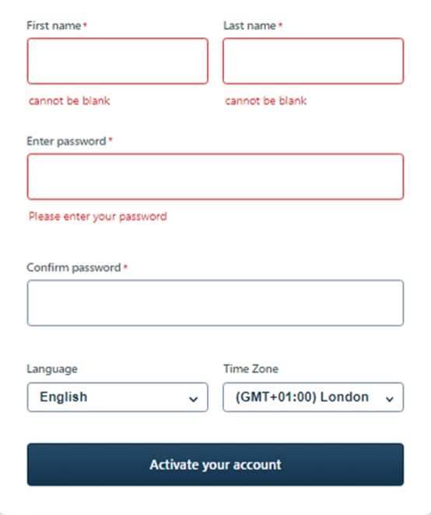
STEP 3:
An email similar to the one below will be sent from the Service Desk to the Email address entered above
PLEASE CHECK THE JUNK\SPAM FOLDER IF THIS IS NOT RECEIVED IN YOUR INBOX
STEP 4:
Click on the link in the email you received from the LHDS Service Desk
to finish setting up the account
This will take you to the Sign in page as below
Complete the fields shown below
Click on Activate your account to continue setup

Slide 3
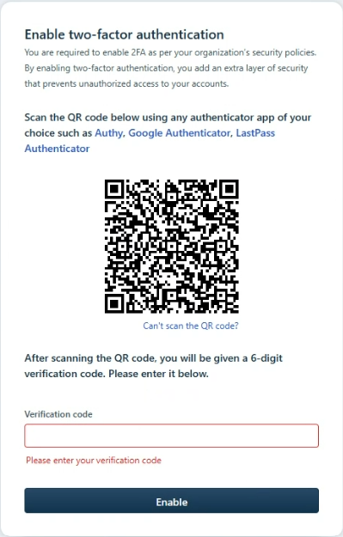
STEP 5:
Enable two factor authentication (2FA)
Open the authenticator app on your phone – Microsoft Authenticator app is commonly used, so if you already have this installed you can use this app to create your 2FA account. If you do not have this installed, please see link below to help guide you through the process
Download and install the Microsoft Authenticator app - Microsoft Support
You will see a set of two factor recovery codes – Please download and save to a secure location of your choice. These are one-time codes and are used if you cannot access your mobile device.
STEP 6:
When prompted enter the verification code and click on Enable to complete the setup of your LHDS Service Desk user account.

Slide 4
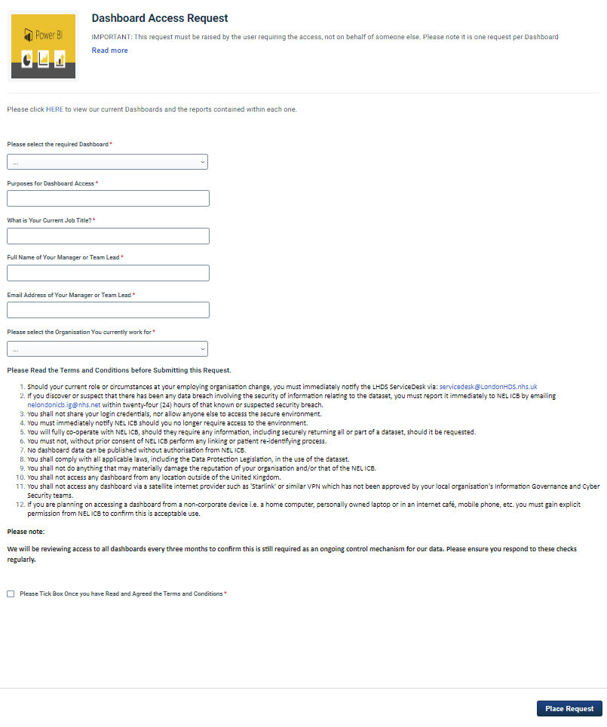
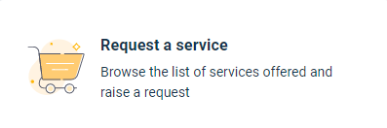
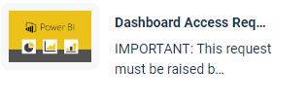
Requesting Access to a Dashboard
Once you have logged into the LondonHDS Service Desk Portal successfully, please follow the steps below to log your Dashboard Access Request.
PLEASE NOTE IT IS ONE REQUEST PER DASHBOARD
STEP 1:
Select Request a service:
STEP 3:
Complete the Form shown by completing all the fields.
Once complete click Place Request to submit your access request.
STEP 2:
Then select Dashboard Access Request

