Slide 1
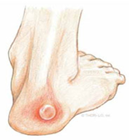
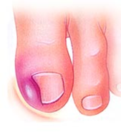
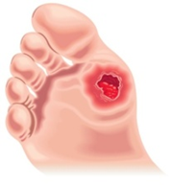
Department of Foot Health
Mile End Hospital
Bancroft Road
London E1 4DG
CHANGES TO THE FOOT HEALTH SERVICE
EMERGENCY CLINIC (EC)
FROM MONDAY 3RD MARCH 2025
THE EMERGENCY CLINIC WILL RUN FROM 09:00- 12:00
REGISTERATION FOR APPOINTMENTS STARTS AT 09:00-09:30HRS.
PATEINTS WILLNOT BE ABLE TO REGISTER FOR THE EC AFTER 09:30HRS
TELEPHONE APPOINTMENTS ARE NOT ACCEPTED MUST ATTEND IN PERSON TO REGISTER
No appointment necessary for the emergency conditions shown below
Blisters, infected sores
Discharging wounds, blood or pus
Swollen/inflamed areas, ingrowing nail
Foot Health Service August 2025

