Slide 1
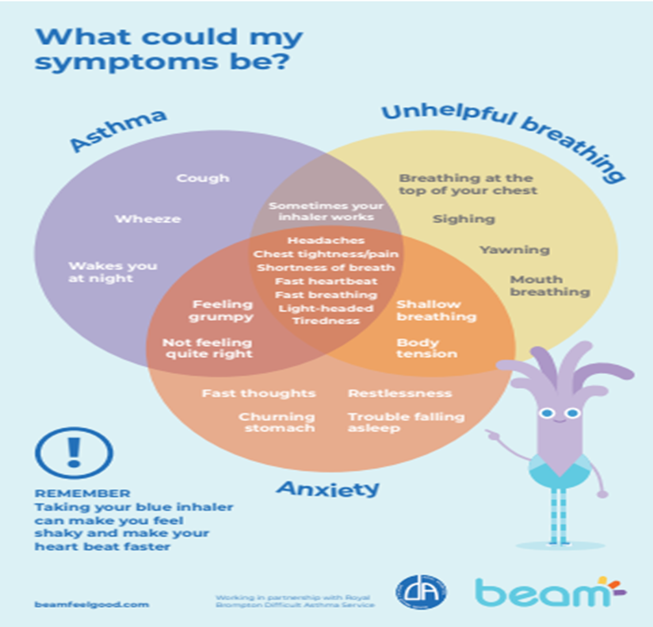
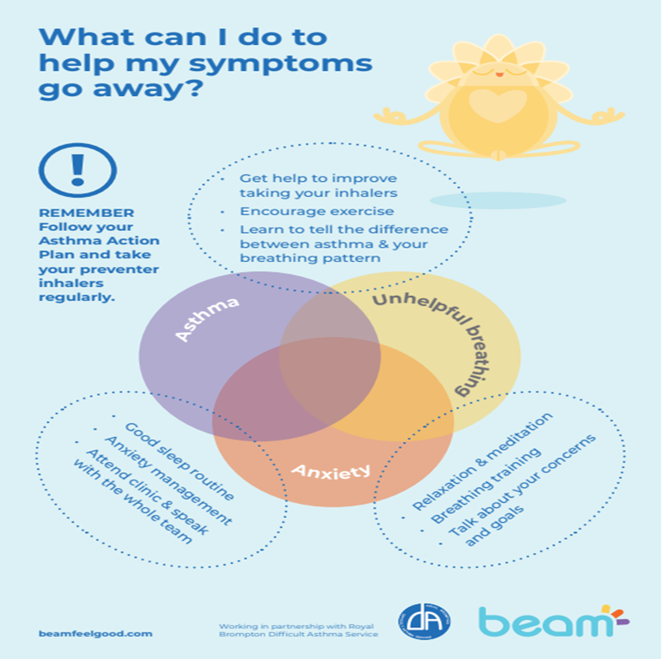
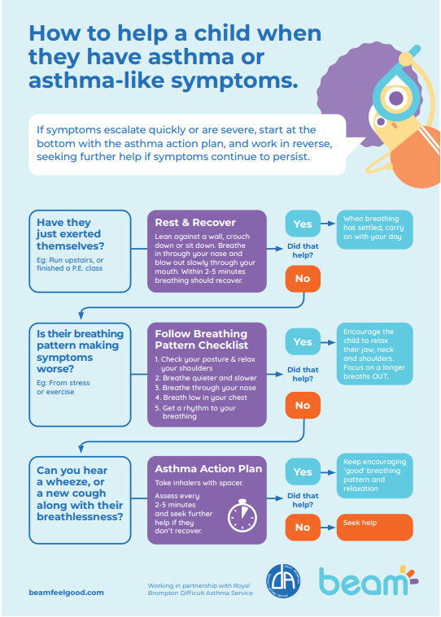
Good Breathing Plan
Its normal to get out of breath when we exercise it happens . Stress and anxiety causes panic attacks and incorrect ways of breathing.
Correct ways of breathing for exercise and difficulties in breathing
Finger Breathing https://www.youtube.com/watch?v=HQVZgpyVQ78
Ball breathing
https://youtu.be/5DqTuWve9t8
Support with stress and anxiety
Kooth: “I really like how you can share your problems anonymously and have help from others. It makes me feel accepted and that people will not judge me.” https://www.kooth.com/
Manfulness: https://www.youtube.com/watch?v=3iUf73v92lI
Sleep aid https://www.youtube.com/watch?v=v7dEjH2MfKQ
Check your peak flow and follow your plan

