Slide 1
NHS App
Troubleshooting Common Issues Guide
November 2024

Slide 2
NHS App Guidance
This guide covers troubleshooting common NHS App issues that patients may ask about:
Device Compatibility and Versions
Common Issues
Patient cannot log in
Patient cannot access the App in their area
Patient cannot order or view repeat prescriptions
Patient has no repeat prescriptions available to order
General guidance on what the NHS App can do and how to navigate it
Error Codes Explained
Permissions
Turning off patient facing services: Merging practices and changing clinical systems
Practice/Patient level permissions
if no one can use a certain functionality
if only some can use a certain functionality
Patient can’t access GP health record
Proxy access (linked accounts)
Prescription permissions
GP appointment permissions
When to seek support from the NHS App team
Duplicate accounts: Patient changed their email address or no longer has access to their email

Slide 3
Other resources for the NHS App
GP Practice Guidance
Quick guide to the NHS App for GP practices (also available as a printout)
GP Practices resource deck (comprehensive guidance to help practices promote/maximise the features in the App)
For patients
Patient help and support pages (can also be accessed via the help button in the top right of the App)
Patient leaflets
Set up a test patient to view what your patients can see in the App
Guidance videos
NHS App walk through videos
NHS account walk through videos (the NHS account contains the same services as the NHS App and can be accessed online, through the NHS website)
More resources can be found on our website

Slide 4
Our support for the NHS App covers:
Android: Version 8 (Oreo) and above, with devices that have a front-facing camera.
Apple iOS : Version 15 and above.
Device compatibility and versions
The App can also be installed on Android versions 6 and 7, and Apple iOS versions 9 and 10.
Please note that these versions may not offer the best experience, and we’re unable to provide technical support for them
Notes:
Plain slide with subhead and bullets

Slide 5
Error codes
3C
3F
3R
3C error codes mean that patients cannot connect to NHS App / login services.
3C will be followed by 4 random characters e.g.
3cfjwd
3F error codes mean that a patient may recently have moved to England from Wales, Scotland or Northern Ireland or is ex-armed forces.
3F will be followed by 4 random characters e.g.
3fplmi
3R error codes mean there is either no ODS code associated with the patient's NHS number being returned to the NHS App, or it is an unsupported ODS code.
3R will be followed by 4 random characters e.g.
3rswtr
More information on error messages

Slide 6
Turning off: patient facing services
The App connects to the main prescribing cost centre ODS code of the practice.
It doesn’t connect to branch ODS codes.
When two practices merge, they will move to one main prescribing cost centre ODS code.
Learn more: Switching patient facing services off - NHS England Digital
Two practices merge

Slide 7
Following a migration, we recommend advising patients with an NHS login to sign into the NHS App, Airmid or Patient Access, using the NHS login service.
This will either create a link to an existing online services account or create a new online services account for a patient.
Patients will then have access to the default services controlled by the practice without having to contact the practice.
Patients that do not want to use the NHS login service will have to contact the practice to receive online login credentials.
Learn more: Switching patient facing services off - NHS England Digital
Turning off: patient facing services
Change in clinical system

Slide 8
Error Code 3C
If the patient doesn’t reconnect to the App, they will see a 3C error code. A 3C error means the user cannot connect their NHS App to mirror their online account. Verification:
Route 1 – Video
Route 2 – PIN document
If the user verifies their identity by video, they will reconnect to the new online account created on your system. If no online account is recreated, the user will have nothing to reconnect to.
If the user has manually entered their PIN document into the NHS App, they will need to reconnect to the new system with a new PIN document.
Helping patients reconnect to App services
Change in clinical system

Slide 9
Error Code 3C
Inform us that you are changing clinical system or merging practices in advance.
We can prepare a tailored response for if a 3C error is reported to inform the user of potential downtime and what to do in the meantime.
This include asking patients to:
Email the practice directly to order their prescription
Phone directly to book an appointments
The NHS App service desk does not have the authority or ability to view or advise about data migration when changing clinical system or merging practices. Please contact your system supplier.
How can the NHS App team help?

Slide 10
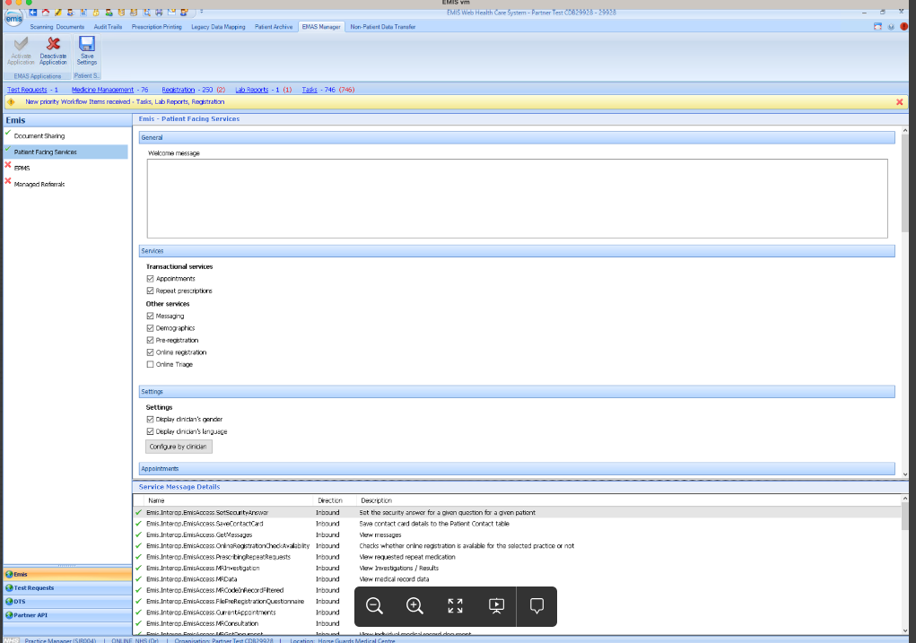
Practice Level Permissions
Permissions that you set that apply to everyone practice wide
Includes: appointments, messaging, prescriptions etc.
When to look out for this: If no one at the practice can use a certain functionality

Slide 11
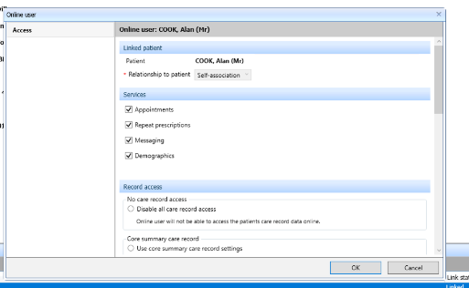
Patient Level Permissions
Permissions that you set that can be changed for each patient
Include appointments, messaging, prescriptions etc.
When to look out for this: if some people at the practice can do something but one/a few can’t

Slide 12
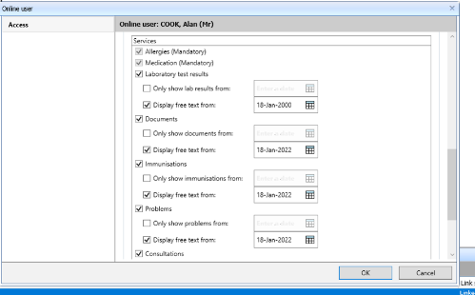
*Remember the NHS App mirrors what is in your GP system
GP Health Records
What to check when patients say they can’t access their medical records:
1) Can you see what they are looking for in their GP Health Record on your GP system?*
2) Do they have access to view the relevant section(s)?
3) Has the ‘view from’ date on the relevant section(s) been set back far enough?
4) Have the relevant parts been made available for online viewing?
If the answers is ‘Yes’ to all of the above questions: Escalate to the GP System Supplier/NHS App support team
More information on GP Health Records

Slide 13
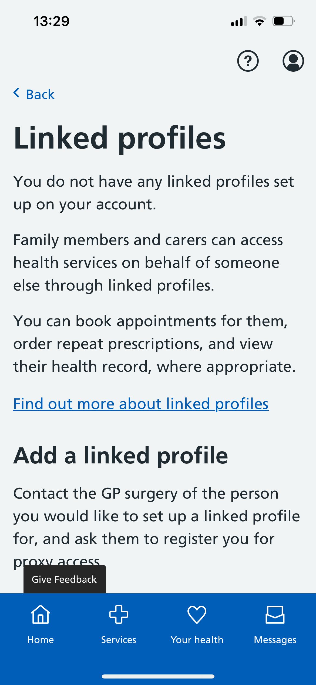
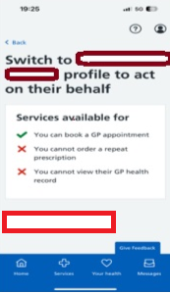
Proxy (Linked Accounts)
Steps for Adding the linked account:
1) Create the linked account
2) Add permissions for the user to access the other person’s services that you want them to access
Key Points:
The same medical record permissions etc. will need to be applied as to regular patients
Person being linked to can be any age
There is no limit to the number of patients a proxy user can manage.
There are certain functionalities that are not available for proxy access (e.g., secondary care, messaging)
Patient's need to be registered at the same practice
More information on Proxy Services

Slide 14
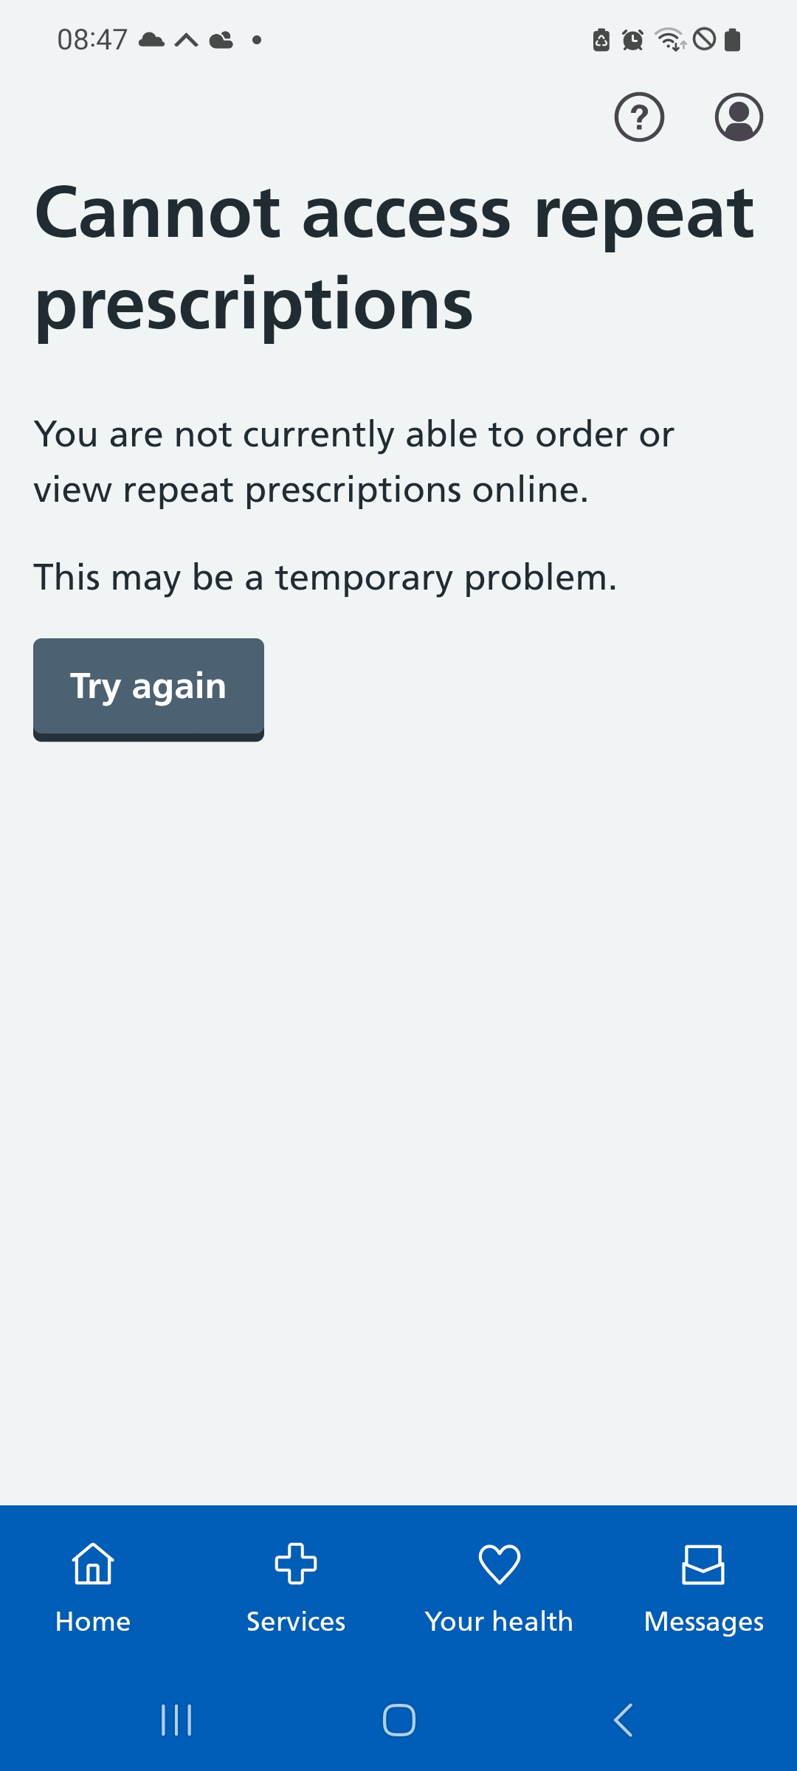
Prescriptions
Only repeat prescriptions are orderable via the NHS App
You can:
1) control whether the patient can order repeat prescriptions
2) amend how far before the order date the patient can request their repeat prescriptions
3) control whether the patient has to give a reason when submitting the prescription
Disclaimer: These may be specific to your GP System Supplier (EMIS/TPP/Medicus/Vision)
More information on prescriptions

Slide 15
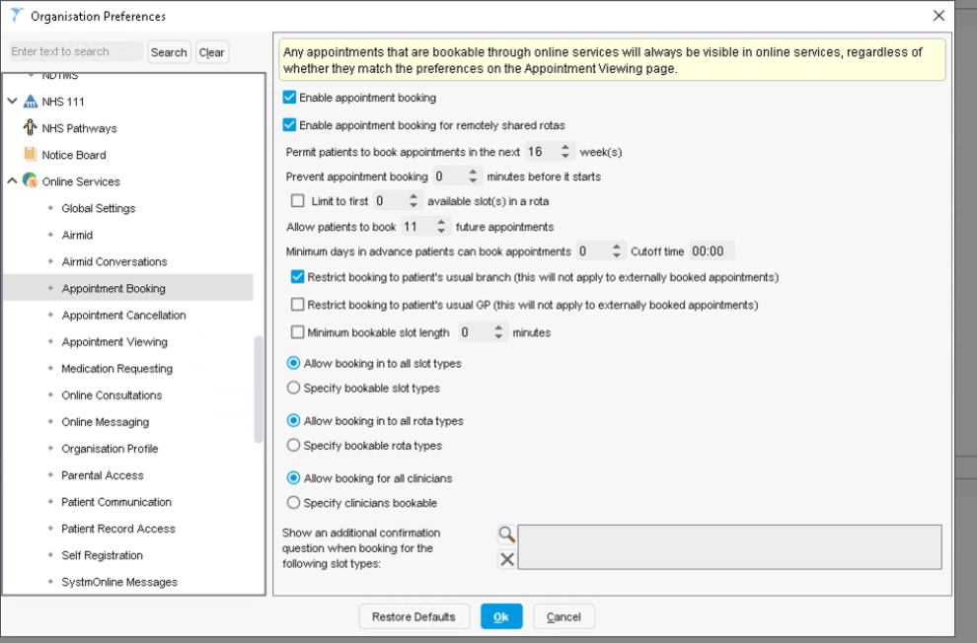
Appointments
You can:
control whether the patients can book appointments
control whether appointments are made available for patients and at what times/days they are made available
amend the name of the appointment slots that patients will see
control whether patients will see a message on online booking systems
control whether the patient has to specify a reason for booking the appointment
limit the number of bookable appointments for each patient at one time
limit the number of appointments patients can book in a particular time frame
control whether patients can book available appointments at branch surgeries
control which appointments can they view in the App (past and future)
Disclaimer: These may be specific to your GP System Supplier (EMIS/TPP/Medicus/Vision)
More information on GP appointments

Slide 16
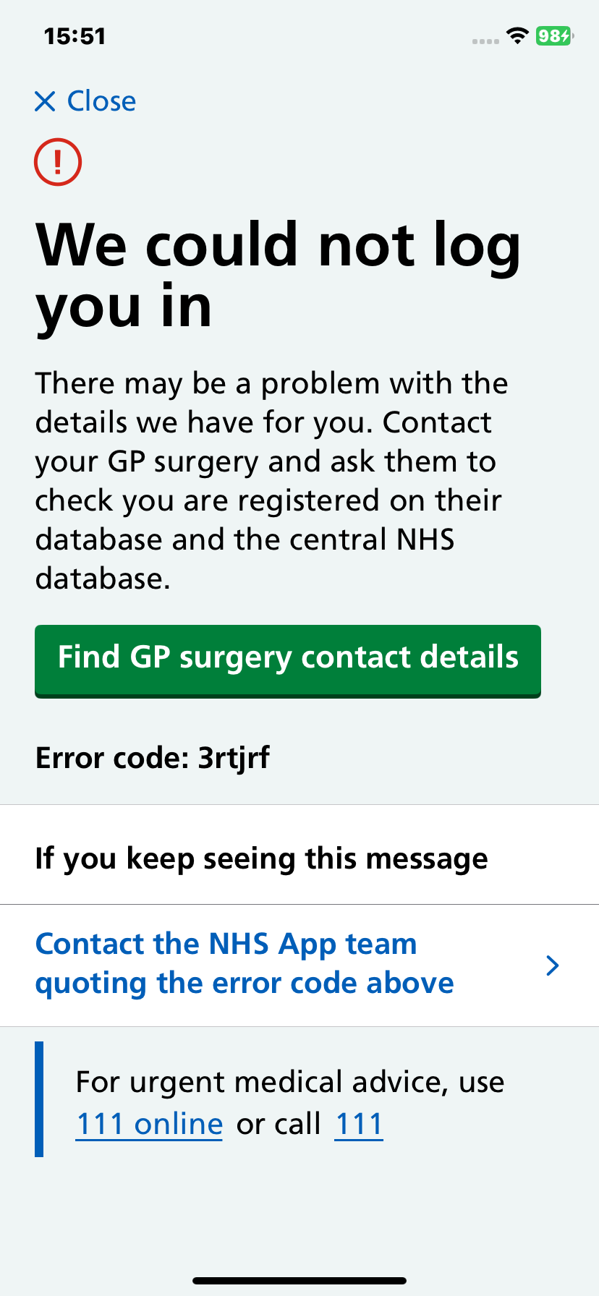
What your patient will see:
Error Code 3R
Patient cannot log in to the NHS App
What does this mean?
No ODS code associated with the patient’s NHS number
How can you help?
Check your patient is registered at the practice on your clinical system
Check Spine is synced with your clinical system by using your NHS Smartcard
Ask the patient to log out and in again
Information on patients changing or losing access to their email

Slide 17
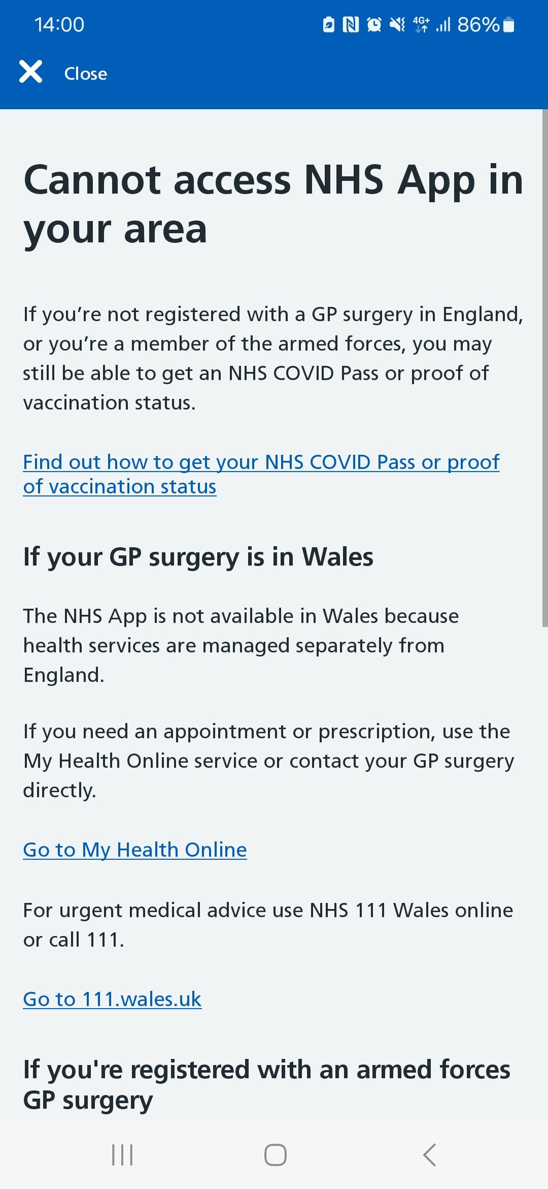
What your patient will see:
Error Code 3F
Patient cannot access the App in their area
What does this mean?
Patient recently moved to England from Wales, Scotland or Northern Ireland*
Patient is ex-armed forces
*the NHS App is only available in England and the Isle of Man
How can you help?
Check your patient is registered at the practice on your clinical system
Check Spine is synced with your clinical system by using your NHS Smartcard
Ask the patient to log out and in again

Slide 18
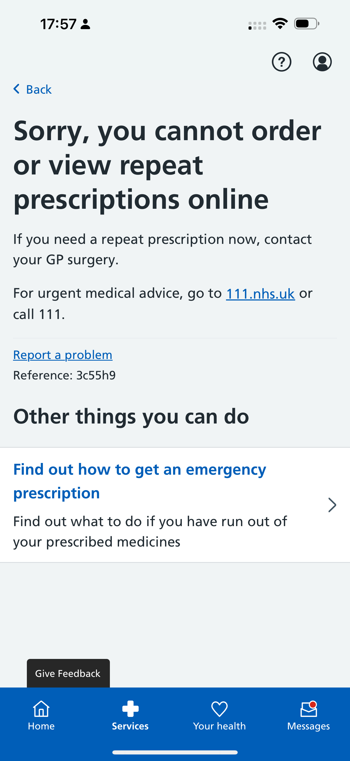
What your patient will see:
Error Code: 3C
Patient cannot order or view repeat prescriptions online
What does this mean?
New patient at the surgery
PFS has been switched off
The practice has recently merged
Clinical supplier change
Patient’s account has been archived due to inactivity
How can you help? Check:
Is Patient Facing Services switched on?
Have you recently merged/changed clinical supplier?
Does the user have the correct permissions?
Ask your patient to log out and in again
If the issue is still ongoing, please raise this directly with our Service Desk: quoting the error reference or stating the user cannot access anything

Slide 19
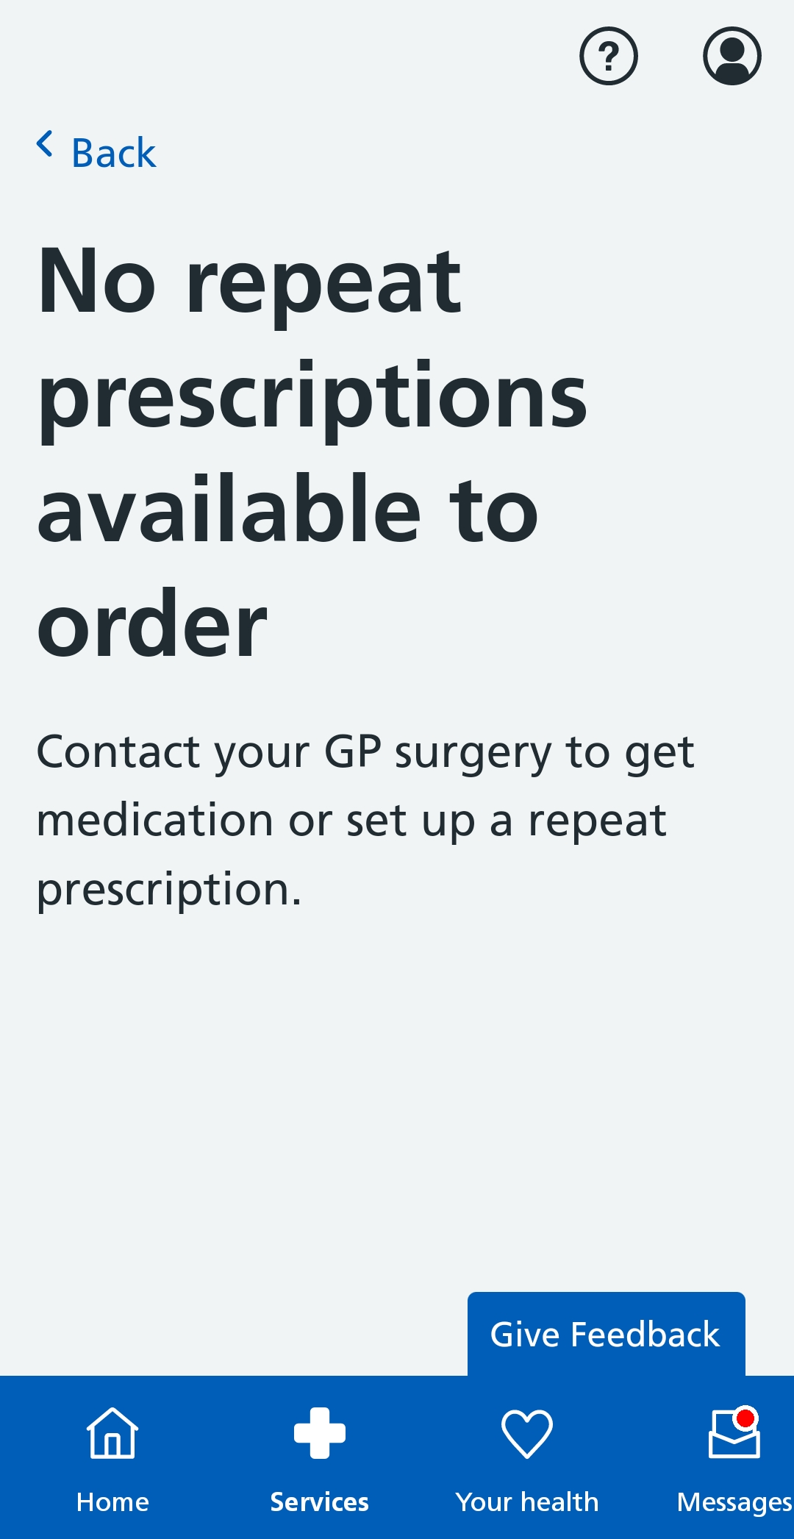
What your patient will see:
Patient has no repeat prescriptions available to order
This is not a technical error
What does this mean?
Your patient needs a medical review
It’s too early to order
Your patient has a repeat dispensing prescription
It’s an acute prescription
How can you help?
Check the patient has repeat prescriptions available to order
Check the user has permissions to order their prescriptions online
Inform your patient when they can order their prescription again, if they are due a review, or the prescription is not a repeat

Slide 20
Duplicate accounts
What to do if your patient has changed their email or no longer has access to their old email address associated with their NHS login account
The patient can remember their password and can remember their old email address:
They need to log into their account with their original email address and change the email associated with the NHS login/NHS App account. https://account.login.nhs.uk/#/manage-nhs-login/
The patient cannot remember the password for their NHS login/NHS App account, but can access their old email account:
They need to select the “forgotten password” link. This will send an email to their old email address for action. The patient can then follow the guidance to reset the email address.
The patient cannot remember their password for their old NHS login/NHS App and cannot access or recover their old email address (e.g. student email address that they no longer have access to):
They need to raise a case to the NHS App & NHS login service desk, as they will need their NHS login account cleansing to associate their new account with their medical record

Slide 21
Contacting the service desk for user account cleansing 1/2
When contacting the NHS login/NHS App service desk, please provide the following information to help us process your request:
1. Patient’s new email address
This should either be in the email address section of the form or in the description. This is so we can ensure that we hold the correct email address to contact the patient and offer support and guidance.
2. Patient’s old email address
This should either be in the email address section of the form or in the description. This is required to help identify the users existing NHS login account.
3. Last 3 digits of the patient’s NHS number
5. The date of the last successful account access, if known
6. Description of steps taken so far
Making clear that the patient cannot access or recover the account

Slide 22
Contacting the service desk for user account cleansing 2/2
When contacting the NHS login/NHS App service desk, please provide the following information to help us process your request:
If the patient cannot provide the information in the previous slide, or if the answers are incorrect, the user’s account may need to be reset.
The user will then need to re-link to their NHS number and potentially need to re-prove who they are via POL (obtain new GP Linkage keys) or PYI to access more sensitive information (this is service dependent). This includes most of the App functionality such as access to medical records, prescription order, appointments etc.
POL can be used for users who do not have any photographic documentation, the GP surgery will require the user to provide other proof as per their own policies & procedures.
PYI can be used with photographic identification.
Prove Your Identity (PYI): verification requiring a face scan/ ID document
Patient Online (POL): verification requiring some key information provided by your practice
More information can be found on the following links:
https://help.login.nhs.uk/provewhoyouare/withid/
https://help.login.nhs.uk/provewhoyouare/withoutid/

Slide 23
How and when to raise to NHS England
If you have a patient raising an NHS App issue and it is not something you can resolve, encourage the patient to raise this directly to us via one of the following contact forms:
NHS login issues (logging in, registering, verifying their identity, changing account login details): https://help.login.nhs.uk/, contact form found under “error messages and support section”.
NHS App issues (after logging in, any issues experienced by users accessing or using the features and functions): https://www.nhs.uk/contact-us/nhs-app-contact-us/
If they cannot, or do not, want to do this themselves, you can choose to raise this to our service desk on their behalf. If you do this, please provide us with the following information:
Patient name
Patient email address associated with their NHS login account
Description of issue, and any triage steps you have taken to date
Confirmation that the patient consents to you raising this on their behalf (you must seek this)

Slide 24
End slide

