Slide 1
Community Pharmacy Selfcare Advice Service
(CPSAS)
General Practice Webinar
27th June 2024

Slide 2

Overview
The main aims of this webinar will be to:
  Provide a brief overview of Pharmacy First (if needed)
  Outline the background and objectives of the Community Pharmacy Selfcare Advice Service (CPSAS), launching on 1st July 2024
  Outline patient eligibility criteria and conditions covered by the service
  Outline how patients can access the service
  Provide contacts for queries or concerns

Slide 3
Pharmacy First Refresher

Slide 4
What is Pharmacy First?
What is the service?
Pharmacy First is a new advanced service which involves Pharmacists providing advice and NHS-funded treatment, where clinically appropriate for seven conditions.
Pharmacy First incorporates the existing elements of Community Pharmacy Consultation Service i.e. Minor Illness consultation with a pharmacist and supply of urgent medicines (and appliances) both following a referral from NHS111, general practices and other authorised healthcare providers.
NHS 111
GP Referral (Electronic)
Walk in
Urgent Supply of Medication
Minor illness
7 Common Health Conditions

Slide 5
Conditions general practice can refer to community pharmacy
Pharmacy First: clinical pathways*
Condition | Age range
Sinusitis | 12 years and over
Sore throat | 5 years and over
Acute otitis media | 1 to 17 years
Infected insect bite | 1 year and over
Impetigo | 1 year and over
Shingles | 18 years and over
Uncomplicated UTI | Women 16 to 64 years
Pharmacy First: minor illness consultations This is not an exhaustive list, Community pharmacies can receive referrals for anything considered a minor illness.
Acne, spots, and pimples | Allergic reaction | Ankle or foot pain or swelling | Athlete’s foot | Bites or stings, insect, or spider | Blisters
Constipation | Cough | Cold and flu | Diarrhoea | Ear discharge or ear wax | Earache
Eye, red or irritable | Eye, sticky or watery | Eyelid problems | Hair loss | Headache | Hearing problems or blocked ear
Hip, thigh, or buttock pain or swelling itch | Knee or lower leg pain | Lower back pain | Lower limb pain or swelling | Mouth ulcers | Nasal congestion
Pain and/or Frequency passing urine | Rectal pain | Scabies | Scratches and grazes | Shoulder pain | Skin, blisters or rash
Sleep difficulties | Sore throat | Teething | Tiredness | Toe pain or swelling | Vaginal discharge
Vaginal itch or soreness | Vomiting | Wound problems – management of dressings | Wrist, hand, or finger pain or swelling
* Each clinical pathway has inclusion & exclusion criteria
6

Slide 6
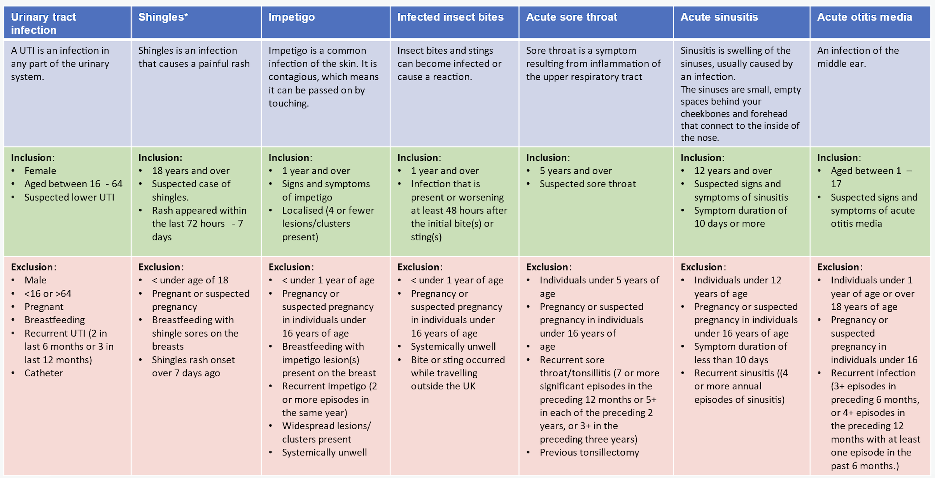
Inclusion & Exclusion Criteria – 7 common conditions

Slide 7
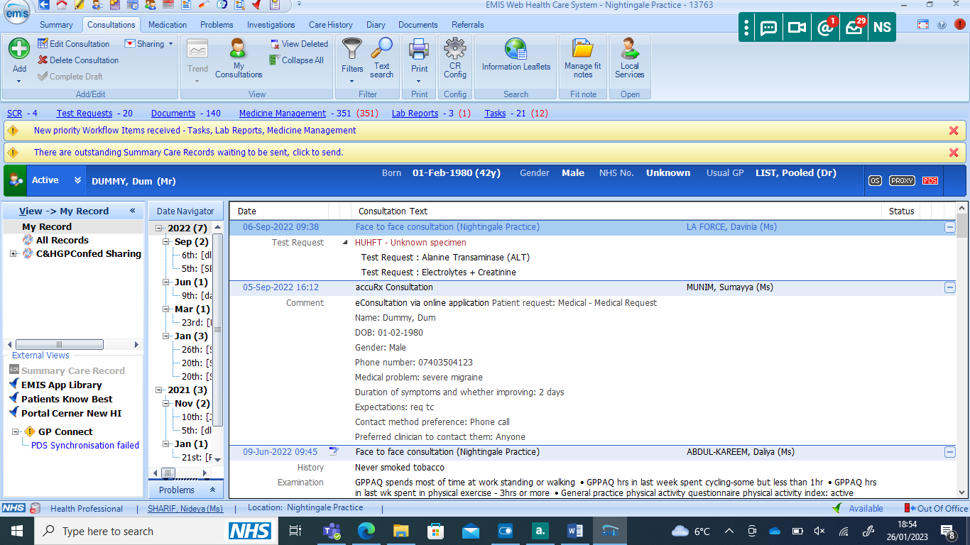
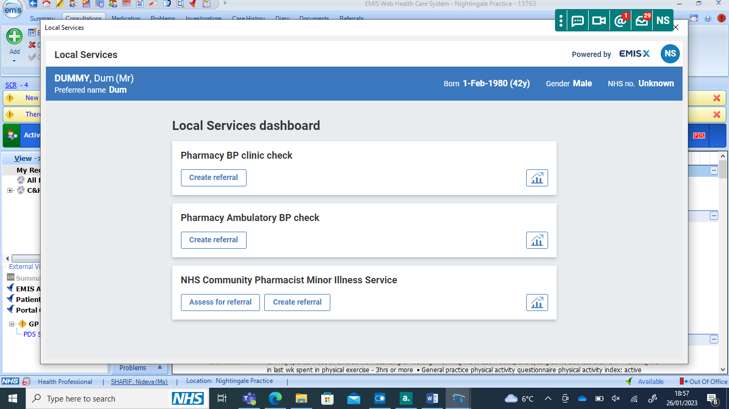

Referrals
Verbal Consent
Prior to referral, verbal consent must be obtained by asking the patient which local pharmacy they would like the referral to be sent to. This is implied consent which allows for patient choice.
Referral Pathway
Use ‘Assess for referral’ allows for this information to be shared with the pharmacy. Includes the inclusion and exclusion criteria for the service.
Once confident, you can use ‘Create referral’.
Use report function as Practice Managers or Clinician to review the referrals being sent.
SystmOne Practice
SystmOne Surgery – Please reach out as you would need to user PharmRefer for integrated referral to pharmacies.

Slide 8
GP Referral [ Local Services]
Access to the service will be LIMITED if not referred through integrated pathway
Gateway met
Urgent Repeat Medication Supply Referral
Low Acuity Minor Illness Referral
Clinical Pathway Consultation Referral
Gateway not met
All Referral must be sent electronically through ‘ Local Services”
Self-Care Service
Patient Consultation
Clinical Pathway | Age Range
Uncomplicated UTI | Women 16-64 years
Shingles | 18 years and over
Impetigo | 1 years and over
Infected Insect Bites | 1 years and over
Sinusitis | 12 years and over
Sore Throat | 5 years and over
Acute Otitis Media | 1 – 17 years
Community pharmacy will be able to provide FREE-of charge OTC medicines to eligible patients for specific minor illnesses, as outlined in the medicine’s formulary

Slide 9
Background – Pharmacy First Data
Activity data for Pharmacy First (from 31 Jan 2024 to May 2024)
NEL Place | Number of Pharmacies (March 2024) | % of Pharmacies Registered for Pharmacy First | Number of Pharmacy First Minor Illness Referrals | % of All NEL Pharmacy First Minor Illness Referrals
Newham | 71 | 97% | 6175 | 29%
Tower Hamlets | 50 | 100% | 2887 | 14%
Waltham Forest | 59 | 98% | 2608 | 12%
City & Hackney | 58 | 100% | 3011 | 14%
Barking & Dagenham | 38 | 100% | 2120 | 10%
Havering | 44 | 100% | 655 | 3%
Redbridge | 53 | 100% | 3723 | 18%
TOTAL | 373 | 98% | 21,179 | 100%
Pharmacy First Top 5 Minor Illness Conditions
1. Cough
2. Skin rash |  | Majority of conditions logged are undefined (57%)
3. Cold |  | Data is not representative of seasonal variations (as only covers 4 months since the service commenced on 31st January 2024)
4. Sore throat |  | CPCS dashboard data does not include information on conditions treated, so cannot be used to extrapolate data
5. Earache

Slide 10
Community Pharmacy Selfcare Advice Service
(CPSAS)
General Practice Webinar
27th June 2024

Slide 11
CPSAS – Introduction & Objectives
The CPSAS will commence across NEL on 1st July 2024
The main objectives of the CP Selfcare Advice Service are:
  To complement and aid implementation of the new nationally commissioned Pharmacy First Service, with the provision of free-of-charge OTC medicines for eligible patients
  To reduce the number of GP appointments and/or A&E attendances for conditions related to specific common conditions
  To help address health inequalities through MECC (Making Every Contact Count) interventions
The service covers 24 common conditions
For City & Hackney only: This service replaces the Health First Pharmacy (HFP) Minor Ailments Service (MAS)

Slide 12
Health Inequalities and Deprivation in NEL:
Minor illnesses amenable to selfcare are a significant proportion of primary care and A&E attendances. However, people living in the most deprived areas often have barriers to accessing selfcare advice and medicines.
Approximately 24% of the NEL population (489,000) live in areas ranked in the most deprived 20% in England.
As of March 2023, there were 5,644 asylum seekers in NEL. The boroughs with the highest numbers are Newham (27%) and Redbridge (21%).
Further information regarding the data for deprivation and asylum seekers is available in the appendices

Slide 13
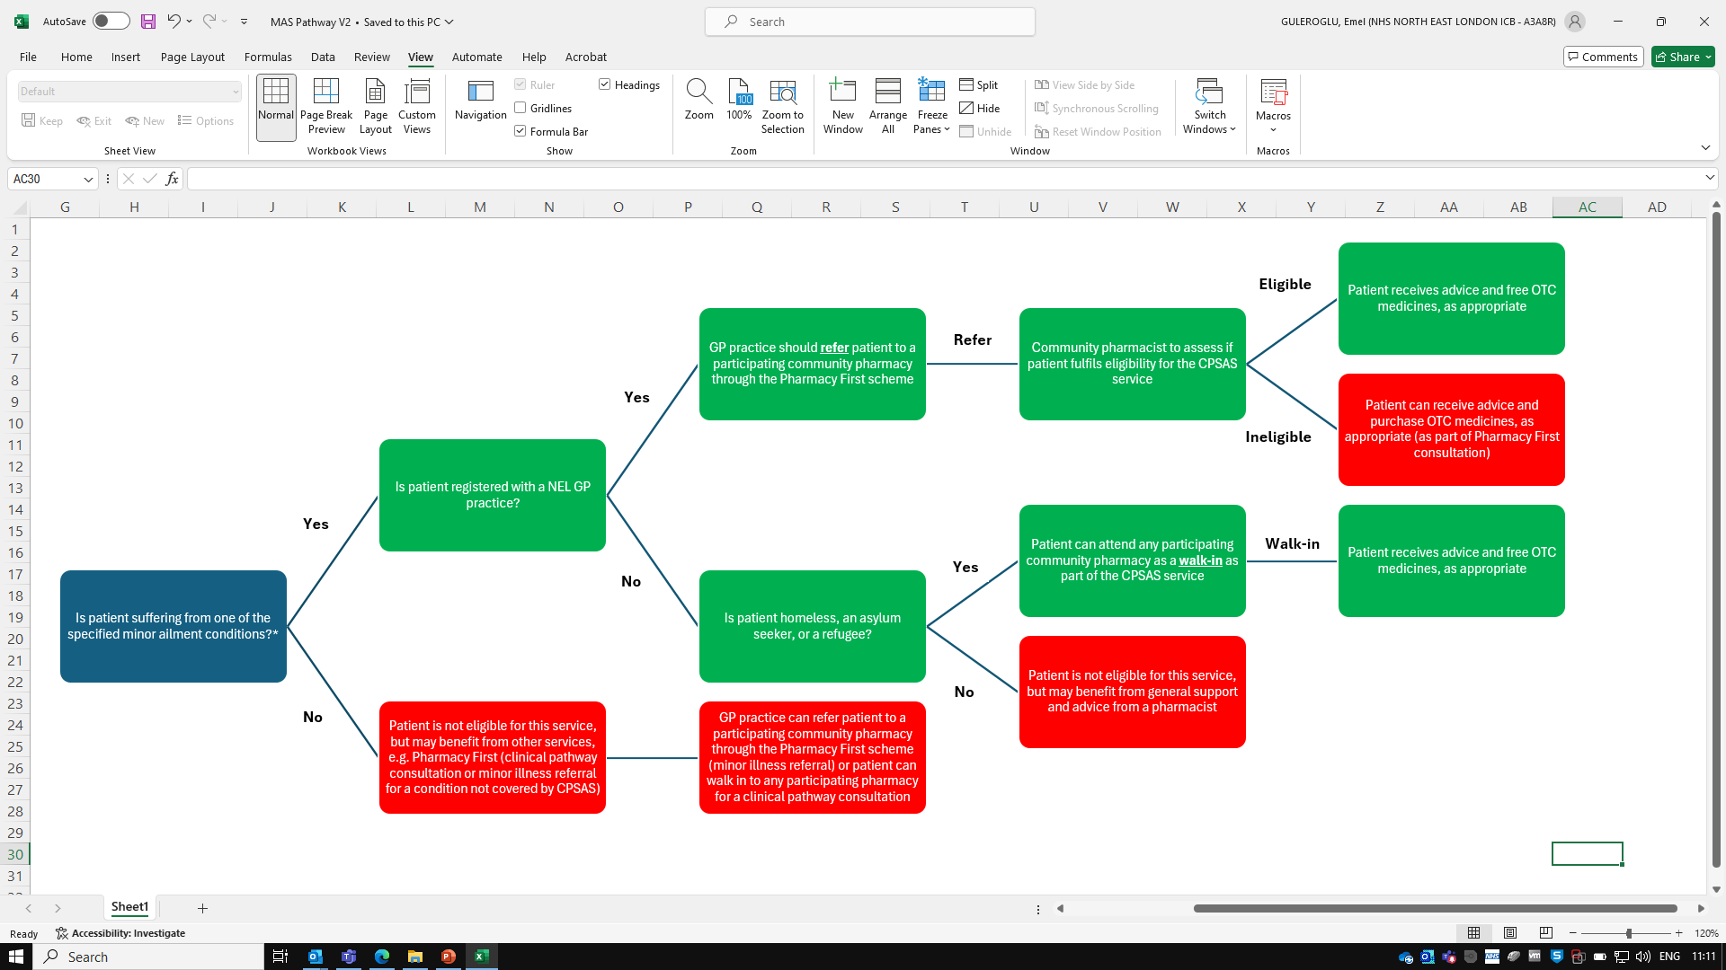
CPSAS Service Pathway
*Refer to next slide for the list of conditions covered by the service

Slide 14
Conditions Covered
Athlete’s foot
Back pain/musculoskeletal pain
Conjunctivitis
Constipation
Contact dermatitis
Diarrhoea
Fever (pyrexia)
Haemorrhoids
Hay fever
Headache
Head lice
Indigestion/heartburn
Insect bites and stings
Nappy rash
Paediatric fever/teething/pain
Primary dysmenorrhoea (period pain)
Ringworm
Scabies
Soft tissue injury
Oral thrush
Threadworm
Toothache
Vaginal thrush
Warts and verrucae
(NB. The conditions in red font were previously not covered by the C&H HFP MAS service.)

Slide 15
Patient Eligibility Criteria
Walk-in eligibility: Only for patients who are Homeless, Asylum Seekers or Refugees based in North East London, who are either not registered with a GP practice or registered with a NEL GP practice, but unable to access easily. (Overseas visitors will not be eligible for this service)
GP referral eligibility:
  All referred patients must be registered with a NEL GP practice
  Patients under 16 years, who have at least one parent who would be eligible for this service
  Patients who are 16, 17 or 18 years old, in full-time education, AND have at least one parent who would be eligible for this service
  All young people who are under the care of the Local Authority
  Young care leavers, aged 16-25 years old
  Patients who are receiving Universal Credit and whose income is at a level where they are eligible for free prescriptions. Patients receiving any other benefits, which give them eligibility for free prescriptions
  Patients who are Homeless, Asylum seekers or Refugees
  Patients eligible for full help (HC2 certificate) under the NHS Low Income Scheme (LIS). LIS eligibility also extends to the partner and any young dependants.
  Patients with a Prescription Exemption Certificate issued by the Ministry of Defence (note that this will normally only offer exemption for an accepted disablement, as specified on the exemption certificate)

Slide 16
Why Not Walk-in for All Patients?
The minor illness element of the national Pharmacy First service can only be accessed via referrals (from GP practices, NHS 111, 999 services, or other urgent and emergency care provider)
This service will help to reduce the risk of patients referred to the Pharmacy First service bouncing back to their GP practices for ‘free prescriptions’ if they cannot afford to purchase OTC medicines recommended by the pharmacist
A walk-in for all patients would also not be financially viable within the financial envelope available for this service
Activity, expenditure and feedback from this service will be monitored closely as part of the planned evaluation, to assess what level of walk-in elements could be incorporated into potential future iteration of this scheme

Slide 17
Participating Pharmacies
GP practices will be notified of participating community pharmacies by the ICB
The aim is for all pharmacies delivering Pharmacy First to also offer the CPSAS
The ICB anticipates universal pharmacy signup from NEL pharmacies

Slide 18
Medicines Formulary
Community pharmacists will be able to provide free-of-charge OTC medicines to eligible patients for specific minor illnesses, as outlined in the medicines formulary (see Appendix)
Patients may receive more than one medicine for a specific condition, if this is considered appropriate by the pharmacist, e.g. loperamide + oral rehydration salts for diarrhoea
Medicines will only be supplied for infrequent minor illnesses. Requests for repeat supplies could indicate a long-term condition that may require investigation and management by a patient’s GP

Slide 19
Referral to Other Services & Resources
Community Pharmacists will also signpost patients to other local or national services and selfcare resources, as appropriate
Local services may include smoking cessation, sexual health, contraception services.
National services may include hypertension case-finding, contraception services, or other elements of Pharmacy First

Slide 20
Referral back to GP Practices
Community Pharmacists may refer patients back to their GP practices in the following situations:
  Patients with a co-morbidity or drug interaction, which may require alternative treatment or closer monitoring
  Patients presenting for frequent repeat supplies for a specific minor illness (as may be indicative of a long-term condition requiring management by GP)
  Patients presenting with any relevant ‘red flags’ such as symptoms associated with sepsis, meningitis or cancer will also be referred to their GP or A&E for urgent investigation and management
Walk-in patients not registered with a GP practice will also be encouraged to register with a GP practice

Slide 21
Communication between Community Pharmacies and GP Practices
A summary of the referred patients episode of care will be sent back to the practice via GP Connect or NHSmail.
In the absence of an automated digital solution, or if there is a temporary problem with the system, communication should be sent via NHSmail or hard copy

Slide 22
Comparison with other Services
 | NEL CP Selfcare Advice Service | NEL C&H Health First Pharmacy minor ailment scheme | Pharmacy First
Patient access to the service | Primarily GP referral (walk-in only for patients who are homeless, asylum seekers, or refugees) | GP referral or walk-ins | Referral only for minor illness element (from GP, A&E or NHS 111) Walk-in only for clinical pathway consultation for the 7 common conditions
No. of minor illness conditions covered | 24 | 21 | No restricted list of conditions (list of symptoms)
Free OTC medicines supply for eligible patients | Yes | Yes | No
Free POM medicines supply for eligible patients | No (Service only covers supply of OTC medicines) | No | Yes (For patients with Rx exemption seen for one of the 7 common conditions)

Slide 23
Service Evaluation
NEL ICB will work alongside Imperial SCARU (Self-Care Academic Research Unit) as our evaluation provider to assess and monitor service delivery, outcomes and KPIs
Community pharmacists, GP practice staff, and patients will be contacted for input and feedback, as appropriate
Evaluation methods may include surveys, interviews, and focus groups

Slide 24
Contacts and Queries
Service queries/issues – Should be directed to the NEL ICB Medicines Optimisation team. Please do NOT send patient identifiable information (nelondonicb.medicinesoptimisationenquiries@nhs.net)
Complaints – Pharmacy providers should follow their own internal procedures for dealing with complaints, but any service specific issues should be reported to NEL ICB (Advice, compliments and complaints - NHS North East London (icb.nhs.uk))
Incident reports – Pharmacy providers and GP practices must report patient safety incidents to NEL ICB through the national LFPSE (Learn From Patient Safety Events) online reporting service (NHS England » Learn from patient safety events (LFPSE) service)
Media/press enquiries – Should be directed to the NEL ICB team for a formal response (nelondonicb.medicinesoptimisationenquiries@nhs.net)

Slide 25
Thank you
Any Questions?

Slide 26
Appendix 1. Deprivation Data
NEL Deprivation Data by Place/Borough:
NEL Place | Registered Population | Healthy Life Expectancy (cf. England average) | Deprivation Ranking in England (Across all domains) | Deprivation Ranking in England (In Barriers to Housing & Services domain) | % of Children in Absolute Low Income Families | A&E Attendance in Children Under 5 Years (per 1,000)
Newham | 427,000 | Females: ↓ (56.8 yrs) Males: ↓ (59.6 yrs) | 43 | 1 | 22.3% | 821
Tower Hamlets | 354,000 | Females: ↓ (59.4 yrs) Males: ↔ (62.6 yrs) | 50 | 24 | 22.1% | 669
Waltham Forest | 322,500 | Females: ↑ (69.7 years) Males: ↔ (64 years) | 82 | 7 | 19.7% | 728
City & Hackney | 330,000 | Females: ↓ (58.8 yrs) Males: ↓ (58.6 yrs) (Figures for Hackney) | 22 (Hackney) 212 (City of London) | 4 (Hackney) 10 (City of London) | 17.8% (Hackney) | 617
Barking & Dagenham | 235,000 | Females: ↓ (59.2 yrs) Males: ↓ (58.4 yrs) | 21 | 2 | 22.5% | 628
Havering | 283,000 | Females: ↑ (64.5 years) Males: ↑ (65.2 years) | 180 | 136 | 14.1% | 498
Redbridge | 339,000 | Females: ↔ (63.7 yrs) Males: ↔ (62.8 yrs) | 173 | 36 | 16.5% | 603
Notes | Population registered with a NEL GP (April 2021) | England average is: 63.5 yrs for females 63.2 yrs for males | Ranking out of 312 local authorities in England (where 1 is greatest deprivation) | Ranking out of 312 local authorities in England (where 1 is greatest deprivation) | England average is 15.6% | England average is 670 per 1,000
NB. NEL population data based on 2021 figures, taken from the NELHCP Population Health report (May 2022) available here: Population health profiles - North East London Health & Care Partnership (northeastlondonhcp.nhs.uk)

Slide 27
Background – Community Pharmacies
NEL Place | Number of Pharmacies (March 2024) | Registered Population (April 2021) | Pharmacies per 100,000 Population | Local Services Provided by Pharmacies
Newham | 71 | 427,000 | 16.6 | Emergency hormonal contraception, End of life care, Needle exchange, Smoking cessation, Condom provision, STI screening, Latent TB service, Asthma & air quality
Tower Hamlets | 50 | 354,000 | 14.1 | Emergency hormonal contraception, End of life care, Needle exchange, Supervised consumption, Smoking cessation, Condom provision, STI screening
Waltham Forest | 59 | 322,500 | 18.3 | Emergency hormonal contraception, End of life care, Needle exchange, Supervised consumption, STI screening
City & Hackney | 58 | 330,000 | 17.6 | Emergency hormonal contraception, Needle exchange, Supervised consumption, Smoking cessation, STI screening, Healthy Start vitamins
Barking & Dagenham | 38 | 235,000 | 16.2 | Emergency hormonal contraception, End of life care, Supervised consumption
Havering | 44 | 283,000 | 15.5 | Emergency hormonal contraception, End of life care, Needle exchange, Supervised consumption, Smoking cessation
Redbridge | 53 | 339,000 | 15.6 | Emergency hormonal contraception, End of life care, Needle exchange, Supervised consumption, Smoking cessation, STI screening
TOTAL | 373 | 2,290,500 | 16.3

Slide 28
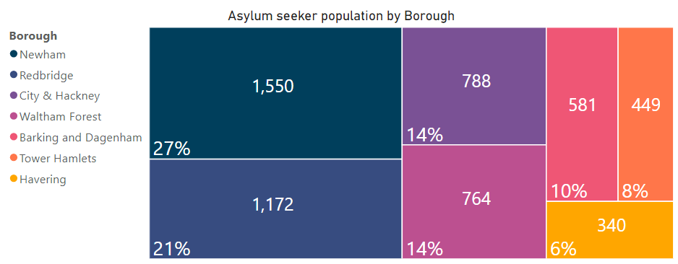
Appendix 2. Asylum Seekers Data
As of March 2023, there were 5,644 asylum seekers in NEL. Nearly half (49%) live in contingency hotels, 44% in dispersal and 7% in subsistence accommodations across NEL.
Please note: The data above relates to people seeking asylum via the Home Office. This, therefore, excludes refugees with no recourse to public funds and those not documented in the system.
Data Source: Home Office - Immigration System Statistics (March 2023)

Slide 29
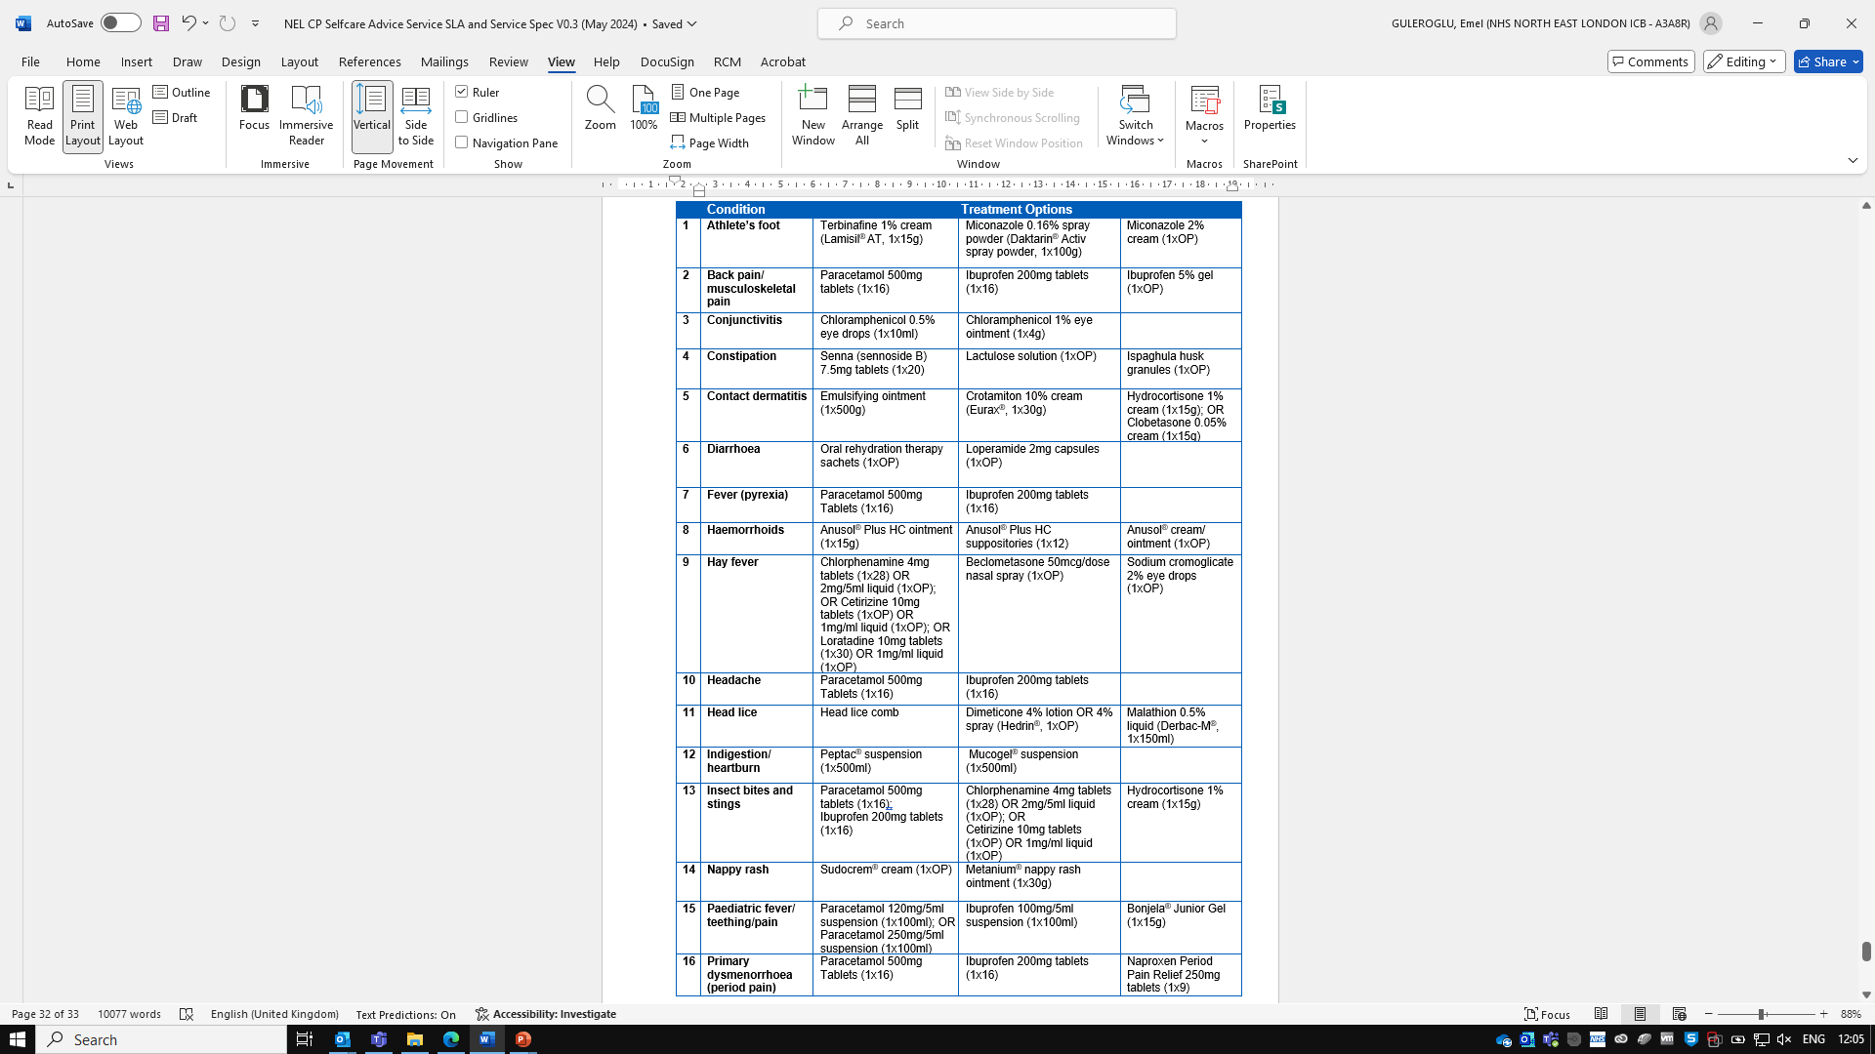
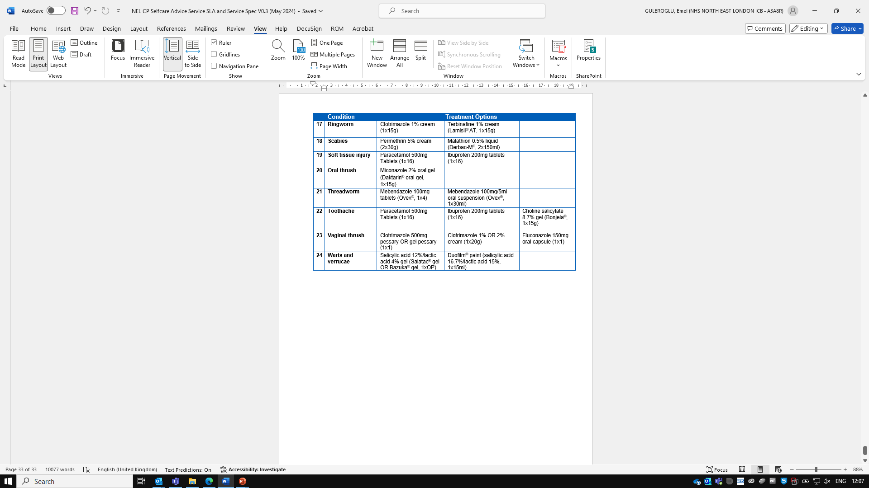
Appendix 3. Medicines Formulary

Slide 30
Pharmacy Payments
For transparency, the payments that pharmacy contractors may claim for are detailed below:
Item | NEL Payment
Consultation fee for walk-ins (Homeless, asylum seekers or refugees only) | £8.00 per consultation
Consultation fee for GP referrals | £0.00 (Pharmacy contractors to claim through Pharmacy First service)
Additional admin fee for supply of free OTC medicines to eligible patients (for both walk-ins and GP referrals) | £2.00 per consultation (Irrespective of number of medicines supplied)
Reimbursement for cost of OTC medicines supplied | Reimbursement as per Drug Tariff (or Chemist & Druggist) cost (plus VAT, where applicable)

