Slide 1
Development & Launch of NHS-Industry Partnership Guidance

Slide 2
Scene Setting & Timeline of NHS-Industry Partnership Guidance
2008 - Introduction of Joint Working
May 2019 - Simplifying cross-sector working between NHS Integrated Care Systems, Sustainability and Transformation Partnerships and industry: Guidance on governance and process
April 2022 -Working Together – A guide for the NHS, Healthcare Organisations and Pharmaceutical Companies
August 2010 - Moving Beyond Sponsorship – Joint Working Between the NHS and Pharmaceutical Industry
2012 - Joint Working – A Quick Start Reference Guide for NHS and Pharmaceutical Industry Partners
12 June 2024 - ABPI/NHS Confederation NHS-Industry Partnership Guidance Toolkit
February 2008 - Best Practice Guidance on Joint Working Between the NHS and Pharmaceutical Industry and Other Relevant Commercial Organisations
2012 - 2016
November 2023 – Working with the Pharmaceutical Industry (Cheshire & Merseyside ICS guidance)
September 2019 – Joint Working – A toolkit for industry and the NHS
2008 - 2012
2016 - 2020
2020 - 2024
2008 ABPI Code of Practice
2012 ABPI Code of Practice
2016 ABPI Code of Practice
2019 ABPI Code of Practice
2021 ABPI Code of Practice
(Introduction of Collaborative Working)
2024 ABPI Code of Practice

Slide 3
Timeline of Guidance Development & Publication
March 2024 – Held three NHS Confederation and ABPI roundtables to operationalise partnership working across primary, secondary and system levels. Over 13 local NHS leaders participated in these discussions (including four PCN leads).
May 2024 – Review of draft guidance by participants of roundtables the PMCPA and NHSE, with feedback incorporated
February 2024 – Extensive literature review of existing NHS-Industry Partnership Guidance to inform the development of new guidance.
April 2024 – Guidance drafted, consolidating existing guidance and the findings of the three roundtables.
June 12 2024 – Publication of Guidance and showcasing at ConfedExpo

Slide 4
Participants from Roundtable Discussions
Name | Role | Organisation
Amit Patel | Chief Executive Officer | Community Pharmacy South West London
Anna Carratt | Deputy Director of Strategic Development | North East London ICS
Brian Duggan | Strategic Partnership Policy Director | ABPI
Clair Huckerby | Chief Pharmacist, Consultant Pharmacist Primary Care | Our Health Partnership
Donal Sutton | Assistant Director, Industry Engagement and Policy | NHS Confederation
Dr Jeanine Smirl | GP and Clinical Director | Norwich PCN
Dr Paul Stevens | Consultant Nephrologist and Medical Examiner | East Kent Hospitals University NHS Foundation Trust
Dula Alicehajic-Becic | Consultant Pharmacist | Wigan Infirmary
Farrah Ahmad | NHS Collaboration Partner | Daiichi Sankyo
Helen Hoyland | Head of Commercial Innovation and Growth | Health Innovation Network Yorkshire
James Thomas West | Medical Director | West Yorkshire Integrated Care Board
Jennifer Gilroy-Cheetham | Senior NHS Engagement Manager | Chiesi
John Byrne | Medical Officer | South West London ICB
Kelly McCormick NHS | NHS Engagement and Access Manager | Sanofi
Louise Organista | Advanced Clinical Pharmacist | University Hospitals of Derby and Burton NHS Foundation
Michael Smith | Chief Executive | Bolton GP Federation
Mike Stansfield | Market Access Project Support Manager | Sanofi
Nabil Rastani | Strategic Partnership Policy Manager | ABPI
Rakesh Marwaha | Managing Partner and Chief Executive | Erewash PCN
Rory Deighton | Director, Acute Network | NHS Confederation
Ross Rotherham | Health System Engagement Lead | Boehringer Ingelheim
Sarika Passi | National Oncology Projects | MSD
Su Jones | Collaborative Working Owner | AstraZeneca
Sue Consterdine | Associate Director, NHS Partnership and Strategy Lead | Bristol Myers Squibb
Tracey Palmer | Oncology Business Manager | Lancashire Teaching Hospitals NHS Foundation Trust

Slide 5
Based on ABPI member and NHS feedback this new guidance…
Updates made to Guidance | Description
Consolidates Guidance on Partnership Working to support NHS organisations | This guidance consolidates and supersedes existing NHS-Industry guidance in place. It also means that the 42 ICSs do not need to develop their own guidance, as they had historically done and instead refer to one definitive document. It also received approved by the NHS Chief Pharmaceutical Officer and PMCPA ensuring it received credibility and support from key stakeholders.
Provides a Breakdown of the ABPI Code of Practice | Feedback from ABPI and NHS Confederation colleagues has suggested that there is a need for us to incorporate more detailed language around the role of the ABPI Code of Practice in serving as a guardrail when undertaking NHS-Industry Partnerships.
Produces Clear Supporting Frameworks | Develop a set of clear framework template forms to support local NHS organisations in understanding collaborative/joint working agreements.
Inclusion of Clear Case Studies | Existing guidance lacks clear case studies, which practically methodise the process of identifying, implementing, and monitoring partnerships. This new guidance will incorporate three examples from across primary, secondary, and system workings to address this.

Slide 6
Content in the NHS-Industry Partnership Guidance
The guidance takes the reader through the life cycle of partnership through the following sections:
Section | Description
What are NHS-Industry Partnerships? | This section describes the two key forms of NHS-Industry partnerships – collaborative working and joint working projects. It also describes the role of the ABPI Code of Practice in serving as a guardrail by which partnerships take place.
Stage 1 – Project Identification and Scoping | This section highlights how a partnership begins, with NHS and industry organisations needing to identify unmet needs to support clinical outcomes. It also describes the key avenues that exist when identifying a potential project across care settings.
Stage 2 – Project Setup and Governance Structures: | The second section explores the governance frameworks needed to establish a partnership. It emphasises the importance of forming a project team that includes representatives from all parties. The section also provides recommendations for engaging stakeholders, particularly those who may be directly or indirectly impacted by the project.
Stage 3 – Project Implementation and Outcomes Reporting | The final section breaks down the delivery and evaluation of a project. This includes the need for continuous monitoring and reporting of the report which requires all parties to publish the project's outcomes within six months of completion, as per the ABPI Code of Practice.
Case Studies & Framework Templates | The guidance includes several case studies illustrating the practical steps of identifying, implementing, and monitoring a prospective partnership. It also contains helpful framework with examples of good practice templates essential for any effective partnership.

Slide 7
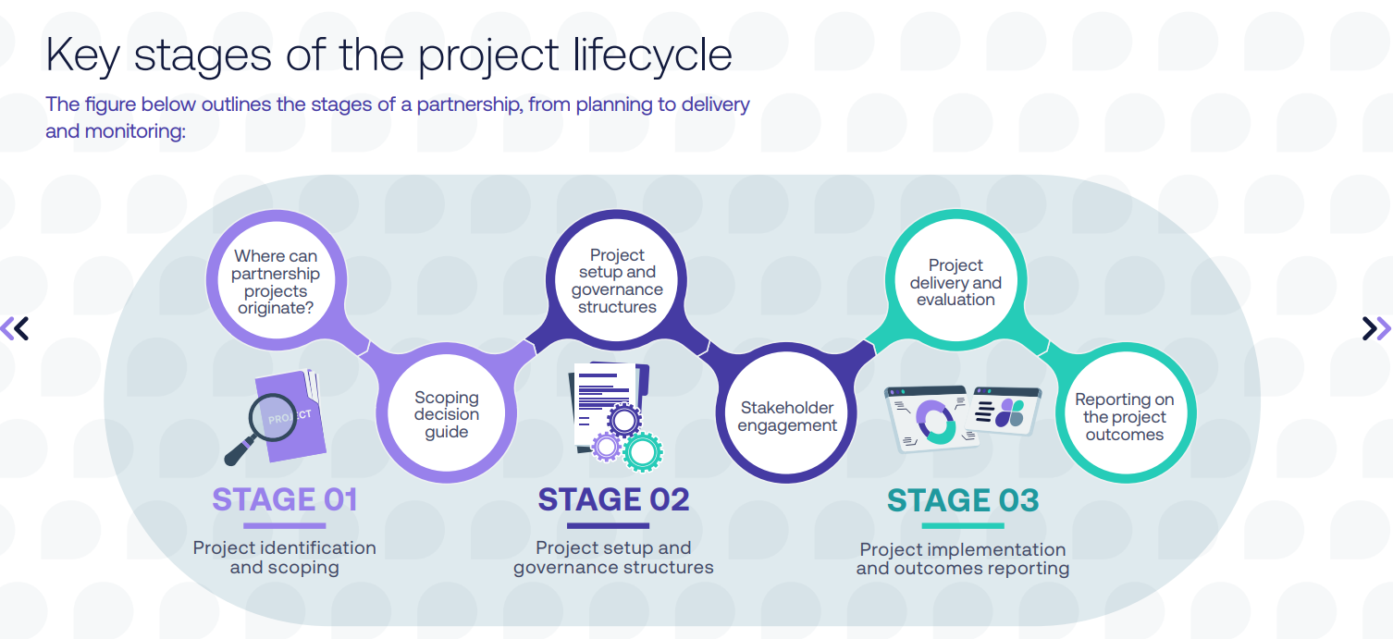
Content in the NHS-Industry Partnership Guidance

Slide 8
Example of NHS-Industry Partnership at a Primary Care Network Level
Background:
AstraZeneca and Hartlepool Health PCN partnered on a project to support patients with chronic obstructive pulmonary disease (COPD). As there was an unmet clinical need, with higher than national COPD prevalence and Hartlepool Health PCN was ranked as having the third highest for hospital admissions. The project focused on funding time for COPD nurses to conduct COPD reviews and support upskilling of staff.
It also looked to:
improve adherence from multiple inhaler triple therapy to single inhaler triple therapy
identify and review patients with cardio-pulmonary risk factors
Project Identification & Monitoring:
AstraZeneca had a relationship with a respiratory nurse regarding education and information, and this helped facilitate the partnership.
The project was monitored through fortnightly meetings against KPI’s of the joint working agreement.
Project Outcomes:
252 COPD patients were reviewed over the project duration.
There was a 60% improvement in the number of patients with a COPD care plan and 71% of patients had an improvement in COPD assessment test scores.

Slide 9
Launch & Dissemination

Slide 10
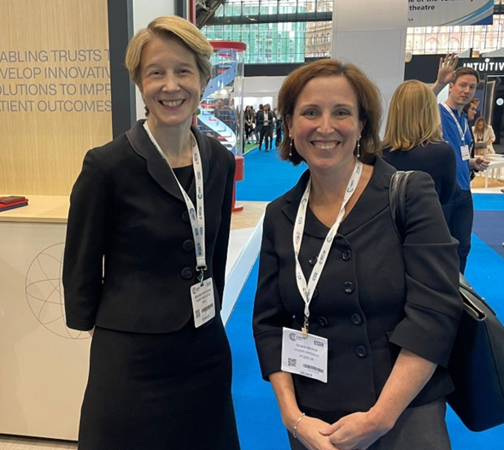
NHS-Industry Partnership Guidance – Launch & Dissemination
On 12th June, the NHS-Industry Partnership Guidance was formally launched at the NHS ConfedExpo in Manchester.
As part of this initiative, an "In-Conversation Zone" event was held.
The event demonstrated the value of the guidance in supporting local NHS organisations and highlighted the positive impact partnerships can have on improving patient outcomes and NHS efficiencies.
The session was attended by over 150 delegates.

Slide 11
Launch & Dissemination
After the report was published, it was distributed through bulletins and networks by the stakeholders listed below, with continued engagement ongoing:
Health Stakeholders | NHS Stakeholders
NHS Confederation – ICS Bulletin (19.06.24) | NHSE Healthcare Leaders Update (17.06.24)
PIFTICK (19.06.24) | NHS Confederation – ConfedExpo Update (12.06.24)
The King’s Fund Bulletin (25.06.24) | NHS Confederation – ICS Bulletin (19.06.24)
Taskforce for Lung Health (26.06.24) | NHSE Genomics Bulletin (June 2024)
Academy of Medical Royal Colleges (28.06.24) | NHSE Procurement Transformation Bulletin (June 2024)
Office for Life Sciences (09.08.24) | NHSE Primary care Bulletin (June 2024)
 | NHSE Transformation Bulletin (June 2024)
 | NHSE Integrated Care Bulletin (June 2024)
 | NHSE IMPACT Bulletin (June 2024)
Notes:
The event was attended by over 140 NHS ConfedExpo delegates and speakers included:
Susan Rienow, President, ABPI
Sarah Walter, Director, ICS Network, NHS Confederation - NHS Confederation
Pauline Hakutangwi, Value and Access Marketing Manager - Novartis UK
Will Browne, Chief Technology Officer – Carnall Farrar
ICS Bulletin goes out to just over 1,000 ICS members and the Daily Bulletin goes out to around 2,000 wider members across Confed.
Other NHSE bulletins
Genomics
Procurement transformation
Primary care
Transformation
Integrated care
NHS IMPACT

Slide 12
Training & Upskilling Sessions
To support the implementation of the guidance at a national, member and system level, the ABPI have arranged a number of upskilling sessions in the coming months:
National Level Training | System Training
NHSE Commercial Oversight Group – Including Fiona Bride (Director, Medicines, Value and Access, NHSE) Jack Turner (Deputy Director, Commercial Medicines Access Policy, NHSE), and Claire Foreman (Director of Medicines Policy and Strategy, NHSE (10 July) | NHS Confederation Members Training Session (20 November)
Office of Life Sciences Briefing (31 July) | Health Innovation Network Training Session (21 November)
NICON (16 October)
Welsh NHS Confederation (6 November)
National Healthcare Inequalities Improvement Programme Training Session (TBC)

Slide 13
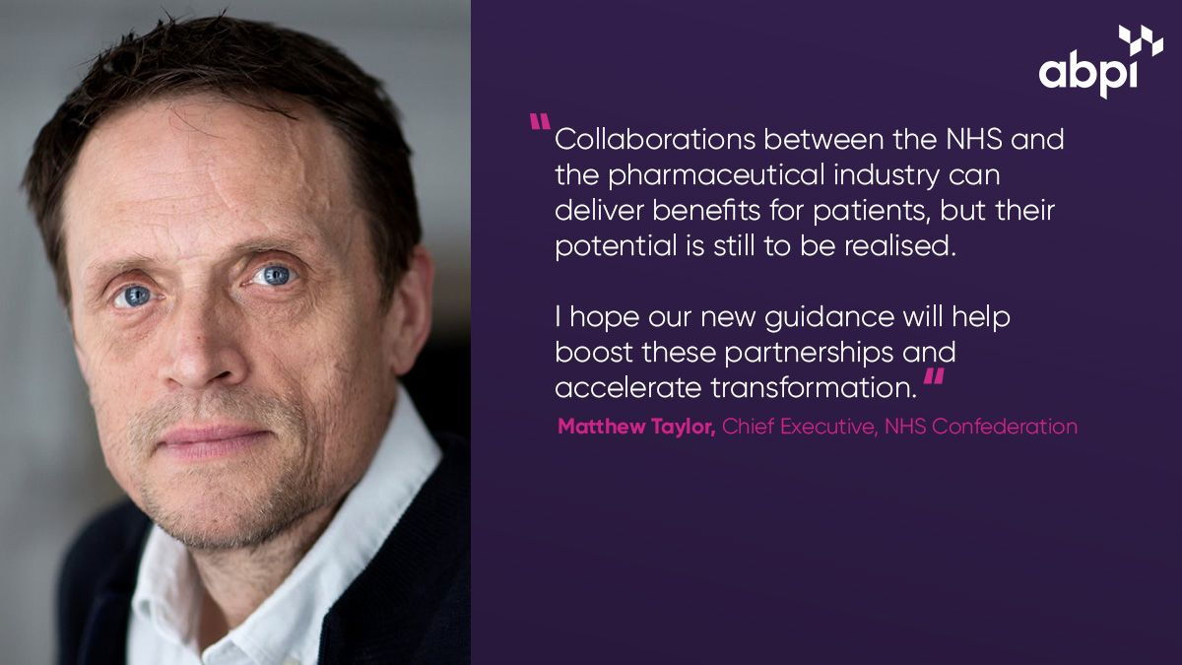
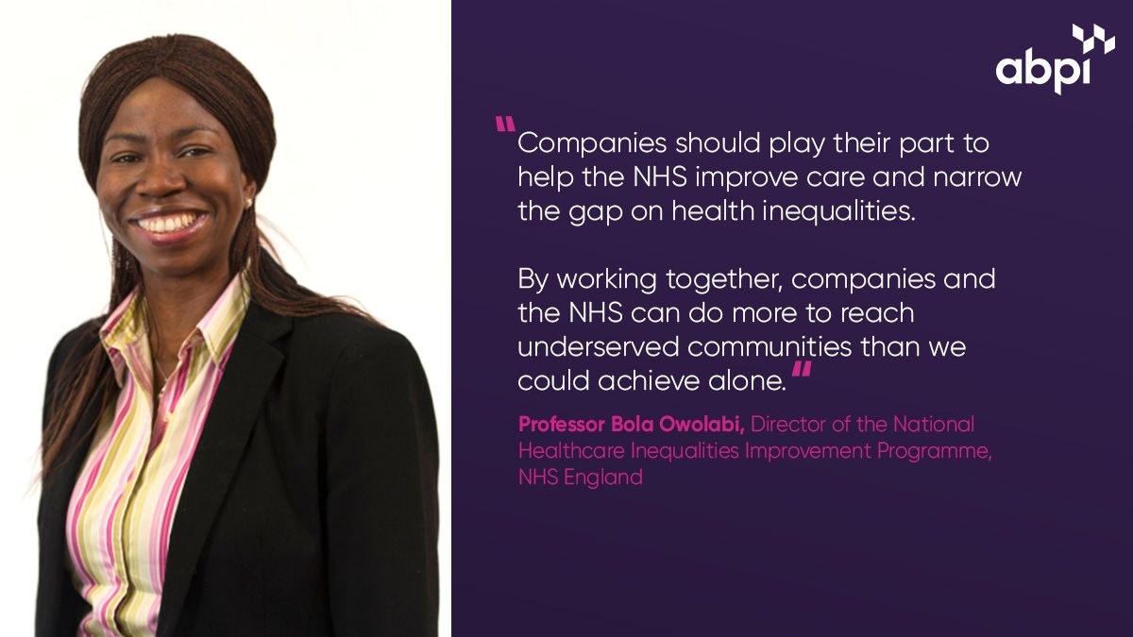
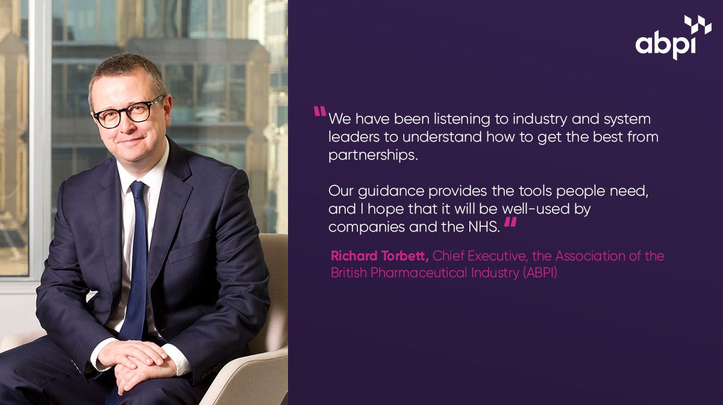
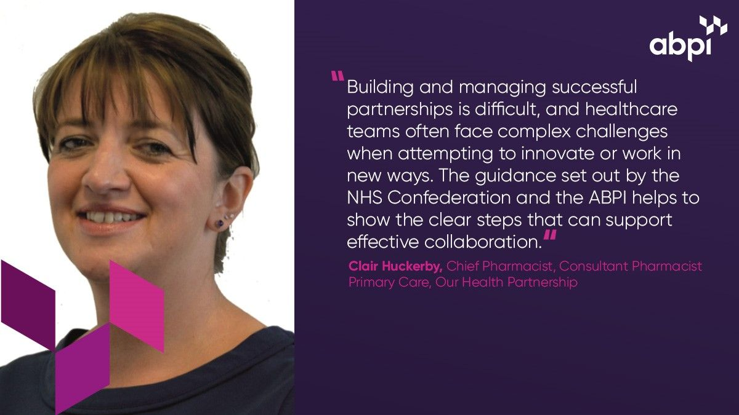
Responses to Guidance & Dissemination – #powerofpartnerships campaign
Notes:
Overall, the power of partnerships campaign has resulted in over 19,000 interactions across social media platforms and has led to 40% higher clickthrough's to the guidance compared to other ABPI publications, the campaign is still very much underway so these are preliminary figures that are constantly evolving. The ABPI team are also contacting additional stakeholders, such as NHSE and HIN leaders for further endorsement quotes.

Slide 14
Responses to Guidance & Dissemination – #powerofpartnerships campaign
ABPI Director Amit Aggarwal posts | NHS pharmacy leader Clair Huckerby posts |  | ABPI Board member MA posts
X/Twitter - https://x.com/ABPI_UK/status/1820747561935736953 LinkedIn - https://www.linkedin.com/feed/update/urn:li:activity:7226513888857460736 Instagram - https://www.instagram.com/p/C-UrCxRoOLL/?utm_source=ig_web_copy_link&igsh=MzRlODBiNWFlZA== | XTwitter - https://x.com/ABPI_UK/status/1821208897606025299 LinkedIn - https://www.linkedin.com/posts/abpi_powerofpartnerships-activity-7226975208820092930-OGS_?utm_source=share&utm_medium=member_desktop Instagram - https://www.instagram.com/p/C-X8fg2oDWU/?utm_source=ig_web_copy_link&igsh=MzRlODBiNWFlZA== |  | XTwitter - https://x.com/ABPI_UK/status/1821496890979938611 LinkedIn - https://www.linkedin.com/posts/abpi_powerofpartnerships-activity-7227263218929283072-WfR-?utm_source=share&utm_medium=member_desktop Instagram - https://www.instagram.com/p/C-Z_SdMIJ1H/?utm_source=ig_web_copy_link&igsh=MzRlODBiNWFlZA==
Novartis case study posts | NHS leader Bola Owolabi posts |  | ABPI Board member Ben Lucas
X/Twitter: https://x.com/ABPI_UK/status/1821848170244018374 LinkedIn: https://www.linkedin.com/feed/update/urn:li:activity:7227614266348974080 Instagram: https://www.instagram.com/reel/C-cezvRKuVA/?utm_source=ig_web_copy_link&igsh=MzRlODBiNWFlZA== | XTwitter - https://x.com/ABPI_UK/status/1822938572091007172 LinkedIn - https://www.linkedin.com/posts/abpi_powerofpartnerships-activity-7228704955937804289-rm7r?utm_source=share&utm_medium=member_desktop Insta - https://www.instagram.com/abpi_uk/p/C-kO7Z_oO_z/?utm_source=ig_web_copy_link&igsh=MzRlODBiNWFlZA== |  | XTwitter - https://x.com/ABPI_UK/status/1823376934534881447 LinkedIn - https://www.linkedin.com/posts/abpi_powerofpartnerships-activity-7229143310584418305-cNVW?utm_source=share&utm_medium=member_desktop Instagram - https://www.instagram.com/p/C-nXVnYIMff/?utm_source=ig_web_copy_link&igsh=MzRlODBiNWFlZA==
MSD case study posts | Ed Piper AstraZeneca posts |  | ABPI Chief Exec Richard Torbett posts
XTwitter: https://x.com/ABPI_UK/status/1823685823751184866 LinkedIn: https://www.linkedin.com/posts/abpi_powerofpartnerships-activity-7229452761321345025-VJy5?utm_source=share&utm_medium=member_desktop Instagram: https://www.instagram.com/reel/C-pt4wjK2Km/?utm_source=ig_web_copy_link&igsh=MzRlODBiNWFlZA== | XTwitter: https://x.com/ABPI_UK/status/1824077641902678043 LinkedIn: https://www.linkedin.com/posts/abpi_powerofpartnerships-activity-7229844026881888256-d5Dw?utm_source=share&utm_medium=member_desktop Instagram: https://www.instagram.com/p/C-u6xb8IV1y/?utm_source=ig_web_copy_link&igsh=MzRlODBiNWFlZA== |  | XTwitter - https://x.com/ABPI_UK/status/1825857194908127672 LinkedIn - https://www.linkedin.com/posts/abpi_powerofpartnerships-activity-7231623397418373120-dMOJ?utm_source=share&utm_medium=member_desktop Instagram - https://www.instagram.com/p/C-4-LmLoiF5/?utm_source=ig_web_copy_link&igsh=MzRlODBiNWFlZA==
NHS Confederation Chief Exec Matthew Taylor posts | Richard Stubbs, Chair, Health Innovation Network
XTwitter: https://x.com/ABPI_UK/status/1826164658656452780 LinkedIn: https://www.linkedin.com/posts/abpi_as-matthew-taylor-says-nhs-industry-partnerships-activity-7231930996734992384-c9WP?utm_source=share&utm_medium=member_desktop Instagram: https://www.instagram.com/p/C-7J-OXIQGY/?utm_source=ig_web_copy_link&igsh=MzRlODBiNWFlZA== | XTwitter: https://x.com/ABPI_UK/status/1828827510169292910 LinkedIn: https://www.linkedin.com/posts/abpi_health-innovation-network-chair-richard-stubbs-activity-7234593868413820928-hkQI?utm_source=share&utm_medium=member_desktop Instagram: https://www.instagram.com/reel/C_OE_sAqSds/?utm_source=ig_web_copy_link&igsh=MzRlODBiNWFlZA==
Notes:
Mention that we are looking at having a webinar with Confed later this year to help embed the guidance
Confirmed webinar with the Health Innovation Networks in November
Confirmed webinar with the National Healthcare Inequalities Improvement Programme at NHS England
Discussions held over possible OLS ministerial site visit

Slide 15
Open Discussion: NHS-Industry Partnerships in Primary Care Settings

Slide 16
Open Discussion: NHS-Industry Partnerships in Primary Care Settings
Improving Understanding of Partnership Working at a PCN level:
What additional work can be done to improve understanding and awareness among PCNs regarding the guidance and partnership working? Are there any forums we could attend to support this?
Clinical Leaders:
How can we further enhance the understanding of this guidance among NCDs?
What further steps can be taken to engage with the Royal Colleges to ensure a comprehensive understanding of the guidance and its effective use?
In addition to collaborating with the NHS Confederation, how can we directly engage with relevant ICB clinical leaders to ensure they feel empowered to implement this guidance?
ABPI Case Study Library:
How can PCNs learn from examples of successful projects (such as those on the ABPI Case Study Library) in undertaking their own partnerships?

