Slide 1
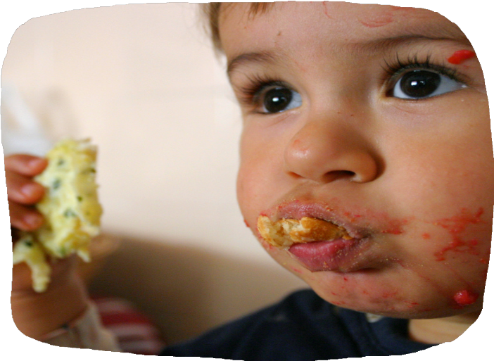
Cow’s Milk Allergy
Toni Russell , Child Healthy Weight Advisor
Tower Hamlet GP Care Group
Child Healthy Weight and Infant Feeding Team
Tower Hamlets GP Care Group, School Health & Wellbeing Team
Notes:
Afternoon everyone,
My name is Toni Russell, I am one of the child healthy weight advisors working within the tower hamlets GP CareGroup and also working very closely with Public Health.
Today I will be presenting on cows milk allergy, there will be some case studies involved within the presentation, so hopefully that will help to engage everyone. But please do feel free to pop your questions in the chat box and we can go through any at the end and I will try my best to answer them.

Slide 2
Overview
Cows milk allergy (CMA) and symptoms
Management of CMA
Appropriate prescribing of infant formula
Moving on from formula and iMAP milk ladder
Notes:
So this is a brief overview of what we will be covering, and the session is about 45 minutes long and that leaves some time for questions and discussion at the end.
we will be going through each topic step by step and I've split it into four sessions.
Firstly we will go through CMA background and the symptoms
Section 2 will be around the management of CMA and looking into allergy tests.
Section 3 will appropriate prescribing of hypoallergenic formulas.
and lastly we will discuss moving on from infant formula and the iMAP milk ladder

Slide 3
CMA Background
Cow’s milk allergy is an immune response to the proteins found in cow’s milk
Not to be mistaken for lactose intolerance (managed differently to CMA)
2-5% of infants in the UK have a CMA – 0.5% exclusively breastfeeding
Prognosis is good
Over diagnosis > can have huge impact on mother and baby, particularly if breast feeding
2-5%
Notes:
So just a little bit of background: CMA is an immune response to the proteins found in cows milk and it can sometimes become confused with lactose intolerance – especially for the parent, so important to get the terminology right and not label it as an intolerance.
Lactose intolerance is the inability to digest lactose and it is quite rare. It is not often seen in infants under 5 years old. Symptoms would include: diarrhoea, abdominal bloating and wind. It is managed very differently to CMA, as lactose would be excluded from the diet... not the milk protein.
It is estimated around 2-5% of children in the UK have a CMA, and only 0.5% of exclusively breast fed babies have CMA. So you can see that exclusively breast fed babies are very unlikely to have CMA.
Prognosis is good
45-50% by 1 year
60-75% at 2 years
85-95% at 3 years
Important to relay this to the parent to manage anxiety
Over diagnosis is common, and this can have a negative impact on parents and the child, in particular breastfeeding mothers and babies.
We also know that fewer that 1 in 5 families receive support from a dietitian

Slide 4
Classification of Food Allergies
IgE Mediated (Immediate)
Non-IgE Mediated (Delayed)
Symptoms can present from 2 hours to days
Delayed symptoms does not mean it is an intolerance
Typically present with several, persistent and troublesome symptoms
Symptoms can present from seconds to 2 hours
Notes:
So looking at the classification of food allergies....immune related food allergy can be split into IgE mediated or non IgE mediated.
IgE mediated is an immediate reaction with symptoms presenting within seconds up to 2 hours after the ingestion of an allergenic food, whereas non IgE mediated allergy is a delayed response with symptoms typically presenting from 2 hours to 3 days after consumption.
We will mostly be focusing on non IgE mediated cows milk allergy throughout this session as this is the allergy that is managed in primary care.

Slide 5
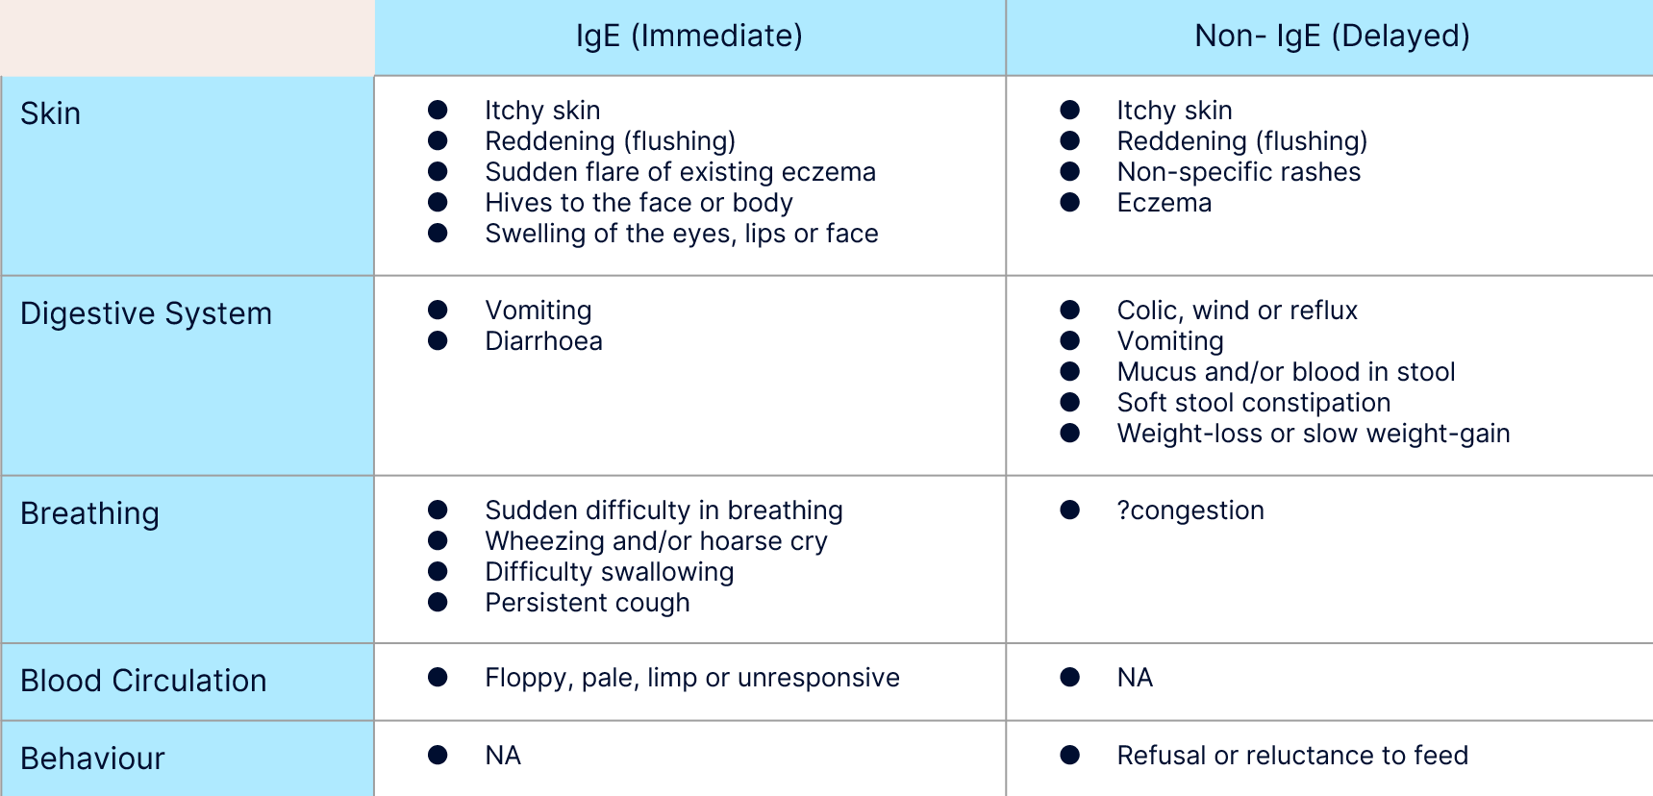
Symptoms of CMA
Both IgE and Non-IgE CMA can impact a patient’s skin, digestive system and breathing but there are some key differences.
Source: Adapted from iMAP 2019
Notes:
This slide shows the symptoms of IgE and non IgE CMA. In most cases of cow’s milk allergy, the infant will show several symptoms that suggest either the delayed or immediate type of food allergy.
Some of the symptoms can appear in both immediate and delayed allergic reactions, so for example you can see eczema and itchy skin in both columns... However, how quickly those symptoms present, usually gives the indication for which type of reaction it is.

Slide 6
First line management of Symptoms
Notes:
Many of the symptoms of delayed allergies, such as these listed on the slide, are common in infants anyway and milk allergy is only one of a number of possible causes, and this is why it is over diagnosed
If individual symptoms are persistent and are worsening, despite first line management, then it could indicate non-IgE CMA.
We will go through some of them, I know many of you know this already, but it is good to re cap and what we want to do is to try and treat the symptoms before jumping to a suspected cows milk allergy diagnosis, unless the allergy history strongly suggests otherwise.

Slide 7
First line management of Symptoms
Tips:
Smaller and more frequent feeds, avoid over feeding, regular winding, keep upright after feeding, avoid constipation.
Check positioning and attachment in breast fed babies.
Treatment: Thickening agents eg/ carobel, Thickened formulas, Alginates, or medication such as omeprazole (PPIs)
Reflux
Please refer to NICE guidance for managing reflux. Overview | Gastro-oesophageal reflux disease in children and young people: diagnosis and management | Guidance | NICE
Notes:
Reflux! Nearly 50% of all babies develop reflux and it is usually not a cause for concern. Only a small number of babies will have reflux as a result of CMA.
First line advice for bottle fed babies includes smaller, more frequent feeds; avoiding over feeding; winding and positional management. It is recommended that infants are kept upright for at least 45 minutes after feeding.
Constipation can worsen reflux symptoms and should therefore be ruled out or treated if needed.
Breastfed babies ideally should be seen by the baby feeding and wellbeing service to check their positioning and attachment and you can signpost them to this service running at the children centres.
Thickening agents, thickened formulas, alginates and proton pump inhibitors can be trialled if there is no improvement following first line management.
Please refer to NICE guidance for managing reflux. Overview | Gastro-oesophageal reflux disease in children and young people: diagnosis and management | Guidance | NICE

Slide 8
First line management of Symptoms
Tips: If breastfed - check attachment and positioning, Encourage parent to seek support.
If bottle fed - avoid over shaking bottle, take regular breaks for winding, ensure pace feeding,, encourage to seek support
Colic
More guidance on management can be found here: https://cks.nice.org.uk/topics/colic-infantile/
Notes:
Colic is defined as crying more than 3 hours per day, 3 days per week for at least 1 week.
It is a common self limiting condition with no clear pathology
It usually improves by itself around 3-4 months of age.
In terms of advice, breastfed babies need their attachment and positioning checked, but most of the advice is around encouraging parents to get support, especially with regard to their wellbeing.
If bottle fed avoid over shaking, taking regular breaks for winding, ensure PACE feeding (which Hannah has already explained) and again making sure parents are supported in terms of their wellbeing.
There is no strong evidence for colic drops, maternal herbal supplements or anti colic formulas.
More guidance on management can be found here: https://cks.nice.org.uk/topics/colic-infantile/
No evidence for treating colic

Slide 9
First line management of Symptoms
Tips: Try bicycle legs, tummy massage, offer water to drink in between feeds/meals if >6 months of age.
Treatment: If appropriate consider prescription of macrogol, lactulose or glycerin suppositories.
Constipation
Notes:
Constipation can be managed with bicycle legs, gentle tummy massage and water to drink in between meals if over 6 months.
If formula feeding, it is useful to check feed volumes and investigate if there have been any recent changes to amounts, preparation or type of feed.
As you all know a trial of laxatives can be prescribed if indicated.
It is important to remember that there are often changes in stool frequency and texture if a baby is moving from breastfeeding to formula or with changing formulas, so reassurance is also important for the parent to manage expectations.

Slide 10
First line management of Symptoms
Eczema
Tips: Ensure good ‘eczema management’ - using frequent creams and emollients to keep the skin in good condition
Notes:
ECZEMA: There are many triggers for eczema such as soap powders, fragrance, temperature, stress, pollen, house dust mites, sweat, wet and messy play, damp and mould. So you can see CMA is just one of many possible cause.
If eczema develops around the age of 3 months or older it tends to be due to genetics rather than a food allergy.
If a cow’s milk allergy is causing the eczema it often presents when the infant is younger than 1 or 2 months old, removing the food trigger alone often will not always fully resolve the eczema. It is still absolutely essential to continue to keep up with regular emollients and steroid creams if necessary and if advised.

Slide 11
Breast Feeding and Allergies
Continuing to breastfeed is the best outcome
Many of the symptoms seen in breastfed infants can be addressed by reassurance around feeding techniques and managing expectations of what is normal for a breastfed baby.
It is rare to need to stop breastfeeding.
Unnecessary elimination of food allergens may adversely impact the nutritional status of the breastfeeding mother EAACI position paper
Be aware on the added burden and impact of quality of life that elimination diets bring for breastfeeding parents EAACI position paper
Notes:
BREASTFEEDING:
We know that breastfeeding is the optimal nutrition for infants and provides many benefits for mum and baby, as Hannah has already kindly gone through with us.
If a mother is presenting with a baby with any of the symptoms we went through, continuing to breastfeed is the best outcome. Many of the symptoms seen in breastfed infants can be addressed by reassurance around feeding techniques and managing expectations of what is normal for a breastfed baby...and that’s where the baby feeding and wellbeing service can support the parents. So please do signpost parents to use this service if breastfeeding.
As we spoke about before CMA is much less common in breastfed infants, only 0.5% of exclusively breastfed infants show reactions to cow’s milk protein compared to 2%-5% of formula fed infants.
So for help with breastfeeding please sign post to the baby feeding and wellbeing service or health visitors and signpost to some of the website I have put at the back of the training.
There is rarely a need to stop breastfeeding if a child has a food allergy, so it is important to reiterate this message to breast feeding mothers and encourage them to continue.

Slide 12
You Suspect CMA….What next?
There are 2 iMAP algorithms to follow for presentation and treatment respectively
iMAP Presentation Algorithm
Setting out all the possible clinical presentations
Guidance on which presentations should be referred on
Guidance on which form of diet all suspected infants need to be started on
Clinically distinguish between exclusively breast fed and mixed/ formula fed
The initial diagnostic Elimination-Reintroduction dietary exclusion trial to confirm or exclude the diagnosis
When referral for dietetic support is advised
When and how to test for naturally re-acquired tolerance to milk protein
iMAP Treatment Algorithm*
Refer to iMAP guidelines (2019) for Presentation Algorithm and Treatment Algorithm
*For mild-to-moderate suspected non-IgE CMA only
Notes:
So just moving on to the guidelines...hopefully everyone is familiar with the iMAP guidelines, which stands for International Milk Allegry in Primary Care. It is the main guideline to follow in primary care when suspecting a CMA.
They consist of two algortihms, so the first one is how the CMA presents itself and then another one on treating CMA.
The link to the newest guideline for managing CMA is here at the bottom of the slide... and it includes great resources you can give to parents so they can manage the allergy whilst waiting for a dietitian referral for support. We'll talk more about the resources later.

Slide 13
Allergy focused History
History
Family History
Infant Atopic History
Symptoms
Age, onset, order of symptoms
Severity, repeated exposure
Feeding History and Growth
Breast milk, formula
Solids
Previous Management
Elimination diet
Medication
Eczema Treatment
Notes:
The first thing to do if you suspect a CMA is an allergy focused history. An allergy-focused clinical history is the cornerstone of diagnosing a food allergy.
So the following questions are involved in a allergy focused history
Asking about family history....Is there a family history of atopy? This includes eczema, asthma, allergic rhinitis or food allergy. A reported history makes diagnosis more likely. If one parent has an allergic condition it increases the infant's risk by 60-80%.
Asking if there is an atopic history in the infant, such as eczema. If it developed in the first few months of life it is more likely to be in relation to food allergy
Asking what symptoms are present, how severe are they and how often are they occurring? If they are within seconds then it is IgE immediate allergy It is important to ask it there has been repeated exposure and if the same symptoms have occured
Asking about the age the symptoms started and how soon after milk ingestion did the symptoms appear - For example, if an infant developed hives straight after having a bottle of formula milk for the first time it is more likely to be an IgE-mediated cow's milk allergy.
Its also important to looks at the infants feeding history and growth – including if child is being breast, formula or mix fed.
Lastly it is important to ask about details of previous management such as medications, eczema treatment or any elimination diets
The iMAP guideline has a comprehensive guide to take you through a clinical history which can be found at the end of this presentation in the more information section.

Slide 14
Allergy Testing
IgE mediated allergy
Non IgE mediated allergy
^{Skin prick testing}
Specific IgE antibody blood tests
They can help to diagnose the likelihood of an allergy but do not predict the severity of a reaction.
Elimination diet for 2-4 weeks followed by reintroduction challenge
resource=food-allergy-intolerance-testing
Notes:
Should a baby have an allergy test?
This is a common question asked by many parents. Allergy tests are often perceived as a ‘screening’ test for diagnosis when in fact it is only useful in diagnosing IgE mediated allergy alongside an allergy focused clinical history. And allergy tests should only be interpreted by those with expertise as we know they can produce high false positive results.
The two main types of tests that are used in CMA are skin prick tests and specific IgE blood tests. The tests only indicate the likelihood of an allergy and do not necessarily prove an allergy. As I said they should always be interpreted alongside an allergy focused clinical history.
The skin prick test and the IgE antibody blood tests should not used in non IgE mediated allergy. The only way to confirm diagnosis in suspected non IgE allergy is through an exclusion diet and reintroduction challenge 4 weeks later.
You may find that parents have paid to have alternative allergy testing which can be purchased on the internet, but these tests are not evidence based, they are very expensive and they don't confirm allergy. Tests include vega testing, hair analysis, pulse testing, cytotoxic testing and IgG antibody tests to name a few. The British Dietetic Association have a fact sheet on food allergy and intolerance testing which you will find in the ‘information’ section, which you can hand out to parents.

Slide 15
Case Study 1: Eva
Eva was born at 39 weeks and has been exclusively breast fed
Now 8 weeks old, presenting with eczema (moderate), feed refusal, mucousy green stools and reflux. Mother and baby have been receiving support from baby feeding and wellbeing service and no concerns with positioning and attachment
Mum describes her as being very unsettled/irritable and has visited her GP a few times who reports no initial concerns as Eva is following her growth centile
Mum presents in your clinic very anxious and does not know what to do
Family history: Mum has hayfever and asthma, dad has no allergies
What do you suspect is the diagnosis?
IgE CMA
Lactose intolerance
Non-IgE CMA
Notes:
Here are 2 case studies now
Eva
Eva was born at 39 weeks and has been exclusively breast fed. She is now 8 weeks old and is presenting with moderate eczema, colic, loose mucousy green stools and reflux. Mum describes her as being very unsettled and has visited her health visitor a few times who reports no initial concerns as Eva is following her growth centile. Mum presents in your clinic very anxious and does not know what to do.
Mum then goes on to give us a family history and reports that she has hayfever and dad has no allergies. However, Eva’s older brother had CMA when he was younger but has since outgrown it.
What do you suspect is the diagnosis?
ANSWER......
ANSWER: 'C': non IgE CMA
Here we can see Eva has gastro symptoms which are suggestive of a mild -moderate non IgE mediated CMA. She has no symptoms to suspect IgE mediated allergy such as hives, swelling or breathing difficulties. When going through an allergy focused history we can also see she presented with moderate eczema in the first few months of life, which can be an indicator of allergy.

Slide 16
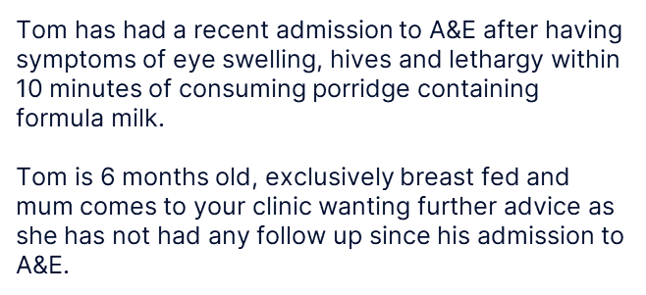
Case Study 2: Tom
What do you suspect is the diagnosis?
IgE CMA
Lactose intolerance
Non-IgE CMA
Notes:
Meet Tom
Tom has had a recent admission to A&E after having symptoms of eye swelling, hives and lethargy within 10 minutes of consuming porridge containing formula milk. Tom is 6 months old, exclusively breast fed and mum comes to your clinic wanting further advice as she has not had any follow up since his admission to A&E.
What do you suspect is the diagnosis?
ANSWER...
ANSWER A: IgE CMA
Here we can see that Tom has had an immediate reaction to the milk in porridge. What makes his reaction more severe is that he became lethargic after the ingestion of milk this can indicate low blood pressure affecting his circulation.

Slide 17
Cows Milk Allergy Management
If an infant has a mild to moderate non IgE mediated allergy they need to be managed in primary care.
If you suspect an infant has an IgE mediated allergy or has a more severe presentations of non-IgE mediated allergy such as food induced protein enterocolitis (FPIES) or eosinophilic oesophagitis (EOE) should be referred into secondary care.
Notes:
Ok so this next section is about management of CMA, so we have spoken about symptoms and allergy history, now this is about the management.
If an infant has a mild to moderate non IgE mediated allergy they need to be managed in primary care. Complex cases (such as those with severe gastro symptoms, faltering in growth or multiple allergies) need to be referred to RLH gastroenterology team and RLH dietitians.
If you suspect an infant has an IgE mediated allergy or has a more severe presentations of non-IgE mediated allergy such as food induced protein enterocolitis (FPIES) or eosinophilic oesophagitis (EOE) should be referred into secondary care allergy team.
(FPIES is a delayed (non IgE mediated) food allergy which leads to repeated vomiting and other gastro symptoms 1-6 hours after the food is congested – it is rare in breast fed babies. Vomiting multiple times, projectile that can lead to suspected FPIES diagnosis)
(EOE or eosinophilic oesphagitis, is an allergic condition of the oesophagus. Symptoms can be feed refusal, failure to thrive and vomiting).

Slide 18
Suspect Non IgE Cows Milk Allergy
Remember!
Cow’s milk exclusion diet for 2-4 weeks
Reintroduce cow’s milk to confirm the diagnosis!
Notes:
Management of mild to moderate non-IgE CMA is in primary care...
If you suspect mild to moderate non IgE mediated allergy, a cow's milk elimination diet for 2 to 4 weeks should be commenced with a planned home milk reintroduction challenge to confirm diagnosis, as per iMAP guidance.
Currently, home challenges are not being advised, completed or reviewed properly… and so many infants continue on a milk free diet unnecessarily.

Slide 19
Suspect IgE CMA
Refer to secondary care allergy services
Refer to RHL Dietitians
Useful signposting for interim support: Allergy UK
Cow’s milk exclusion
Notes:
If you suspect an IgE CMA then ideally these needs to be managed by secondary care allergy team. The royal london hospital Dietitians have fed back that they will see straight forward IgE CMA patients. And you can also signpost parents to Allergy UK webiste for support...the allegry UK website has a helpline which the parent can call and speak to a dietitian for general advice.

Slide 20
Notes:
Although a busy slide, I just wanted to show you what the iMAP guidelines look like. They have a very comprehensive algorithm on how to manage breast and formula fed infants with suspected CMA.
The algorithm highlights the difference between mild-moderate non IgE cow's milk allergy and severe non IgE mediated cow's milk allergy as well as highlighting mild-moderate IgE mediated cows milk protein allergy. So it basically covers all the different allergies!
The box highlighted in red is to remind the clinician that over diagnosis is common, so clinical judgement is needed as well as a detailed allergry history and as mentioned this is particularly important for breast fed babies as CMA is very rare in exclusievely breast fed babies.

Slide 21
Breastfeeding Mothers
1
2
3
4
Identify risk factors and symptoms
Refer to iMAP guidelines
Provide advice
Milk Reintroduction Challenge
Breastfeeding support
Return to exclusive breastfeeding if symptoms only with formula
Cow’s milk protein exclusion for 2-4 weeks
Calcium & vitamin D supplement
Refer to dietitian
Highlight importance of milk-reintroduction challenge to confirm/disprove diagnosis
C-section
Eczema
Mucus stools
Feed refusal & reflux
Family history
Refer to iMAP presentation and treatment algorithms.
Mother to reintroduce cow’s milk protein into diet over a 1 week period. If the symptoms return, STOP the reintroduction, return to full milk exclusion diet. If no symptoms occur = no cow’s milk allergy.
Links: Initial fact sheet for parents; Fact sheet whilst breastfeeding; Home reintroduction milk challenge
Notes:
So looking at how we would start to manage a suspected non IgE CMA in breast fed infant.
If an infant is exclusively breast fed then the mother should commence a cow’s milk free diet (there is no absolutely need to start a formula, and continuing to breast feed is the best outcome for mother and baby). mother should also start an over the counter calcium and vitamin D supplement. The healthy start vitamins contain vitamin D and are free for all breastfeeding mothers up until 1 year in tower hamlets.
Remember the dairy free diet is recommended for 2-4 weeks and then a home reintroduction challenge must be done to confirm the allergy, and this is for non IgE CMA.

Slide 22
What is the Infant if formula fed?
The first 2 steps remain the same but advice and reintroduction are slightly different.
3
4
Milk Reintroduction Challenge
Provide advice
Refer to local guidelines on the first line hypoallergenic formula.
Advise parents on transitioning infant onto new formula
Remain on this formula for 2-4 weeks.
Highlight know side effects such as: reduced intake & green loose stools.
Highlight importance of milk-reintroduction challenge to confirm/disprove diagnosis.
Introduce standard formula into first bottle of the day, 1oz at a time mixed with prescribed formula. Build up per oz daily until up to a full bottle.
Once full bottle tolerated, then to conduct ‘per bottle’ rather than ‘per oz’.
If the symptoms return, STOP the reintroduction, return to prescribed formula. If no symptoms occur = no cow’s milk allergy.
Notes:
For managing those infants who are formula fed a trial of an extensively hydrolysed formula should be prescribed for 4 weeks. However, you only need to prescribe 1-2 tins to start with and then check whether the baby tolerates it before prescribing more, to ensure there is no wastage.
The hypoallergenic formulas are bitter in taste, so to help with tolerance parents can titrate the new formula into the established one over the course of a few days. For example on day 1: A quarter of the new prescribed formula mixed with 3 quarters of the babies current formula, and on day 2: half the new prescribed formula mixed with half of the babies current formula and so on.
It can take around 7-10 days before any improvement is seen and up to 4 weeks for symptoms to resolve, again this is something that care givers need to be told to avoid them returning too soon and wanting to switch formulas.
For those that are mix feeding and wish to continue to do this, extensively hydrolysed formula is also recommended alongside the breast milk. We will discuss formulas later.
Again remember it’s the ehf for 2-4 weeks then reintroduction to confirm the allergy

Slide 23
Case Study: Eva
Summary
Exclusively breastfed baby with suspected non-IgE CMA
Symptoms: eczema (moderate), feed refusal, mucousy green stools and reflux
No concerns with growth and has accessed baby feeding and wellbeing service with no concerns with breast feeding.
What would be your next step?
Advise stopping breastfeeding and change to extensively hydrolysed formula
Recommend mum follows a milk exclusion diet for 2-4 weeks with a reintroduction challenge at 4 weeks to confirm diagnosis
Refer to secondary care Allergy Service
Notes:
So now we have been through the start of the management of CMA, let’s revisit our case studies, if you remember, we suspected that Eva may have non-IgE CMA.
What would be your next steps?
ANSWER...
ANSWER B
We would recommend mum follows a milk exclusion diet for 2-4 weeks with a reintroduction challenge at 4 weeks to confirm diagnosis.
Remember to advice mother to take calcium supplement as well as her usualy vitamin D supplement.
If Eva was formula fed or mixed fed then an extensively hydrolysed formula would need to be trialled.

Slide 24
Case Study: Tom
Summary
Tom is suspected to have IgE CMA
Tom is 6 months old, exclusively breast fed with symptoms of eye swelling, hives and lethargy within 10 minutes of consuming porridge containing formula milk
What would be your next steps? (choose 2)
Advise stopping breastfeeding and change to hypoallergenic formula
Recommend mum and Tom follow a milk exclusion diet
Recommend mum to continue breastfeeding with no dietary changes and for Tom to follow a milk exclusion diet
Refer to allergy clinic
Refer to RHL Dietitians
Notes:
And now, back to Tom who is suspected to have an IgE mediated CMA.
What would be your next steps? (choose 2)
ANSWER...
ANSWER C and D
Tom has had no reactions to breastmilk despite mum having dairy in her diet, so therefore there is not a need for mum to follow an exclusion diet. Tom does however need to exclude all dairy from his diet, as he reacted to milk in porridge, until he received further advice from the allergy team.
And as he had symptoms of lathargy, this is severe reaction and therefore he needs to be referred to secondary care allergy team for SPT – the allergy team has a dietitian also who will provide advice.
While Tom is waiting to be seen by the allergy clinic, advice on milk free weaning is needed. If there is no access to a dietitian then there are many websites that Tom’s parents can be signposted to such as AllergyUK and the Anaphylaxis campaign where there are downloadable diet sheets. The Allergy UK also has a really useful helpline that parents can call, and access general information from a dietitian in the interim.

Slide 25
Home Reintroduction
Breastfed
Maternal consumption of all milk products (milk, yogurts, cheese) over one week
Formula fed
Gradual introduction over one week
Day 1: 30ml/1oz of cow’s milk formula to hypoallergenic formula
Day 2: 60ml/2oz to the first bottle and so on until Day 7
Notes:
So after the 4 week dairy exclusion diet, the home milk reintroduction challenge must be done, which consists of bringing cow’s milk protein back into the diet to see if the symptoms return. It is paramount in diagnosing non-IgE mediated CMA, but unfortunately it is also step which is commonly left out when CMA advice is given.
The home reintroduction challenge is advised to do this at home for a period of one week unless symptoms return sooner.
It is also important for the parents to ensure their infant is well before commencing the reintroduction. This includes the baby not having common coughs and colds, teething, an eczema flare or any unexpected bowel symptoms. It’s always worth discussing this with parents BEFORE they start the exclusion so that they are aware this is part of the process of confirming or excluding a diagnosis
If a baby is breast feeding and a maternal milk free diet is being followed, all cow’s milk products must e consumed by the mother over a period of one week. There is no need to gradually increase the amount of cow’s milk products, or to eat more than mother usually would. If symptoms appear then the challenge must be stopped, as well as reverting back to a maternal milk-free diet.
If the infant is formula or mixed fed then gradual reintroduction is needed. This includes increasing the amount of cow’s milk formula each day to the first bottle of hypoallergenic formula. Starting with 30mls/1oz of regular cow’s milk formula on day 1 and building to 60mls/2oz on day 2 and so on until day 7. If at any stage the infant reacts, cow’s milk formula should be stopped.
If there is no reaction in the re challenge period then regular cow’s milk formula can be continued and the baby does not have a CMA.
So the key message to take away here is that ALL babies who are on a dairy free diet for non IgE CMA need to carry out a reintroduction challenge after 2-4 weeks to confirm the diagnosis.
The iMAP guideline has an easy step by step reintroduction sheet which can be given to parents. You can access it in the further information section.

Slide 26
Milk Free Weaning Advice
Weaning a baby who has a cow’s milk allergy should be the same as weaning a non-allergic baby, except that you must not give any foods that contain cow’s milk protein.
Advise parent to ALWAYS read labels
‘May Contain’: A child is more likely to tolerate low levels of contamination if they have delayed, non-IgE mediated allergy, unless they are extremely sensitive.
Key Nutrients
Calcium
Vitamin D
Iodine
Required for brain development and thyroid function. Main sources in dairy. Other good sources: fish, shellfish, eggs, and fortified dairy alternatives.
Required for strong bones and teeth. Non-dairy sources can be found in tinned fish with soft bones, broccoli, kale, spring greens, pak choi, and oranges. Fortified options include bread, cereals and alternatives ‘milks’ and cheese.
Vitamin D improves the absorption of calcium. All breastfed babies should receive supplement of 8.5-10mcg per day from birth. Formula fed babies need supplementation once having less than 500ml formula per day. Healthy Start Vitamins!
Notes:
So if you have done the reintroduction challenge with the parent and baby, and the baby has a confirmed non IgE CMA diagnosis the next step would be milk free weaning advice, which can start around 6 months old.
Ideally dietitian can go through this with the parent, but as there can be long waiting lists it is good to have some general advice that you give to parents.
Obviously the main message is that weaning a baby who has a cow’s milk allergy should be the same as weaning a non-allergic baby, except that you must not give any foods that contain cow’s milk protein.
Label reading is important and I have put ALWAYS in capitals because food products often change their ingredients and something which does not contain milk, may do so at another point in time.
'May contain' labels, this comes down to clinical judgement and is individual advice tailored to the patients. A child is more likely to tolerate low levels of contamination if they have delayed, non-IgE mediated allergy, unless they are extremely sensitive.
The I have listed other key nutrients to consider when on a dairy free diet, but I wont go into them as ideally this will be covered by a dietitian.

Slide 27
Introducing Other Foods to a Baby with non IgE CMA
Important note - Deliberate exclusion or delayed introduction may increase risk of food allergy.
Checklist
Quantity
Building Up
Allergenic Foods
Time of Day
Infant is established on first foods (veg, fruits, starchy and protein foods). Baby is well and any eczema is well controlled
Egg
Peanuts & Nuts
Wheat
Soya
Crustaceans & Molluscs
Fish
Sesame
Introduce early on in the day
Start with introducing ¼ - ½ tsp initially and then increase over a few days
Once successfully introduced to keep in diet 1-2x per week.
Notes:
When is comes to introducing other allergenic foods, it is important for the parent to know that deliberate exclusion or delayed introduction can increase the risk of a food allergy.
General advice is:
Make sure baby is fully well (no cough, symptoms or teething) for allergenic foods to be introduced
There are 14 major allergenic foods - On the slide we have outlined majority, but this list also includes: Celery, Mustard, Lupin (found in flour) and also Sulphur Dioxide (which is often used in preparation of fried fruits).
Introduce allergens one at a time, early on in the day, so any symptoms can be noted.
Start small and build up over a period of 3 days.
Lastly once an allergenic food is tolerated it should be kept in the diet 1-2 times per week

Slide 28
Appropriate Prescribing of Infant Formulas
Breast feeding is the best outcome
Formula | Standard formula Whole, intact protein | Comfort formula Partially hydrolysed | Extensively hydrolysed formula (EHF) | Amino acid formula (AAF)
Availability | Purchased from supermarkets or pharmacies Not to be prescribed. | Purchased from supermarkets or pharmacies. Not to be prescribed. | Prescription only | Prescription only
When to use | All infants without allergy. Not suitable for CMA. | Marketed for infants with colic or constipation- note limited evidence. Not suitable for CMA. | First line formula when CMA is suspected. Tolerated by 90% of infants with proven CMA . | If infant is presenting with severe symptoms of CMA, or has symptoms persist on EHF.
Notes | Frequent changes in formula is not recommended. |  | Bitter in taste. Side effects include: reduced intake, green, loose stools, worsening of reflux.
Notes:
This next section is about prescribed infant formulas. We know that breast feeding is the best outcome for babies with or without CMA, but formula fed babies with suspected or diagnosed CMA will need to be prescribed an allergenic formula milk.
There are many formulas that are used in the management of CMA and so it can get confusing knowing which one to choose. There are specific local guidelines on certain formula choice so please do refer to these as well.
You can see on the slide there are 4 different 'types' of formula. We have formulas with whole intact protein chains – these are your standard infant formula that parents purchase from the supermarkets. Then you have 'partially hydrolysed' formulas, which is your 'comfort, anti colic' ones – there's no evidence for these and these are not suitable for CMA babies.
Moving on we have extensively hydrolysed formula...these formulas are suitable for 90% of babies with a CMA. You can see the protein chain is broken down so small, that the majority of babies with non IgE CMA can tolerate it.
Lastly we have the Amino Acid formulas, where there are no protein chains. This is usually only prescribed in secondary care and is only for babies with severe IgE CMA and who are faltering in growth.
There are many side effects of these milks,
they are bitter in taste
Can cause green, loose stools
They can worsen reflux as they are quite thin.
Important to let the parent know what to expected and also that intake of milk is usually reduced in the baby when started on these formulas.

Slide 29
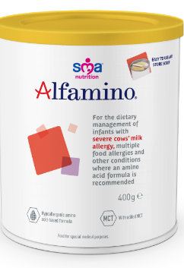
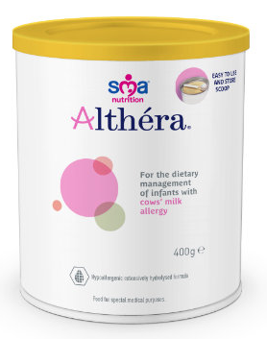
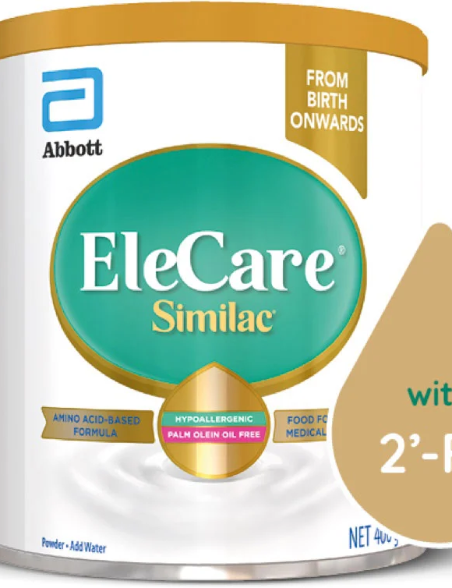
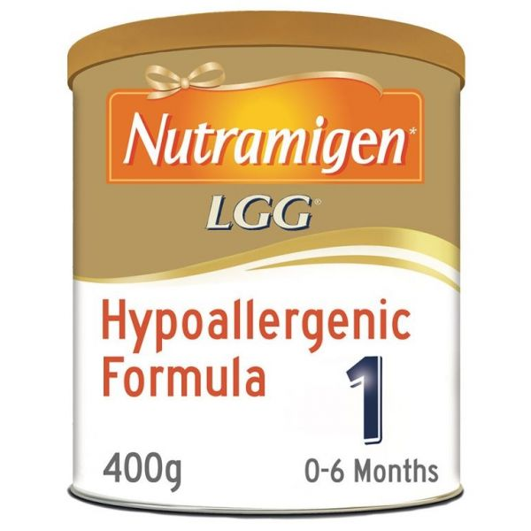
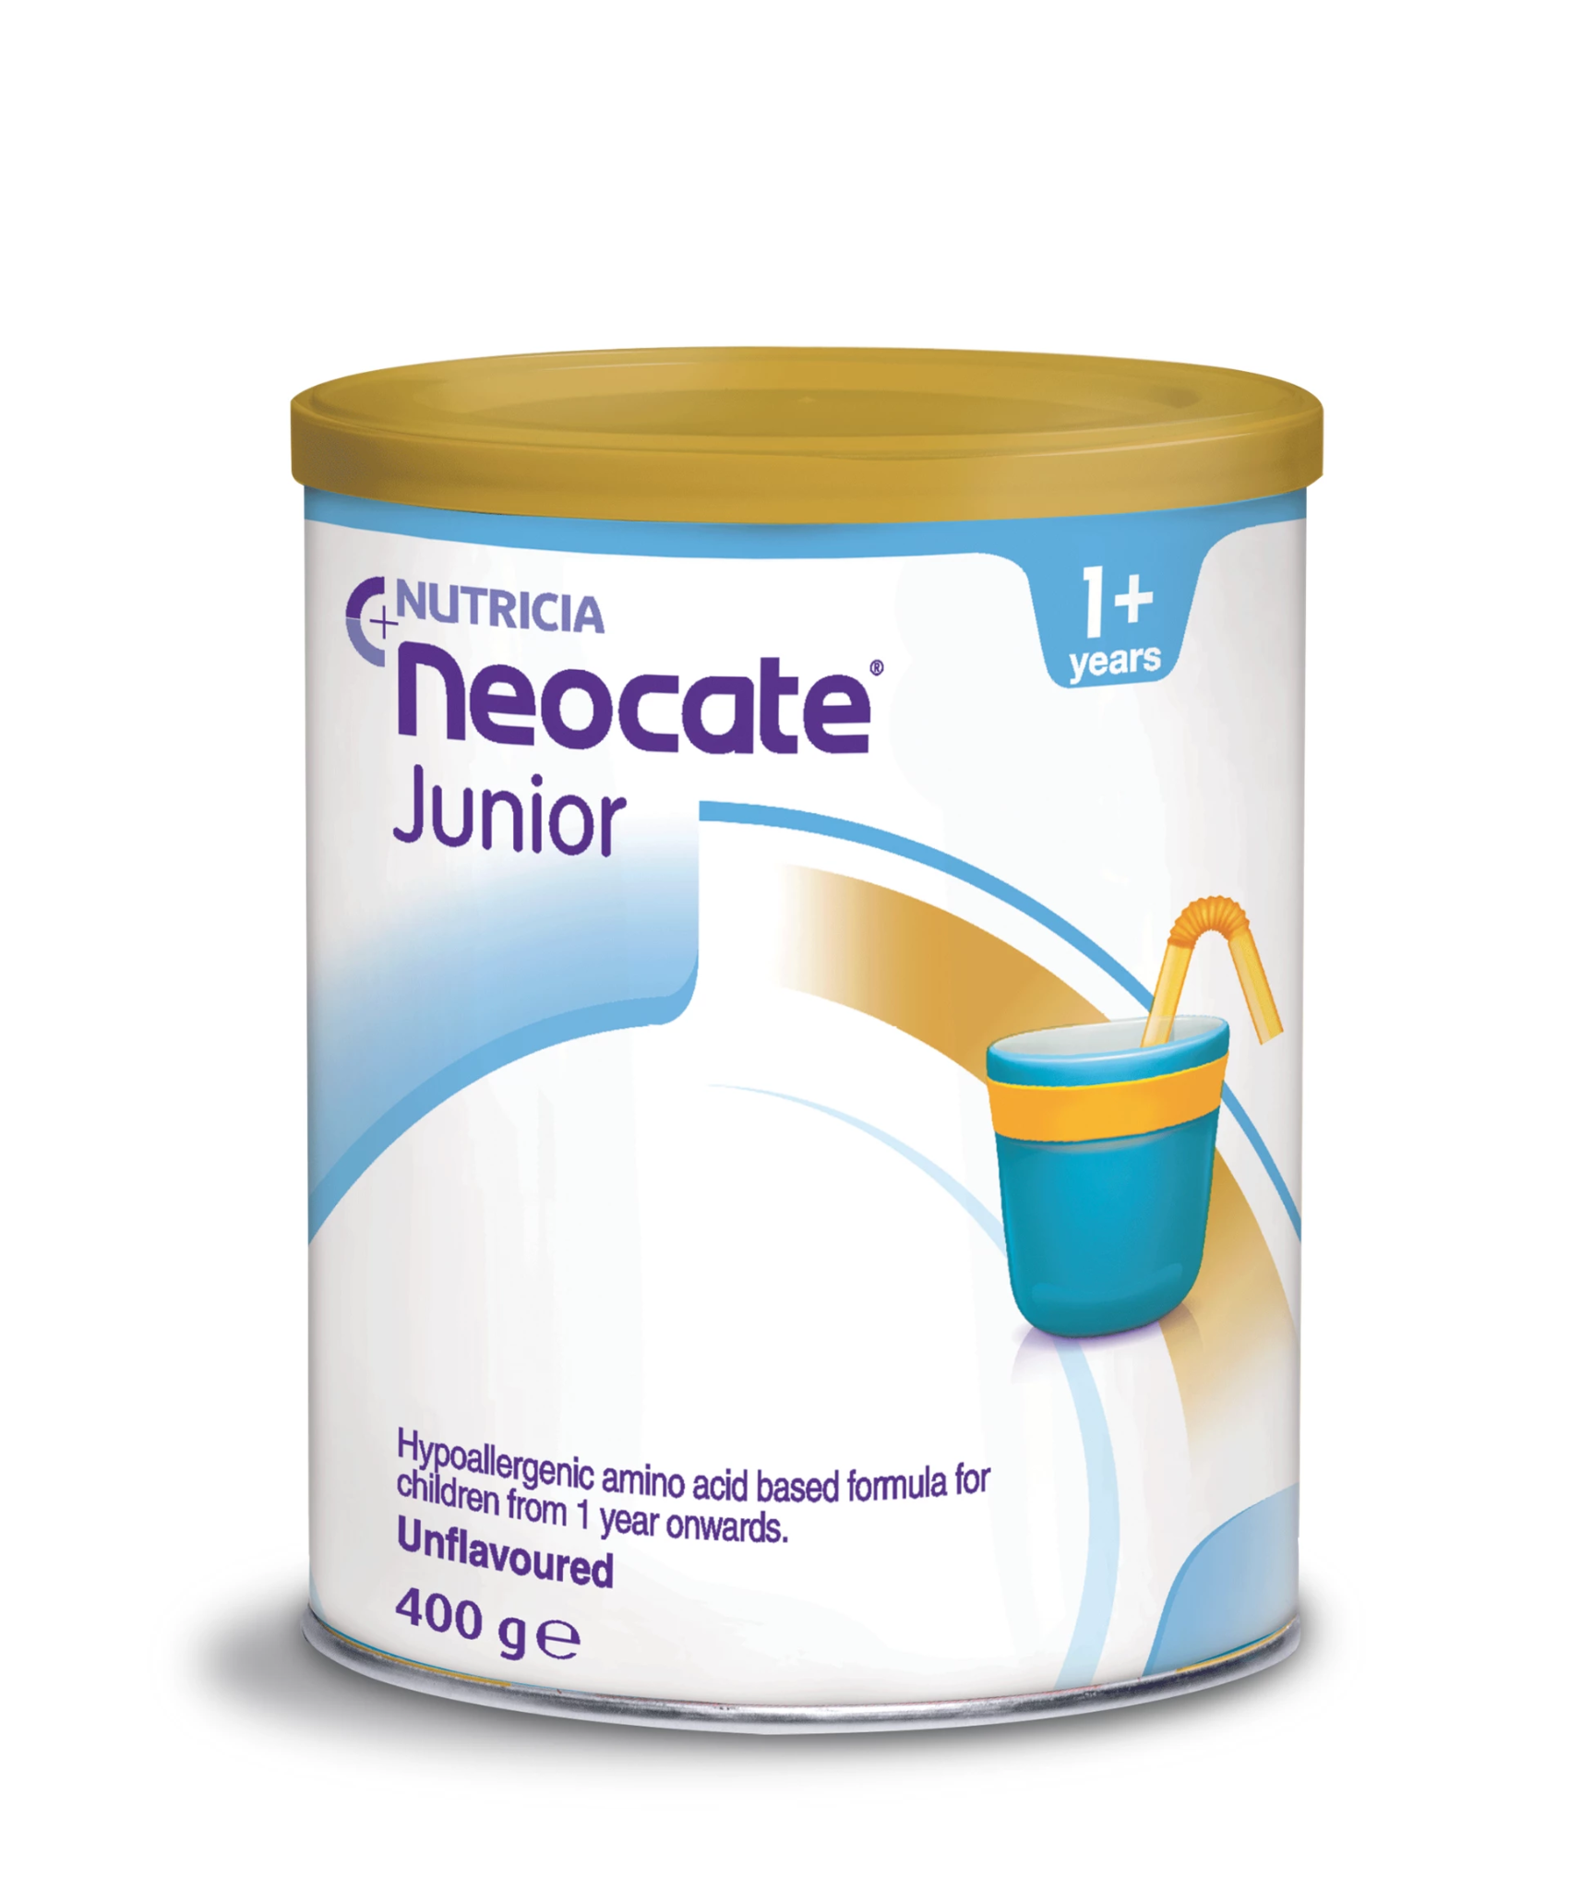
List of prescribable EHF and AAFs
Breast feeding is the best outcome
Amino Acid (AA) Formulas
NOT TO BE ROUTINELY STARTED IN PRIMARY CARE
Extensively Hydrolysed Formulas (ehf)
Image | Formula
 | Alfamino (Nestle) utramigen Puramino (Reckitt)
 | Nutramigen Puramino (Reckitt)
 | Elecare (Abbot)
 | Neocate LCP (Nutricia)
 | Neocate Syneo (Nutricia)
 | Neocate Junior (Nutricia)
Image | Formula | First Line in Primary Care
 | Alimentum (Abbot) | N/a
 | Althera (Nestle) – (Halal and vegetarian) | Yes*
 | Aptamil Pepti 1 & 2 (Nutricia) | No
 | Nutramigen LGG 1 & 2 (Reckitt)) | No
 | Aptamil Pepti Syneo (Nutricia) | No
* Always check your local CCG prescribing guidance and availability of any products at the time of prescribing
* If a patient presents with clear anaphylactic reaction to cow’s milk and requires formula these AAF should be commenced in primary care, with immediate onward referral to secondary or specialist care. Those in bold would be suitable only in these circumstances.
Notes:
I know im talking about formula a lot, but please remember that breast feeding is best – this is only for babies who are formula fed.
In mild -moderate non IgE CMA an extensively hydrolysed formula should be trialled first.
It may take up to 4 weeks on an extensively hydrolysed formula for symptoms to resolve and as I said they are tolerated in around 90% of cow’s milk protein allergic infants.
There are a number of extensively hydrolysed formulas on the market varying from the protein used (such as casein or whey) to either containing probiotics, prebiotics or lactose. The evidence shows that no one formula is better than another and so it is based on your local infant formula guidelines and clinical judgement – I had a look at the guidelines being used in Tower Hamlets and the first line is breast milk, and then if a formula needs to be used it is SMA Althera which needs to be prescribed.
Amino acid formulas are often inappropriately prescribed and are not first line formula in mild-moderate non IgE CMA. As discussed they are only indicated if there is faltering growth or anaphylaxis. Amino acid formulas are 2.5 times more expensive than extensively hydrolysed formula and so prescriptions should be monitored carefully and regularly reviewed.

Slide 30
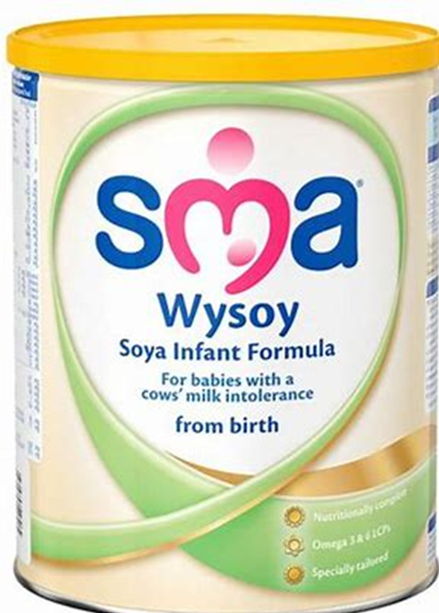
Soya Formula
Should not be prescribed
Available in supermarkets and chemists
Can be considered in those >6 months if hypoallergenic formula is not tolerated and if there is no cross reactivity to soya
Notes:
Just taking a look at the other formulas.
We get many questions regarding the use of soya formula, which can be bought in supermarkets and chemists. However, it should not be used in infants under 6 months old because of the phytoestrogen content.
It is also not recommended as a first line formula over 6 months for those with CMA, as between 2-14% of children with IgE mediated allergy and up to 50% of non-IgE mediated allergy may react to soya as well.
It can be considered in those over 6 months where hypoallergenic formula is not tolerated and there is no soya cross reactivity. For example: Tried many different hypoallergenic formula, but the baby is not liking the taste and starting to refuse to dirnk it, and they are fine with soya in their diet i.e. there is no reaction, then this is when you could recommend a soya formula.

Slide 31
Formulas that need to be purchased
Notes:
Other infant formulas that are commonly seen on prescriptions, that should not be include lactose-free formula, comfort formula also known as partially hydrolysed formula, as well as anti-reflux formulas. Dietitians do not routinely recommend follow-on formulas, e.g. Aptamil Pepti 2 (which is recommended from 6 months old) as the difference in nutrition is minimal.
Other milks such as Goat’s milk formula are also not recommended for patient with CMA, as the proteins are very similar to those in cows milk formula.
Hungrier baby formula is not usually recommended either as there is limited evidence to support the claims made.

Slide 32
Formulas after 1 year of age
Formula is often NOT needed after 1 year of age for babies with or without CMA
Notes:
There are a few nutritional companies that advertise formulas after one years of age.
Often these are not required unless nutritional status is compromised and there is faltering growth.
Many infants that are not tolerating cow’s milk by 12 months are moved onto a shop bought calcium fortified alternative milk such as soya or oat milk. This is usually done under the supervision of a dietitian to ensure nutritional requirements are met.

Slide 33
Typical formula Volumes
Age | Volume per 24 hours | Tins per month
0-3 months | 500-1000ml | 5-11
3-6 months | 850-1100ml | 9-12
6 -12 months | 880-1000ml | 9-11
Notes:
Here are estimated volumes of formula milk that are needed according to age which should help with prescribing amounts.
Typically, no more than 13 tins should be prescribed per month, unless directed by a dietitian.
Volumes of milk intake decrease as the baby gets older, so it is important to review the prescription and then stop it at 1 years old unless indicated otherwise.

Slide 34
CMA Background
6-12 Months
12+ Months
0-6 Months
Milk-free alternatives can be used on foods, cereals and within meal preparations
Most babies with CMA can move from prescribed hypoallergenic formula to an alternative milk
Breast milk or prescribed hypoallergenic formula only
Suitable alternatives and examples *
Soya: Calcium fortified soya milk is an excellent alternative to cow’s milk if tolerated. Alpro do a soya growing up milk which has added iodine, iron & adequate protein and calories
Oat: Oatly Barista, Oatly full fat and Alpro Growing up oat drink have added calcium, iodine & adequate protein and calories
Pea: Mighty Pea milk has added calcium and iodine, adequate protein but low calories. Or, Sproud unsweetened pea milk has adequate protein, calcium and adequate calories but no iodine.
Coconut: Koko dairy free super drink is the only suitable alternative which has added iodine, iron, adequate protein & calories
Nut based milks e.g. almond milk, hazelnut milk are not suitable as a drink after 12 months due to their very low energy content. However they can be used in food to expose babies to different nuts.
Rice milk not suitable until 4.5 years due to inorganic arsenic levels
Notes:
In these next few slides we will discuss moving on from infant formula and the iMAP milk ladder
So as mentioned a infant who is on a prescribed formula with no growth concerns can move onto a dairy free alternative milk, purchased from over the counter. These dairy free milks include Soya, Oat, Pea and Coconut. And correct me if im wrong but I believe the healthy start vouchers can be used to purchase these milks. As you can see from the slide, there are a wide variety of plant based milks that are suitable for use in cooking from 6 months and as a drink from 12 months.
If possible it is best for a dietitian to assess the child’s diet before suggesting a suitable plant based milk alternative, so they can ensure it is meeting their nutritional requirements.
Be aware that milk alternatives is a fast moving market, there are lots of alternatives that are always changing. The milk-alternative needs to be fortified with calcium and ideally iodine. Organic milk alternatives are often not fortified and therefore need to be avoided.
As mentioned, lactose-free milk and goats milk are not suitable.

Slide 35
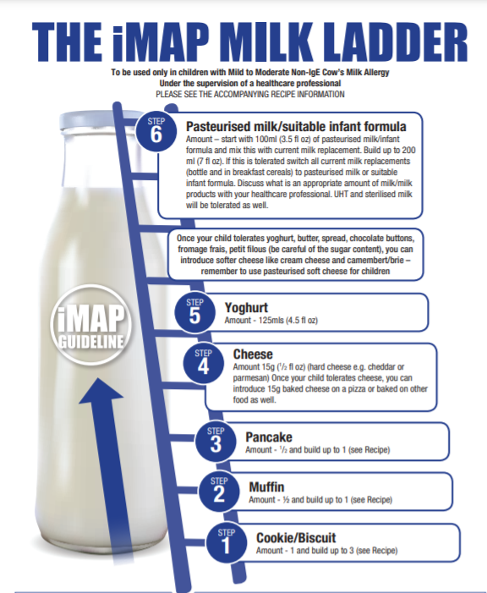
iMAP Milk ladder
For use in non-IgE mediated CMA
The milk ladder is an evidence based guideline for completion of a home milk reintroduction.
This should be under supervision of dietitian and/or allergy professional.
It is a gradual progression through different stages of milk protein introduction. Starting with baked milk which is less allergenic.
It is started around 12 months of age and/or when infant has been symptom free and following milk free diet for 6 months.
Link: iMAP milk ladder
Notes:
So this is the milk ladder.
The milk ladder is an evidence based approach guideline for reintroducing milk at a time when a child may have started to outgrow the allergy.
It is only suitable for mild-moderate non-Ige symptoms.
It is a gradual progression through different stages of milk protein – it starts with with baked milk (less allergenic) and builds up to milk itself.
The iMAP milk ladder usually started around 12 months of age and/or when the infant has been symptom free and following a milk-free diet for 6 months.

Slide 36
Discontinuing Formula
After 12 months, milk becomes less important due to food intake. Calcium requirements are lower (350mg/day) which are easily achieved.
Assess appropriateness of stopping formula with each infant. Looking at their growth and dietary intake.
Nutrients achieved through diet and milk-alternatives. Multivitamin containing vits A,C & D advised until 5 years of age.
If cow’s milk still not tolerated, will need ~300mls of fortified milk-alternative per day.
Link: Vitamins for infants, NHS
Notes:
So discontinuing formula...from the age of one year most babies with cow's milk allergy can move off prescribed formula and switch to an alternative dairy free milk.
After 12 months old, milk becomes less important due to food intake. Calcium requirements are also lower after 1 years old, and easily achieved through diet.
If the child is growing well and food intake is good then formula can be discontinued and replaced with the over the counter dairy free fortified milk.
Multivitamin containing vits A,C & D such as the healthy start vitamins are still advised until 5 years of age, these are free for all children up to the age of 4 years old
If cow’s milk is still not tolerated when formula is stopped, then ~300mls of fortified milk-alternative is needed per day.

Slide 37
Useful Links
Guidelines
www.gpifn.org.uk/imap/
www.nice.org.uk/guidance/cg116
Factsheets
www.allergyuk.org/resources/does-my-child-have-a-cows-milk-allergy/
www.bda.uk.com/resourceDetail/printPdf/?resource=milk-allergy
Other useful links
https://laleche.org.uk/
Gastro-oesophageal reflux disease in children and young people https://www.nice.org.uk/guidance/ng1
https://cks.nice.org.uk/topics/colic-infantile/
www.nhs.uk/conditions/pregnancy-and-baby/eczema-in-children/
www.eczema.org/
www.itchysneezywheezy.co.uk/
www.allergyuk.org/
www.anaphylaxis.org.uk/
Overview | Gastro-oesophageal reflux disease in children and young people: diagnosis and management | Guidance | NICE
Notes:
So here are some useful links for you to refer to and signpost patients to.
The list includes the iMAP guidelines and the fact sheets we spoke about.
Then there are other useful links, such a those relating to managing common symptoms.

Slide 38
Thank You
GP Care Group CIC
Island Health
145 East Ferry Road
London
E14 3BQ
@THGPCareGroup
www.gpcaregroup.org
Notes:
Thank you for listening, I really hope you found this helpful.
I think the main take home message here is:
allergy focused history and first line treatment of symptoms is crucial to avoid over diagnosis
If advising a dairy diet for suspected mild to moderate non IgE CMA then recommend it for 4 weeks only followed by the home reintroduction challenge
And finally, allergy in breast fed babies is very uncommon, if is a confirmed food allergy, then breast feeding should continue with maternal exclusion diet.
Ok lets see if there are any questions to go through.

