Slide 1
Wait well, Stay well Website
We have developed a new website called ‘Wait well, Stay well’. The website is designed to help people to manage their own health and wellbeing by providing useful information and links to local and national resources. It is aimed at people waiting for hospital treatment to support them while they are waiting, help them to manage their condition and stay healthy whilst they wait. The website includes information in the following areas:
How to maintain your physical health
How to look after your mental health
Being prepared for surgery
Links to routine waiting time information by specialty and Trust
Frequently Asked Questions (FAQs)
We are working with GPs and hospital consultants to direct patients to the website. Information and resources on the website will be updated regularly so it always current.
waitwellstaywell.northeastlondon.icb.nhs.uk/

Slide 2
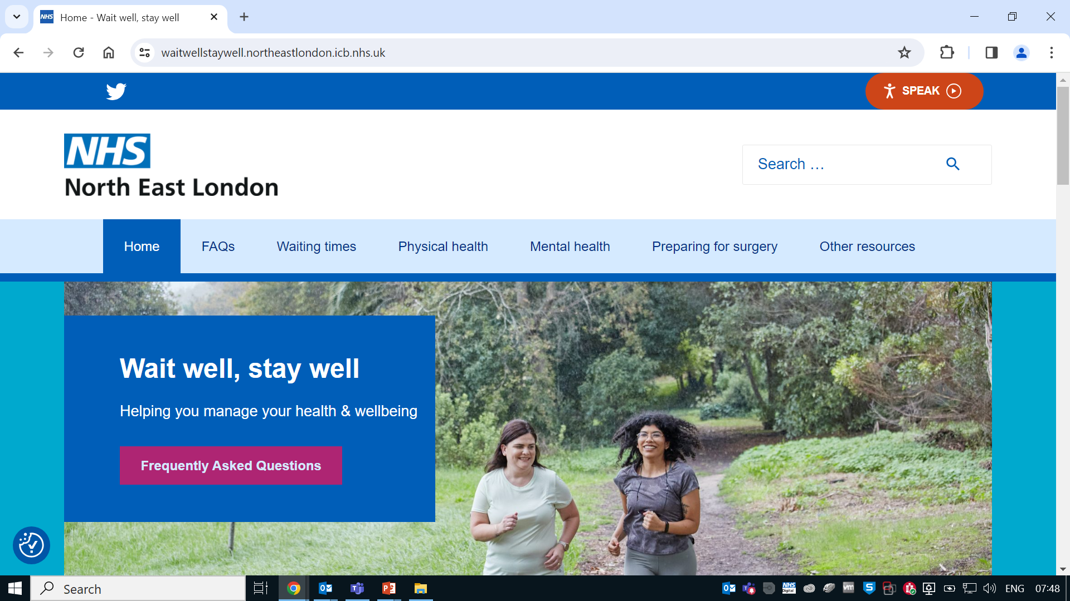
Wait well, Stay well Website
The ‘Wait well, Stay well’ website is designed to help people to manage their own health and wellbeing by providing useful information and links to local and national resources. It is aimed at people waiting for hospital treatment to support them while they are waiting, help them to manage their condition and stay healthy whilst they wait
waitwellstaywell.northeastlondon.icb.nhs.uk/

