Slide 1
Tower Hamlets Women’s Health Hub update
Guy Slade Women’s Health Hub Project Manager – Tower Hamlets and City & Hackney Homerton Healthcare and Barts Health
Ishi Bains
GP THCCG, Primary care lead for gynaecology NHS London,
Planned care clinical lead - women’s health NEL ICB

Slide 2
Tower Hamlets Women’s Health Hub is arriving on
1st December 2023, including
Single Point of Access for women’s health advice and triage to the right service
Women’s Health Hub clinics led by a multidisciplinary team
Why a Women’s Health Hub?
Tower Hamlets faces significant challenges in managing women’s health:
increasing demand for care, particularly for chronic problems like menopause, menstrual health, PCOS and other pelvic health
variable confidence and skill sets in managing women’s health in primary care
convoluted pathways across community, general and specialist services
long wait times
women going to the wrong sub-specialty clinics
inefficient use of outpatient capacity

Slide 3
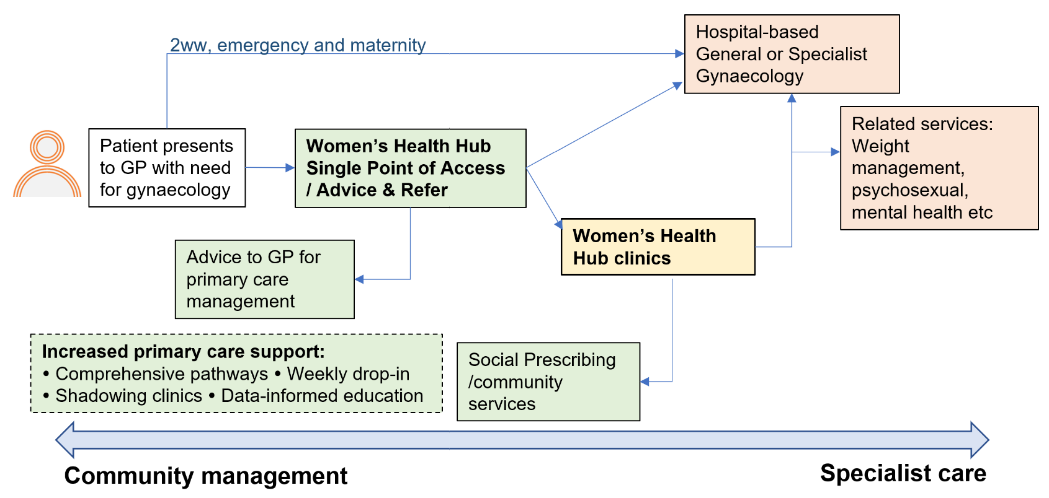
Overview of changes to Gynaecology referral pathways

Slide 4
Single Point of Access
From Friday 1st December 2023, all GP requests for advice or referrals for gynaecology services go through a Single Point of Access – except for 2 week waits, women in pregnancy, abortions, emergency gynaecology and <16 year olds.
On ERS, GPs will use, within the Gynaecology specialty:
Advice & Guidance – Tower Hamlets Women’s Health Hub Single Point of Access - Barts Health NHS Trust – R1
Advice and triage provided by a MDT, including:
Consultant Gynaecologist
Sexual and Reproductive Health Consultant
GP with a Special Interest (GPSI) in Women’s Health
Administrator
on Monday afternoon, Tuesday morning and Thursday morning
We are also working towards providing a hotline for GPs to briefly discuss any queries they may have.
Practised running through Advice & Guidance over last 6 weeks and reduced backlog.
Aim to improve quality of advice and more efficient use of services (including new Women’s Health Hub clinics)

Slide 5
Women’s Health Hub clinics
MDT at Sylvia Pankhurst Centre/Community Women’s Health Services at Mile End Hospital
On Wednesdays and Fridays starting on Wednesday 3rd January 2024.
For common gynaecological needs (not requiring invasive investigation), including:
Menorrhagia, LARC (contraception and menorrhagia), Postnatal care 8 weeks plus, Chronic Pelvic pain, Vaginismus, AUB, Menopause, Urogynaecology, Urinary incontinence, PMS, PCOS, Difficult smears/ difficult threads, Biopsies (vulval).
The clinics are run by:
GPs with a Special Interest (GPSI) in Women’s Health who are experienced GPs working in Tower Hamlets practices.
Physiotherapist offering specialist assessment and rehabilitation for pelvic, bladder and bowel pain and dysfunction. They support women for incontinence, chronic pelvic pain, vaginismus, sexual intercourse issues and post-natal care (beyond 6-8 weeks).
Specialist Nurse e.g. for LARC insertion for menorrhagia and/or contraception, biopsies and difficult coil thread checks.
Sonographer to ensure that any patients requiring scanning can be identified, scanned and receive other investigations and care within the same visit.
Sexual and Reproductive Health Consultant and Consultant Gynaecologist for specialist care and to provide necessary training, supervision and support for other members of the team.
Health Care Assistant

Slide 6
What else?
Joint NEL work / plans:
North East London Community Gynaecology weekly drop-in
every Wednesday at 1:00-2:00pm on MS Teams to discuss cases, ask questions, or listen and learn. Gynaecologists/SRH Consultants from North East London (Homerton, Barts and BHR) give advice or answer questions on anything related to women’s health e.g. menopause, menstrual health, contraception and vulvovaginal problems. Please email guyslade@nhs.net if you want the meeting invite or more information – or you can join the meeting here
Development of common pathways
Shared evaluation of our Women’s Health Hub services
Exploring potential for shared roles across North East London, e.g. women’s health dietitian
We are also open to ideas from primary care and others about how we can achieve our aims during the pilot
Work will begin soon on the business case for a service after the pilot ends from September 2024.

