Slide 1
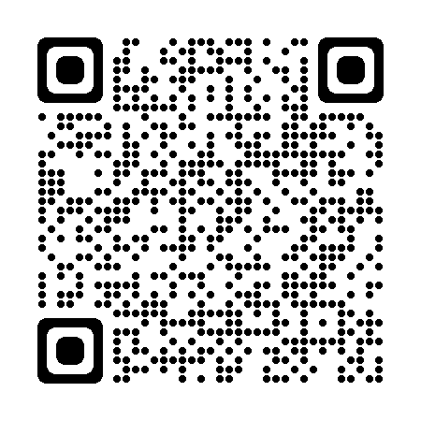
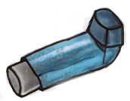
Wheeze Discharge Advice
Advice for parents/carers
What is wheeze?
Wheeze is a whistling sound caused by narrowing of the airways. This can sometimes only be heard through a stethoscope. It has many causes including viral infections.
If you cannot hear a wheeze, an increase in your child / young person’s work of breathing can also be a useful sign of airway narrowing. Scan the QR code for an example.
Using salbutamol (the blue inhaler) to treat wheeze at home
When your child is wheezy it is important to use the blue inhaler to treat their symptoms. This flow chart can guide treatment during an asthma attack, and can help you reduce treatment safely as your child recovers. It is important to assess your child’s symptoms regularly and at least four hourly to be sure they are getting better. This is particularly important at night and first thing in the morning.
Assess your child
Are they breathless or wheezy?
Do they have increased work of breathing?
Yes?
Give 2 puffs one at a time using a spacer.
Review their response after 5-10 minutes.
If not improving give another 2 puffs and reassess after a further 5-10 minutes.
If still not improving, repeat up to a total dose of 10 puffs and reassess in 5-10 minutes.
No?
They do not need their blue inhaler.
Continue to review them at least every 4 hours for the next 12 hours.
Children who are improving and look well should still be checked regularly but don't have to be woken up.
Reassess your child
Are you still concerned about your child’s breathing?
Yes?
Give up to another 10 puffs of blue inhaler one at a time using a spacer and then
SEEK URGENT HELP!
Call 999 or attend the Emergency Department
At their most unwell your child might need the blue inhaler as often as every 4 hours.
Needing it less often is a sign that your child is getting better.
Needing it more often may mean they need urgent medical help: Call 111, see your GP, or go the emergency department if you are worried.
Call 999 if you think your child is very unwell.
Please document your assessments and salbutamol treatment in the log on the next page.
Bring the log to any medical review.
Wheeze Discharge Advice Leaflet - Version 1 Sept 2022 - L King, C Nwokoro - Barts Health NHS Trust
based on an original document by S Harper, G Connett, D James - University Hospital Southampton NHS Foundation Trust

Slide 2
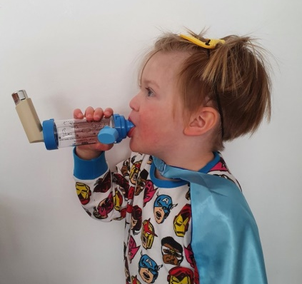
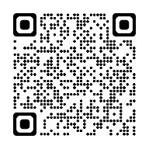
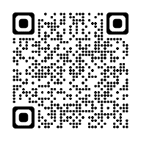
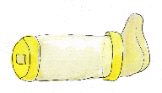
Wheeze Discharge Advice
Advice for parents/carers
How to use an inhaler with a spacer
1 Shake the inhaler and remove cap.
2 Fit the inhaler into the opening at the end of the spacer.
3 Place the mask over the child’s mouth and nose or the mouthpiece in their mouth ensuring a good seal (many children aged over 3 years can manage without a mask).
4 Press the inhaler once and allow the child to take 5 slow breaths or slowly count to 10 whilst they breath through the spacer.
5 Remove the inhaler and shake it. Wait 1 minute before giving a second puff.
6 Repeat steps 1 – 5 if more puffs are needed.
Plastic spacers should be washed before being used for the first time and every month as per manufacturer’s guidelines
Scan the icons below with your smartphone camera to see a video showing how to use a spacer:
With a facemask
With a mouthpiece
Scan this code with your smartphone camera to see a video showing increased work of breathing.
Salbutamol (Blue inhaler) treatment log
Please document assessments and treatment. Show this log to your doctor or nurse treating you for your wheeze attack.
Wheeze Discharge Advice Leaflet - Version 1 Sept 2022 - L King, C Nwokoro - Barts Health NHS Trust
based on an original document by S Harper, G Connett, D James - University Hospital Southampton NHS Foundation Trust

