Slide 1
Children and Young people in primary care
julia.moody@nhs.net

Slide 2
C19 is generally affecting adults but….
There is high anxiety and reduced presentation in all settings for children and pregnant women
non-C19 morbidity and mortality; suggested increased in London but not locally
and also suggestions of a new multi organ inflammatory condition with overlapping features of toxic shock syndrome and atypical Kawasaki Disease of C19 or post C19 aetilogy, single figures nationally, under review
Children are harder to assess remotely and with confidence
The impact on families and children of self-isolation is significant

Slide 3
agenda
Assessing children remotely, and F2F
Opportunities for integrated working, eg the 6-8 week check, 0-19s service, Health Spot and Safe East, Locality Paediatricians
Mental Health and service update
Medically vulnerable children for “shielding”
Other vulnerabilities, safeguarding and working with partners
Resources

Slide 4
Assessing children
Same criteria and pathways………
…………………………………………but a new context

Slide 5
Remote consultations
Where are they and who is in the home/room? Consider video 360deg view.
“Are you able to answer my questions safely?”
Avoid using a family member for advocacy if possible. Language shop conference call etc.
How is the child behaving, what are they doing? Note activity levels.
What has the oral intake of the child been today and when last passed urine? (note reduced fluids by 50% , not PU for 12hrs, or < 3 wet nappies in 24hrs)
Can parents obtain a digital thermometer and check the axilliary temp?
Ask how they are managing with lockdown, what are the challenges?

Slide 6
Consider where best to examine - when necessary
Assess C19 infection risk
Share decisions with a colleague
The child and one adult

Slide 8
MANAGEMENT BY REMOTE ASSESSMENT(E.G. TELEPHONE TRIAGE)
Children whose symptoms suggest an immediate life-threatening illness should be referred immediately for emergency medical care (usually via 999 -ambulance)
Children with any red features but who are not considered to have an immediately life-threatening illness should be assessed urgently in a face to face setting within 2 hours.
Children with amber but no red features should be assessed in a face to face setting.
Children with green features only can be cared for at home with appropriate advice for carers, including advice on when to seek further attention from healthcare services.

Slide 9
3 minute assessment
https://spottingthesickchild.com/videos/basic-child-assessment/3-minute-toolkit/3-min-toolkit-demo/3-min-toolkit-demo/

Slide 10
Kawasaki disease?
be aware of the possibility of Kawasaki disease in children with fever that has lasted 5 days or longer. Additional features of Kawasaki disease may include:
Bilateral conjunctival injection without exudate.
Erythema and cracking of lips; strawberry tongue; or erythema of oral and pharyngeal mucosa.
Oedema and erythema in the hands and feet.
Polymorphous rash.
Cervical lymphadenopathy.
  Ask parents or carers about the presence of these features since the onset of fever, because they may have resolved by the time of assessment. Be aware that children under 1 year may present with fewer clinical features Kawasaki disease in addition to fever, but may be at higher risk of coronary artery abnormalities than older children.

Slide 11
Tonsillitis?
Suspected tonsillitis in primary care or emergency departments, RCPCH
During the COVID-19 pandemic, if a diagnosis of tonsillitis is suspected based on clinical history, the default becomes not examining the throat unless absolutely necessary.
If using the feverpain scoring system to decide if antibiotics are indicated (validated in children 3 years and older),3 we suggest that a pragmatic approach is adopted, and automatically starting with a score of 2 in lieu of an examination seems reasonable.
Antibiotics should be considered in children with a total feverpain score of 4 or 5 (we suggest children with a score of 3 or less receive safety netting advice alone).
Although this is likely to result in a temporary increase in antibiotic prescribing in children, we feel that this is preferable to healthcare staff being unnecessary exposed to COVID-19. Antibiotics rarely confer a benefit in children under 3 years with tonsillitis and should only be prescribed in exceptional circumstances or if a diagnosis of scarlet fever is strongly considered.

Slide 12
Ibuprofen?
Experts at RCPCH recommend that parents treat symptoms of fever or pain related to COVID-19 with either paracetamol or ibuprofen.
The Commission on Human Medicines’ Expert Working Group on coronavirus (COVID-19) has concluded that there is currently insufficient evidence to establish a link between use of ibuprofen, or other nonsteroidal anti-inflammatory drugs (NSAIDs), and contracting or worsening of COVID-19.

Slide 13
Paediatric support
NW Locality Paediatrician:
akshaya.jain@nhs.net
•NE Locality Paediatrician:
rima.alsaffar@nhs.net
•SW Locality Paediatrician:
susie.minson@nhs.net
•SE Locality Paediatrician:
anna.riddell@nhs.net
•Other contacts:
g.peh@nhs.net
georgios.eleftheriou@nhs.net
antonyaston@nhs.net
andrew.prendergast@nhs.net
benita.morrissey@nhs.net
abali@nhs.net
j.halbert@nhs.net​
For complete Barts consultant contacts click here
The Paediatric Hotline for TH GPs; 07919598173
Paediatric Rapid Access Clinic, via Hotline
Guidelines;
http://gp.towerhamletsccg.nhs.uk/clinical-services/paediatric-guidelines.htm
Notes:
What guidelines
What could integrated paeds look like moving forward?

Slide 14
Integrated Contacts
Suggested combined screening assessment and 8 week imms, see documents
Midwives see for screening and weight at day 5 and at day14, then handover to HV
Family Nurses, Health Visitors and School Nurse are currently undertaking virtual consultations via video link. Family Nurses and Health Visitors are also now offering face to face contacts in Children’s Centres (following screening) for children with medical need or where safeguarding concerns require an assessment greater than video contact is able to provide.
Health Visitors and School Nurses are available for virtual MDT meetings for vulnerable children.
https://www.gpcaregroup.org/section/455/Services/page/aa00a727-6bda-4611-8539-4713474e22db/Health-Visiting

Slide 15
Adolescent health
Health Spot; An extended Hub GP service for YP;
https://wearespotlight.com/news/health-spot-has-landed/
Working alongside Safe East (integrated sexual health and drugs misuse for YP)
https://www.compass-uk.org/services/tower-hamlets-compass-safe-east/

Slide 16
Medically high risk children for screening
Those in the adult groups and:
Cyanotic Congenital Heart Disease
Severe Asthma, see below
Cystic Fibrosis
Sickle Cell disease
chronic respiratory disease of the newborn requiring oxygen
respiratory vulnerability due to neurodevelopmental disorders (latter 2 groups known to childrens community and therapy teams and should have been contacted)
Those in remission from leukaemia may still be at risk, seek advice

Slide 17
asthma
Increasing with hayfever, a good time to ensure they have been reviewed;
The current children’s asthma guideline;
https://drive.google.com/file/d/1a-XKLJqORFGm0VoD8SKTtknEX4Z5-kMs/view
Asthma in Covid19 ELHCA guidelines for clinicians and families;
https://onedrive.live.com/view.aspx?resid=A7FC78D24D1DACE7!1340&ithint=file%2cdocx&authkey=!AFCqGkyzcDgR6Gk

Slide 18
Mental health
Childline and Youngminds both report increased anxiety and mental health issues and safeguarding concerns. Early increase in completed suicides in South Wales
Core CAMHS service accepting referrals
CAMHS; duty number is 02074262375, 9-5pm, Crisis Team 9-9pm 7/7
Crisis number; 24/7 for CYP, parents and carers; 02077715807
The Community Eating Disorders (CEDS) duty team is contactable on 02082155270.
Step Forward,
Docklands Outreach, 020 7538 1601 info@dockout.org.uk
The Community Eating Disorders (CEDS) duty team is contactable on 02082155270.
https://youngminds.org.uk/blog/what-to-do-if-you-re-anxious-about-coronavirus/
CAMHS recommend the following link for CYP and families; https://youtu.be/zDx1LKkk5c4

Slide 19
safeguarding
GP Practice cSG Leads are now being sent weekly lists of children with CP Plans and those Looked After.
Early Help Hub and Children’s Social Care via MASH can be contacted in the usual ways as per these links;
https://www.towerhamlets.gov.uk/lgnl/health__social_care/children_and_family_care/Early_Help/Early_Help_Hub.aspx
http://gp.towerhamletsccg.nhs.uk/GP%20services/safeguarding%20children/FINAL%20version%20cSG%20advice%20and%20referral%20TH%20CCG%20primary%20care.pdf

Slide 20
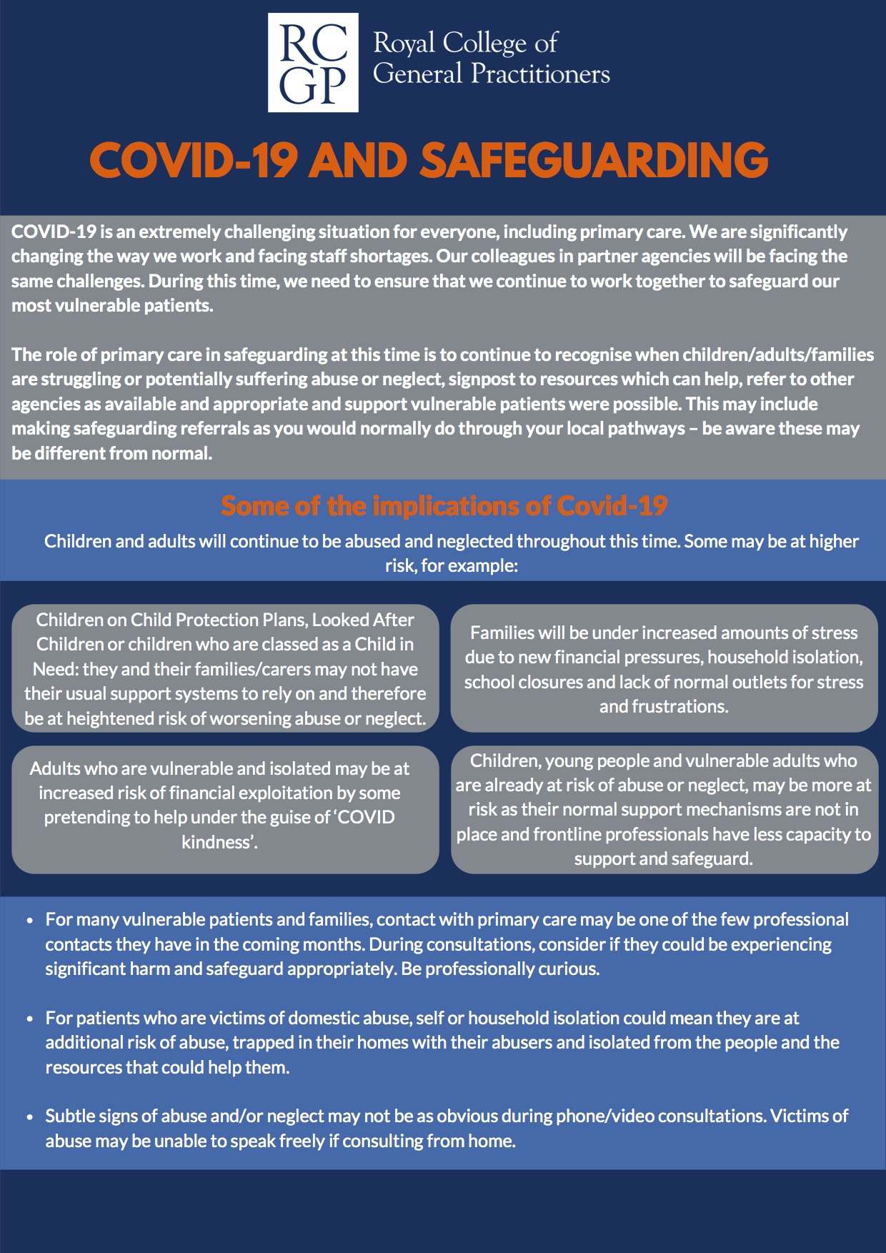
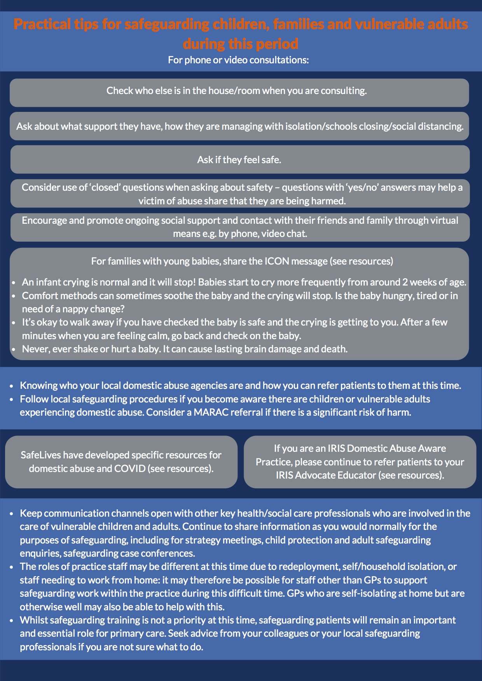

Slide 21
Domestic abuse
The freephone, 24-hour National Domestic Abuse Helpline 0808 2000 247
999 call when not able to speak; call 999, cough, dial 55
https://policeconduct.gov.uk/sites/default/files/Documents/research-learning/Silent_solution_poster.pdf

Slide 22
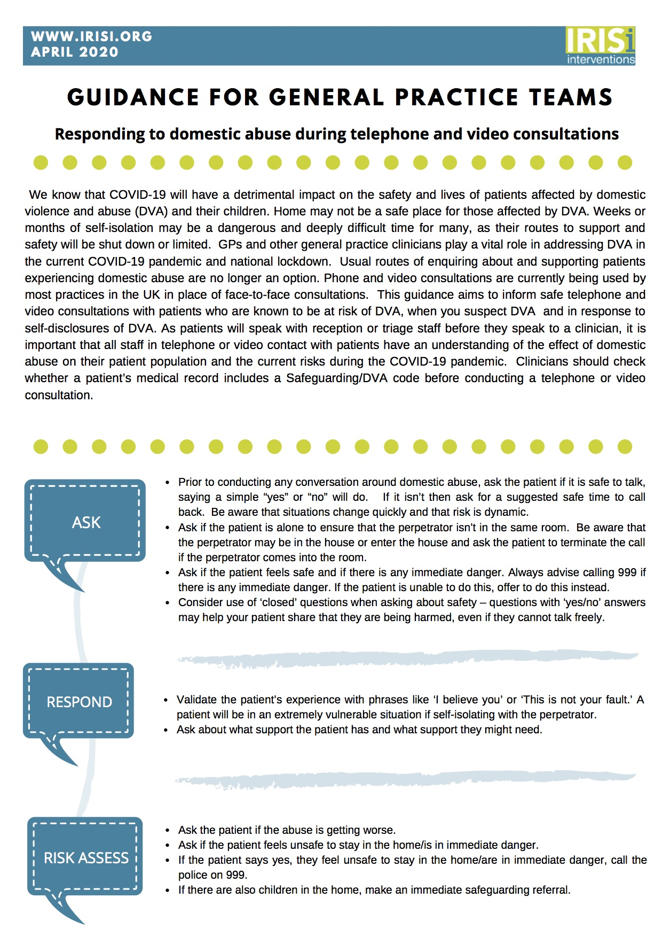
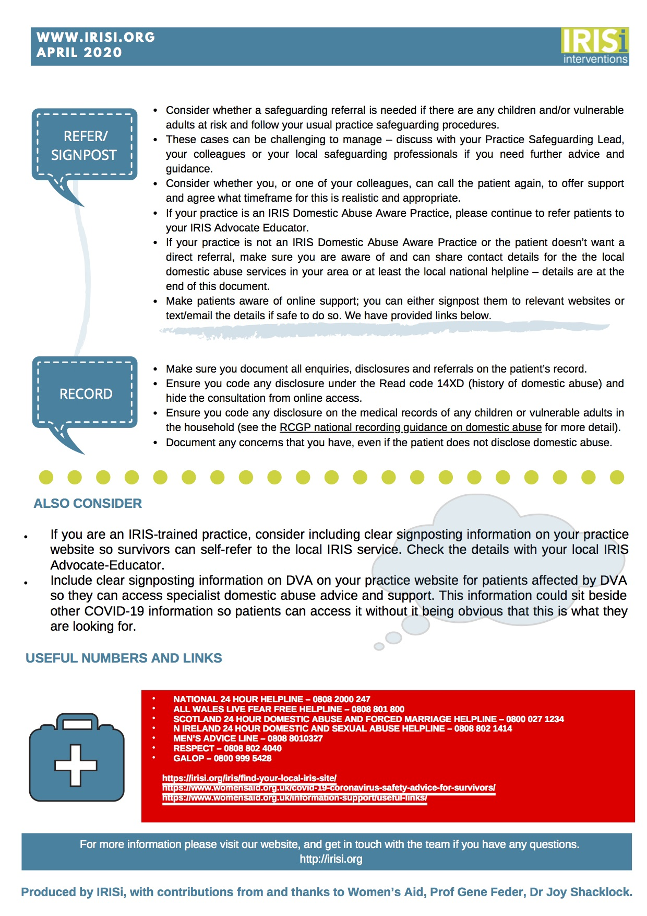
Notes:
Consider video 360deg view.

Slide 23
Palliative care and bereavement
How to tell the the children;
https://www.psych.ox.ac.uk/files/research/how-to-tell-children-that-someone-has-died.pdf
Phone calls breaking the news of bereavement;
https://www.rcpch.ac.uk/sites/default/files/2020-04/contacting_relatives_by_phone_to_communicate_death_of_a_patient_final.pdf
CYP palliative care; Richard House and the GOSH palliative care team; https://www.england.nhs.uk/coronavirus/wp-content/uploads/sites/52/2020/03/C0249-clinical-guidelines-children-young-people-with-palliative-care-needs-24-04-2020.pdf
Notes:
Schools bereavement package

Slide 24
Resources for parents
Parents advice 111 leaflet
http://www.whenshouldiworry.com
Care Confident materials;
https://www.towerhamletstogether.com/care-confident
Parents of Children with Complex Needs;
https://www.wellchild.org.uk/2020/03/11/covid-19-information-for-parents-and-carers/
Children with Cancer, advice for parents; https://www.cclg.org.uk/Coronavirus-advice

Slide 27
recoverY
Mental health impacts
Obesity and Exercise
“New Normal”, what can we learn?

Slide 28
Questions;
Breastfeeding; No evidence of vertical transmission yet, WHO recommend hand washing and mask if mother infected;
https://www.who.int/news-room/q-a-detail/q-a-on-covid-19-and-breastfeeding
Unicef guidance;
Unicef-UK-Baby-Friendly-Initiative-statement-on-infant-feeding-during-the-Covid-19-outbreak

