Slide 1
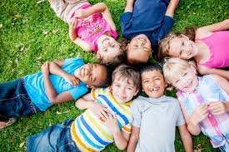
MMR Vaccination Programme
Toolkit for improving uptake in Primary Care
https://www.england.nhs.uk/london/our-work/immunis-team/

Slide 2
Aim of this toolkit
Measles, Mumps and Rubella (MMR) toolkit
Since the introduction of the MMR vaccine, there has been a significant reduction in the prevalence of measles, mumps and rubella in England and Wales. However, due to a number of factors including misinformation about the impact of the MMR vaccine on behavioural conditions, there have been fluctuating uptake levels.
The consequences of contracting measles or Rubella can be significant: around one in 5000 individuals with Measles is likely to die and since 2006, there have been 3 deaths from measles in England and Wales. Complications of Rubella are rare for those who are pregnant, catching Rubella during pregnancy, can lead to devastating consequences for the unborn baby such as cataracts, deafness, heart defects and in some cases even miscarriage.
Due to a resurgence of measles in the last few years, the UK has lost its measles free statutes. Post Covid we are seeing an increased activity in measles uptake and therefore tit is important to vaccinate our population.
The purpose of this toolkit is to increase the uptake of the MMR vaccine by:
Giving a summary of the vaccine landscape in London in order to help contextualise the problem
Identifying key barriers to increasef vaccine uptake
Suggesting evidence based / best practice ideas to increase uptake with little to no cost implications for your practice
Highlighting resources available to help with patient discussions.
We are always looking for ways to capture best practice so if you have any suggestions you think we should include in future updates of this toolkit please email england.londonimms@nhs.net
MMR Vaccination Toolkit
2023/24
https://www.england.nhs.uk/london/our-work/immunis-team/

Slide 3
What is the background?
Measles cases are rising in England this year. There were 128 cases from 1st Jan – 30th June, of which the majority were in London, this is not expected to be higher. The vaccination rate is lower than the 95% target set by WHO and as low as 60% in some areas of London.
UKHSA have predicted that the risk in London is high this year and cases could rise to between 40k and 160k due to low uptake of the MMR and the number of cases being imported and spread.
The overall risk to England is low, but there are cases of measles in every region and numbers are rising. UKHSA suggest that without intervention cases will continue to rise in all regions.
UKHSA are publishing their ministerial submission and modeling paper outlining the risk of measles in England as low and London as high on 14th July 2023. It is expected to gain much press interest.
NHS England are launching a measles awareness campaign on 14th July encouraging the uptake of the MMR vaccine.
MMR Vaccination Toolkit
2023/24
https://www.england.nhs.uk/london/our-work/immunis-team/

Slide 4
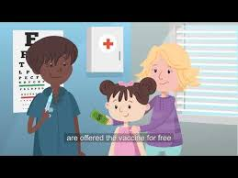
Contents
Measles, Mumps and Rubella 1 -2
MMR Vaccine – What is it? 3
MMR facts 4-5
Identifying eligible patients 6
Challenges to MMR Uptake 7
Over coming challenges in Primary Care 8
Address Inequalities in Update 9 -10
GP contract Update 11-14
GP Payments 15
MMR Snomed Codes 16 - 22
Ordering MMR Vaccine 23
MMR Contra-indications 24
Inviting and Informing patents 25
MMR Vaccination Toolkit
2023/24
https://www.england.nhs.uk/london/our-work/immunis-team/

Slide 5
What is MMR? (Measles, Mumps and Rubella)
(Source: Measles | Doctor | Patient)
 | Measles | Mumps
What is it? | Measles is an acute viral illness caused by a morbillivirus of the paramyxovirus family. Measles is one of the most infectious diseases with an average of 15-20 people being infected from a single case in a susceptible population. | Mumps is an acute viral illness caused by a paramyxovirus. It is usually characterised by bilateral parotid swelling, although it may present with unilateral swelling. Parotitis may be preceded by several days of non-specific symptoms such as fever, headache, malaise, myalgias and anorexia. Asymptomatic mumps infection is common, particularly in children (Plotkin and Orenstein, 2004).
Transmission | Measles is transmitted through respiratory droplets but can also be spread indirectly through surfaces. | Measles is transmitted through respiratory droplets but can also be spread indirectly through surfaces.
Incubation Period and Infectiousness | From time of exposure, measles incubates for 10 days with a further 2-4 days of prodromal symptoms before rash appears. Infectiousness begins when prodromal symptoms first appear to about 4 days after onset of the rash. | The average incubation period is around 16-18 days but this can range from 12-25 days. Individuals are most infectious around 1-2 days before onset of symptoms and for up to 9 days after.
Symptoms | 2-4 days of fever, cough, runny nose, mild conjunctivitis and diarrhoea. Koplik’s spots are pathognomonic (they appear in 60-70% of patients) Rash for at least 3 days, high fever, sometimes there can be swelling around the eyes and photophobia. | Fever, headache, malaise, myalgia and anorexia (non-specific symptoms) can occur before the parotitis Painful parotitis (usually bilateral but can be unilateral), severe swelling, fever as high as 39.5OC
Complications | Likely to occur in certain groups including people with weakened immune systems, babies under one year old and pregnant women. Complications can include chest and ear infections, fits, diarrhoea, encephalitis (infection of the brain) and brain damage. Those who develop complications may need to admitted to hospital for treatment. | Mumps can be very painful and can include inflammation of the ovaries or testicles, and in rarer cases, the pancreas. Mumps can also cause viral meningitis and encephalitis (infection of the brain). Although permanent hearing loss after mumps is rare, around one in 20 people infected may have temporary hearing loss. Mumps is an acute viral infection caused by a paramyxovirus that can affect any organ but usually affects the salivary glands. Most mumps infections are in children and young people
MMR Vaccination Toolkit
2023/24
https://www.england.nhs.uk/london/our-work/immunis-team/
1

Slide 6
What is MMR? (Measles, Mumps and Rubella)
 | Rubella (German Measles)
What is it? | Rubella is a mild disease cased by a togavirus. There may be a mild prodromal illness involving a low-grade fever, malaise, coryza and mild conjunctivitis. Lymphadenopathy involving post-auricular and sub-occipital glands may precede the rash. The rash is usually transitory, erythematous and mostly seen behind the ears and on the face and neck. Clinical diagnosis is unreliable as the rash may be fleeting and is not specific to rubella. Rubella is spread by droplet transmission. Individuals with rubella are infectious from one week before symptoms appear to four days after the onset of the rash.
Transmission | Rubella is transmitted by airborne droplets from infected people.
Incubation Period and Infectiousness | The incubation period is 14-21 days and individuals are infectious up to 7 days before and 4 days after symptoms occur.
Symptoms | Prodrome: General fatigue, low grade fever, headache, mild conjunctivitis, anorexia and rhinorrhoea. This prodrome is more noticeable in adults and may be absent in children. Other symptoms: The main symptom Rubella causes is a red or pink discrete macular rash that coalesce starting behind the ears and spreads to the head neck and body . Other symptoms include lymphadenopathy which may precede the rash and arthralgia in older patients.
Complications | Complications of rubella are rare but if a pregnant woman catches rubella during pregnancy, there can be devastating consequences for her unborn baby which could lead to the baby being born with cataracts (eye problems), deafness, heart problems or brain damage.
MMR Vaccination Toolkit
2023/24
https://www.england.nhs.uk/london/our-work/immunis-team/
2

Slide 7
Introduction
Introduction
Introduction
Introduction
Introduction
Introduction
MMR Vaccine: what is it?
The MMR vaccine is a safe and effective combined vaccine. ( Green Book of Immunisation - Chapter 21 Measles (publishing.service.gov.uk))
1. One vaccine
The MMR vaccine is a single injection that is administered into the thigh of young children or the upper arm of older children or adults. It is a live vaccine which means that it contains weakened versions of measles, mumps and rubella viruses. These have been weakened enough to produce immunity without causing disease.
2. Two doses
The MMR vaccine gives long lasting protection with just two doses of the vaccine. The first dose is given at the age of 12 months and the second dose is given at around three years and four months, before starting school. Having both doses gives long lasting protection against measles, mumps and rubella. In adults and older children the two doses can be given with a one month gap between them. ( Green Book of Immunisation - Chapter 21 Measles (publishing.service.gov.uk))
3. Three infections
The MMR vaccine protects against three infections; measles, mumps and rubella. These are viral infections that can quickly spread to unprotected children and adults – they spread more easily than flu or the common cold.
Effectiveness of the MMR vaccine (https://www.cdc.gov/vaccines/vpd/mmr/public/index.html)
The MMR vaccine is very effective.
After 2 doses:
around 99% of people will be protected against measles and rubella
around 88% of people will be protected against mumps
People who are vaccinated against mumps, but still catch it, are less likely to have serious complications or be admitted to hospital.
Protection against measles, mumps and rubella starts to develop around 2 weeks after having the MMR vaccine
3
MMR Vaccination Toolkit
2023/24
https://www.england.nhs.uk/london/our-work/immunis-team/
1

Slide 8
Introduction
Introduction
Introduction
Introduction
Introduction
Introduction
MMR Facts
One vaccine, Protects against 3 infectious diseases:
Measles, Mumps and Rubella
MMR Vaccine Schedule:
Child's age | Vaccine
1 year | MMR (1st dose)
3 years and 4 months | MMR (2nd dose)
Symptoms include:
Rubella include a rash, cold-like symptoms, and aching joints.
Mumps usually last around two weeks and can include headache and fever but the most common symptom is swelling of the glands at the side of the face. This can give the appearance of having a ‘hamster face’ and can cause pain and difficulty swallowing.
Measles include fever, sore red eyes and rash. It can be a very serious infection for some people.
Source: NHS
4
MMR Vaccination Toolkit
2023/24
https://www.england.nhs.uk/london/our-work/immunis-team/
2

Slide 9
Introduction
Introduction
Introduction
Introduction
Introduction
Introduction
MMR Facts
Why are babies given the MMR vaccine at 1 year, plus 3 years and 4 months?
MMR at 1 year
Newborn babies have antibodies passed on from their mother at birth. This helps protect them for a short time against measles, mumps and rubella.
These antibodies make the MMR vaccine less effective if it's given to a newborn.
By the time a child is 1 year old, the antibodies are almost gone, and the MMR vaccine will be effective.
MMR at 3 years and 4 months
The 2nd dose is given at around 3 years and 4 months, before a child starts school.
Having both doses gives long-lasting protection against measles, mumps and rubella.
Is the MMR vaccine ever given to babies earlier?
Babies over 6 months old are sometimes given the MMR vaccine earlier than usual if:
they may have been exposed to the measles virus
there is an outbreak of measles
they are travelling abroad to a country where measles is common
The 2 usual doses of MMR will still be needed when they're older to ensure full protection.
When older children and adults should have the MMR vaccine.
Anyone who has not had 2 doses of the MMR vaccine should ask their GP surgery for a vaccination appointment.
It's important to check you've had both doses if you:
are about to start college or university
are going to travel abroad
are planning a pregnancy
are a frontline health or social care worker
were born between 1970 and 1979, as you may have only been vaccinated against measles
were born between 1980 and 1990, as you may not be protected against mumps.
Source: NHS
5
MMR Vaccination Toolkit
2023/24
https://www.england.nhs.uk/london/our-work/immunis-team/
2

Slide 10
Introduction
Introduction
Introduction
Introduction
Introduction
Introduction
MMR: Identifying Eligible Patients
The UK national vaccination programme ensures to offer all eligible patients (children and adults) immunisations so they can be protected from infectious diseases. All patients remain eligible until they have completed the immunisation schedule.
Young children:
Two deses of the MMR vaccination should be offered to children
- the first one just after the first birthday and
- the second dose before they start school, (usually at around three years and four months of age).
Women of Child bearing age.
Rubella can be very serious infection for unborn babies, it can cause blindness, deafness and even if the patient is planning to have a baby, GP practice should ensure that patents has had two doses of MMR vaccine before they become pregnant.
Older adults
GP practice should check records of older adults to ensure they have received 2 doeses of the MMR.
Older children, teenagers and young adults
If the patients have never previously had MMR vaccine or have only had one dose of it, GP practice should arrange to catch up with the outstanding doses.
If the patient has already had one dose of MMR vaccine as a young child then the GP practice should arrange a further dose .
If the patient need two doses then they can be given with a one month gap between them.
Born or brought up abroad
People who were born or brought up abroad may need two doses of MMR. Different countries offer different immunisations and not all use the combined MMR vaccine. Please check the algortium for not sure and unvaccinated.
Source: NHS
6
MMR Vaccination Toolkit
2023/24
https://www.england.nhs.uk/london/our-work/immunis-team/
3

Slide 11
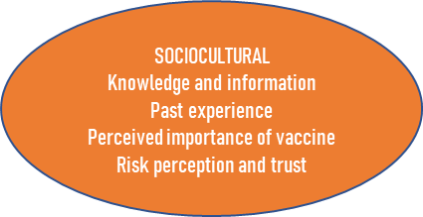
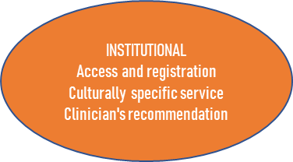
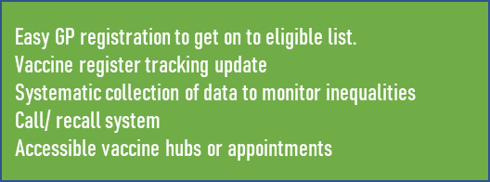
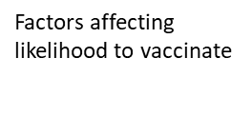
Introduction
Introduction
Introduction
Introduction
Introduction
Introduction
Challenges to MMR Uptake
The decision to vaccinate is affected by many factors and as a result, to increase uptake of vaccine, factors that support the uptake of vaccine should be promoted and mitigated actions should be taken to decrease the influence of factors tat increase hesitancy.
Framework highlights key opportunities where GP Practices can influence patients/ parents to vaccinate.
Source: Framework adapted and simplified from OHID London theoretical framework for vaccine uptake
7
MMR Vaccination Toolkit
2023/24
https://www.england.nhs.uk/london/our-work/immunis-team/
3

Slide 12
Overcoming Challenges to MMR Uptake: Primary Care
The Royal Society of Public Health identified the key barriers to uptake of vaccination were accessibility and convenience of vaccination services. Factors specifically relevant to primary care include timing of appointment and availability of appointments.
Send invites and reminders: | Ensure patient details are accurately recorded and that invitations are sent in good time There is evidence that call/recall is the single most effective intervention to increase uptake. (Source) There is also evidence that use of text message reminders which include the cost of appointments can significantly reduce rate of non-attendance (Source)
Proactive identification (Source): | Receptionist can check if children/ people are up to date with vaccines when booking appointments and offer them an appointment for a catch up vaccine Incorporating alerts into IT systems to flag those who are due a vaccine
Accurate Data Collection | Record vaccinations using the correct Read 2, CTV3 or SNOMED Codes (see Coding section) to ensure your practice’s coverage is not wrongly recorded as being lower than it is
Appointments and Recommendations | Offer more appointments and appointments which are longer and more flexible – there is evidence to support flexible appointments as an effective measure to overcome barrier to uptake. (Source) Use the opportunity during other appointments to speak confidently about vaccines to parents – you can sign up to get regular vaccine updates here There is evidence that a you can sign up to get regular vaccine updates here (Vaccine update - GOV.UK (www.gov.uk). Strong recommendation from a healthcare worker is effective at encouraging vaccination. (source)
MMR Vaccination Toolkit
2023/24
https://www.england.nhs.uk/london/our-work/immunis-team/
8

Slide 13
Overcoming Challenge to MMR Uptake: Addressing Inequalities in Uptake (Learnings from COVID)
There is evidence that amongst childhood vaccinations including the MMR vaccine, there is lower uptake amongst those from some Black, Asian and other ethnic minority groups (Source).
There is also a known association between lower uptake of the MMR vaccine in more deprived groups (Source)
This is especially important, given that London is the most diverse region in the UK with varying levels of deprivation, that specific barriers to uptake affecting these groups are addressed in order to increase uptake of the MMR vaccines (and indeed all other vaccines). The roll out of the COVID vaccine provided an opportunity to learn about best practice and key lessons (Source).
Lessons from the COVID vaccine (Source)
Barrier 1 | Lack of trust in government institution:
 | A history of historic injustices and inequalities, concerns about repercussions with ‘lack of ID, proof of address or immigration status’
Barrier 2 | Lack of trust in information.
 | A lack of information around specific concerns (e.g. fertility) from healthcare professionals combined with specific social media/ online platforms purporting a distrust in the vaccine
Barrier 3 | Belief that cost outweighs benefits.
 | Needing to inconvenience oneself e.g. taking time off work to recover from the vaccine and its side effects can lead to a reluctance to uptake
MMR Vaccination Toolkit
2023/24
https://www.england.nhs.uk/london/our-work/immunis-team/
9

Slide 14
Overcoming Challenges
Target messaging: | Information made available in relevant languages and distributed to residents in low uptake groups. GP Practices could work to addressing specific concerns during consultations in order to correct erroneous beliefs Proactively working to improve trust and relationships with patients
Community Engagement | GP Practices could work with community champions/ social prescribers especially those who are from the same communities as those targeted to be a ‘bridge’ and address hesitancy Focus groups to identity and address key issues but also as a means of ‘getting the correct message out there’
MMR Vaccination Toolkit
2023/24
https://www.england.nhs.uk/london/our-work/immunis-team/
10

Slide 15
Update on GP Contract 23/24
The focus for contractual arrangements this year (23/24) is on supporting teams and improving patient access and experience. We recognise current workload pressures in general practice and no additional requirements will be added to the PCN service specifications in 2023/24 with some other contractual requirements streamlined too.
This is the last year of the five year GP contract reform framework, Investment and Evolution (published 2019), which was introduced to deliver the commitments set out in the NHS Long Term Plan. NHS England will be engaging with the profession, patients, ICSs, government and other key stakeholders during 2023/24 to inform the next steps for general practice.
MMR Vaccination Toolkit
2023/24
https://www.england.nhs.uk/london/our-work/immunis-team/
11

Slide 16
Key changes for 2023/24
The headline changes to the 2023/24 contract are:
Improving patient experience and satisfaction of access
Taking on board feedback from general practice:
building on the success of the Additional Roles Reimbursement Scheme (ARRS) and expanding flexibility of the scheme
changes to childhood immunisations
A streamlined approach to the Impact and Investment Fund (IIF) and Quality and Outcomes (QOF) with a focus on staff wellbeing in the Quality Improvement (QI) module
Freeing up workforce capacity through reducing targets
Contract changed to reflect upcoming updates to vaccinations and immunisations
MMR Vaccination Toolkit
2023/24
https://www.england.nhs.uk/london/our-work/immunis-team/
12

Slide 17
Changes to Immunisations and Vaccinations: Childhood Immunisations
Following feedback from PCN teams and GPC England, there will be the following changes to childhood vaccinations in 2023/24:
the V & I repayment mechanism will be removed for practice performance below 80% coverage across the routine childhood programmes
Childhood V & I QOF indicators:
the lower thresholds will be reduced to 89% (VI001) 86% (VI002) and 81% (VI003) and the upper thresholds raised to 96%
all the points for each indicator will be put into a sliding scale of reward between the lower and upper threshold
reducing the lower thresholds will decrease the number of practices receiving no payment across the three indicators
clarification of the wording in the SFE that an Item of Service (IoS) fee will be payable for vaccinations administered for medical reasons and incomplete or unknown vaccination status (‘evergreen offer’) for the programmes outlined in the SFE Part 5 Vaccinations and Immunisation, section 19.
A new Personalised Care Adjustment will also be introduced for patients who registered at the practice too late to be included in the cohort
MMR Vaccination Toolkit
2023/24
https://www.england.nhs.uk/london/our-work/immunis-team/
13

Slide 18
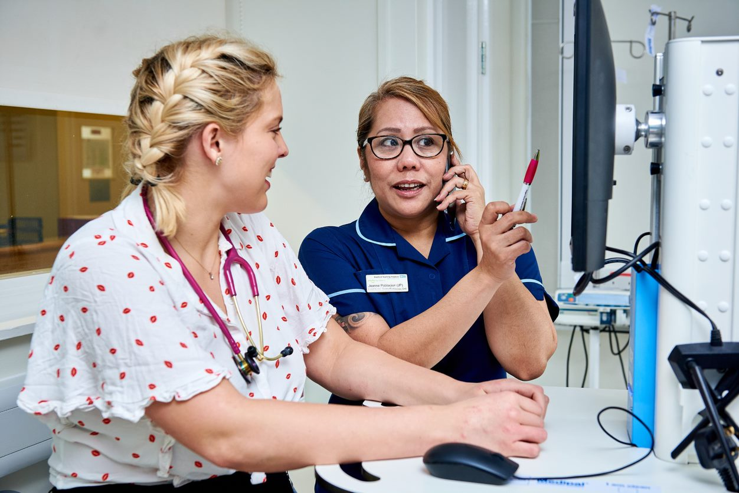
Introduction
Introduction
Introduction
Introduction
Introduction
Introduction
Payments: Requirements
The vaccine is centrally supplied, it has a single item of service payment of £10.06.
All of the following requirements must be met for payment:
The GP practice is contracted to provide vaccine and immunisations as part of additional services.
All patients in respect of whom payments are being claimed were on the GP practices registered list at the time the vaccine was administered and all of the following apply:
The GP practice administered the vaccine to all patients in respect of whom the payment is being claimed.
All patients in respect of whom payment is being claimed were within the cohort (as per the service specification section) at the time the vaccine was administered.
The GP practice did not receive any payment from any other source in respect of the vaccine.
The GP practice submits the claim within six months of administering the vaccine.
10
MMR Vaccination Toolkit
2023/24
https://www.england.nhs.uk/london/our-work/immunis-team/
15

Slide 19
Introduction
Introduction
Introduction
Introduction
Introduction
Introduction
Snomed Codes for MMR Vaccinations
Using the correct clinical code is important to ensure accurate and timely payment as well as helping to inform data on MMR vaccine uptake.
Descriptor | Descriptor | SNOMED Concept ID
MMR (1st dose) | Measles/Mumps/Rubella Vaccine | 38598009
MMR (2nd dose) | Measles, mumps and Rubella booster vaccination | 170431005
 | MMR pre-school booster vaccination | 170432003
Sources:
https://digital.nhs.uk/data-and-information/data-collections-and-data-sets/data-collections/quality-and-outcomes-framework-qof
Quality and Outcomes Framework (QOF), enhanced services and core contract extraction specifications (business rules) - NHS Digital
16
MMR Vaccination Toolkit v2.0
2021/22
https://www.england.nhs.uk/london/our-work/immunis-team/
3

Slide 20
Introduction
Introduction
Introduction
Introduction
Introduction
Introduction
Snomed Codes for MMR Vaccinations
In addition to the codes for the MMR vaccine, GP practices may find it useful to have the following codes:
Descriptor | SNOMED Concept ID
MMR catch-up vaccine invite – enhanced services administration (1st and 2nd Dose) | 505001000000109
17
MMR Vaccination Toolkit
2023/24
https://www.england.nhs.uk/london/our-work/immunis-team/
3

Slide 21
Introduction
Introduction
Introduction
Introduction
Introduction
Introduction
Snomed Codes for MMR Vaccinations
VI002. The percentage of children who reached 18 months old in the preceding 12 months, who have received at least 1 dose of MMR between the ages of 12 and 18 months (NICE 2020 menu ID: NM198) Points: 18 Achievement Thresholds: 95%
Term | Concept ID
M-M-RVAXPRO vaccine powder and solvent for suspension for injection 0.5ml pre-filled syringes (Merck Sharp & Dohme Ltd) | 13968211000001108
Measles, Mumps and Rubella vaccine (live) powder and solvent for suspension for injection 0.5ml pre-filled syringes | 14015211000001108
Priorix vaccine powder and solvent for solution for injection 0.5ml pre-filled syringes (GlaxoSmithKline UK Ltd) | 34925111000001104
Measles, Mumps and Rubella vaccine (live) powder and solvent for solution for injection 0.5ml pre-filled syringes | 34938511000001103
Priorix vaccine powder and solvent for solution for injection 0.5ml vials (GlaxoSmithKline UK Ltd) | 4621611000001106
M-M-R II vaccine powder and solvent for solution for injection 0.5ml vials (Merck Sharp & Dohme Ltd) | 4830211000001107
Vaccination given MMR 1st Vaccinations SNOMED CT
Measles, mumps, and rubella vaccination given | 150971000119104
Measles mumps and rubella vaccination - first dose | 308081000000105
Measles-mumps-rubella vaccination | 38598009
3
MMR Vaccination Toolkit
2023/24
https://www.england.nhs.uk/london/our-work/immunis-team/
18

Slide 22
Introduction
Introduction
Introduction
Introduction
Introduction
Introduction
Snomed Codes for MMR Vaccinations
Administration of MMR 1st Vaccinations SNOMED CT
Administration of measles, mumps, rubella, and varicella vaccine | 432636005
Measles mumps rubella catch-up vaccination | 505001000000109
Administration of measles + mumps + rubella live vaccine | 571591000119106
Administration of measles + mumps + rubella + varicella live vaccine | 572511000119105
MR 1st Vaccination given by other healthcare providers SNOMED CT
First MMR (measles mumps and rubella) vaccination given by other healthcare provider | 999026691000230015
19
MMR Vaccination Toolkit
2023/24
https://www.england.nhs.uk/london/our-work/immunis-team/
3

Slide 23
Introduction
Introduction
Introduction
Introduction
Introduction
Introduction
Snomed Codes for MMR Vaccinations
VI003. The percentage of children who reached 5 years old in the preceding 12 months, who have received a reinforcing dose of DTaP/IPV and at least 2 doses of MMR between the ages of 1 and 5 years. (NICE 2020 menu ID: NM199) Part 1 & 2 is required Points: 18 Achievement Thresholds: 95%
Term | Concept ID
(Part 1) MMR 2nd Drugs SNOMED CT
M-M-RVAXPRO vaccine powder and solvent for suspension for injection 0.5ml pre-filled syringes (Merck Sharp & Dohme Ltd) | 13968211000001108
Measles, Mumps and Rubella vaccine (live) powder and solvent for suspension for injection 0.5ml pre-filled syringes | 14015211000001108
Priorix vaccine powder and solvent for solution for injection 0.5ml pre-filled syringes (GlaxoSmithKline UK Ltd) | 34925111000001104
Measles, Mumps and Rubella vaccine (live) powder and solvent for solution for injection 0.5ml pre-filled syringes | 34938511000001103
Measles, Mumps and Rubella vaccine (live) powder and solvent for solution for injection 0.5ml pre-filled syringes | 34938511000001103
Priorix vaccine powder and solvent for solution for injection 0.5ml vials (GlaxoSmithKline UK Ltd) | 4621611000001106
M-M-R II vaccine powder and solvent for solution for injection 0.5ml vials (Merck Sharp & Dohme Ltd) | 4830211000001107
3
MMR Vaccination Toolkit
2023/24
https://www.england.nhs.uk/london/our-work/immunis-team/
20

Slide 24
Introduction
Introduction
Introduction
Introduction
Introduction
Introduction
Snomed Codes for MMR Vaccinations
(Part 1) MMR 2nd Vaccination SNOMED CT
Measles, mumps and rubella vaccination given | 150971000119104
Measles-mumps-rubella vaccination | 38598009
Administration of measles, mumps, rubella, and varicella vaccine | 432636005
Measles mumps rubella catch-up vaccination | 505001000000109
Administration of measles + mumps + rubella live vaccine | 571591000119106
Administration of measles + mumps + rubella + varicella live vaccine | 572511000119105
(Part 1) Administration of MMR 2nd Vaccinations SNOMED CT
Second MMR (measles mumps and rubella) vaccination given by other healthcare provider | 1037271000000106
(Part 1) MMR Pre-school and Booster Vaccinations SNOMED CT
Measles mumps and rubella booster vaccination | 170431005
MMR pre-school booster vaccination | 170432003
(Part 1) Vaccination given MMR 2nd Vaccinations SNOMED CT
Measles mumps and rubella vaccination - second dose | 170433008
21
MMR Vaccination Toolkit
2023/24
https://www.england.nhs.uk/london/our-work/immunis-team/
3

Slide 25
Introduction
Introduction
Introduction
Introduction
Introduction
Introduction
Snomed Codes for MMR Vaccinations
(Part 1) Administration of 1st and 2nd MMR Vaccinations SNOMED CT
Administration of second measles, mumps, rubella, and varicella vaccine | 433733003
(Part 2) DTap and IPV Vaccinations SNOMED CT
Booster diphtheria, tetanus, acellular pertussis and inactivated polio vaccination | 247821000000102
MMR Vaccine Contra-Indicated | 999026891000230106
22
MMR Vaccination Toolkit v2.0
2021/22
https://www.england.nhs.uk/london/our-work/immunis-team/
3

Slide 26
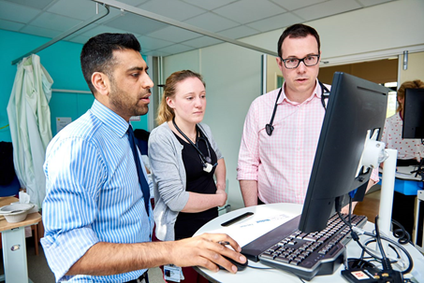
Introduction
Introduction
Introduction
Introduction
Introduction
Introduction
Ordering MMR Vaccine
Using pop up alerts for opportunistic appointments
There are 2 types of MMR Vaccine - Priorix ® and M-M-RVaxPro®
Contents:
Neither vaccine contain thiomersal or any other preservatives
MMRVaxPro® contains porcine material and as such, Priorix® should be offered to individuals who have religious restrictions relating to porcine products. Orders for Priorix® is limited per practice and if a large number of this vaccine is required the practice can contact Immform directly.
Storage:
Un reconstituted MMR vaccine and its diluent should be stored in original packaging at temperature between 2 and 8 degrees Celsius.
The MMR vaccine (like all vaccines) is sensitive to heat and cold and as such, vaccine effectiveness cannot be guaranteed unless they are stored at the correct temperature.
Vaccine ordering:
GP practices should ensure all vaccine ordering is conducted in line with national guidance and adhere to any limits on stock to be held. (Greenbook)
Set up your clinical system to identify all eligible patients and generate pop-up alerts on their patient record, so that staff are reminded to offer the vaccination opportunistically each time the patient’s record is opened. Ensure that clinicians are trained to monitor these alerts so that no patients are missed.
If your system is not able to do this, notifications can be set up manually.
Accurate and complete patient data are needed, including identifying ‘ghosts’ – patients who have transferred out of the area , but are still sent invitations for vaccinations
23
MMR Vaccination Toolkit
2023/24
https://www.england.nhs.uk/london/our-work/immunis-team/
4

Slide 27
Introduction
Introduction
Introduction
Introduction
Introduction
Introduction
MMR: Contra-indications
There are very few individuals who cannot receive MMR vaccine. When there is doubt, appropriate advice should be sought from a consultant paediatrician, immunisation co-ordinator or consultant in communicable disease control rather than withholding the vaccine. The vaccine should not be given to:
● Those who are immunosuppressed (see Chapter 6 for more detail)
● Those who have had a confirmed anaphylactic reaction to a previous dose of a measles-, mumps- or rubella-containing vaccine
● Those who have had a confirmed anaphylactic reaction to neomycin or gelatine
● Pregnant women
24
MMR Vaccination Toolkit
2023/24
https://www.england.nhs.uk/london/our-work/immunis-team/
5

Slide 28
Introduction
Introduction
Introduction
Introduction
Introduction
Introduction
Inviting And Informing Patients
Offer a call/recall service
Phone your patients
Text or write to patients
It is considered good practice to offer the MMR vaccination on a call-recall basis. Ensure that all eligible patients are recalled to invite them to have the vaccination. Follow up any non-responders with letters and/or telephone calls.
To maximise safety and efficiency, it is worth pre-screening patients in the correct age band prior to recalling in order to ensure patients are not inadvertently recalled that have contraindications to receiving the vaccination.
General awareness of the vaccination and the seriousness of infection are poor. A personal telephone call is often all it takes to encourage a patient to book an immunisation appointment. The call should therefore be undertaken by a healthcare professional who is well briefed on what the MMR vaccination can offer patients.
A 2005 Cochrane review found that patient recall systems can improve vaccination rates by up to 20%: telephone calls were the most effective method, but practices should be aware of cost implications
Sending a Birthday card or letter may help encourage patients to attend. Letters should be personal and from the named GP.
Send an NHS information leaflet alongside the invitation letter to ensure that patients are given sufficient information to reach an informed decision.
Sending text or email reminders is a cheap and easy method of improving appointment attendance. For patients who do not have mobile phones or email, letters and telephone calls should be used.
Make Every Contact Count
Talk to your patients about shingles vaccination (and consider administering it) during other appointments, to save multiple attendances at the surgery.
The vaccination can be given at the same time as the pneumococcal and influenza vaccination, although should be administered in different sites, and ideally different limbs (Green book pg 6). The injection site should be recorded.
25
MMR Vaccination Toolkit
2023/24
https://www.england.nhs.uk/london/our-work/immunis-team/
6

Slide 29
Resources:
Training and Information Resources
E-learning for healthcare (Immunisation→ Vaccine Preventable Diseases → Vaccine Preventable Diseases – Measles Mumps and Rubella) HEE elfh Hub (e-lfh.org.uk)
The Greenbook on MMR - Green Book of Immunisation - Chapter 21 Measles (publishing.service.gov.uk)
Quick Factsheet and Q+A on Measles: MEASLES - Don’t let your child catch it (publishing.service.gov.uk)
Mumps: Risk in Pregnancy, Infection in Healthcare setting and MMR vaccine - Mumps: risk in pregnancy, infection in healthcare settings and MMR vaccine - GOV.UK (www.gov.uk)
Resources for Your GP practice – Website or Waiting Room
https://www.healthpublications.gov.uk/ViewArticle.html?sp=Squicklinksvaccinationforpregnantwomenposter
Think Measles (in young people) poster: Think Measles! (publishing.service.gov.uk)
Resources for MMR catch up: MMR catch up for 10 and 11 year olds (publishing.service.gov.uk)
Resources for Patients
MMR Leaflet : MMR vaccination (publishing.service.gov.uk)
NHS Website on MMR: MMR (measles, mumps and rubella) vaccine - NHS (www.nhs.uk)
MMR Guide: MMR for all: general guide - GOV.UK (www.gov.uk)
Measles Flyer for Parents: MEASLES - Don’t let your child catch it (publishing.service.gov.uk)
Think Measles Leaflet for Young People: Think Measles! (publishing.service.gov.uk)
What do I need to know about the MMR vaccine (UKHSA): What do I need to know about the MMR vaccine? - UK Health Security Agency (blog.gov.uk)
MMR Vaccine in Pregnant Women: MMR (measles, mumps, rubella) vaccine: advice for pregnant women - GOV.UK (www.gov.uk)
Vaccination in Pregnancy Leaflet: Pregnant? Immunisation helps to protect you and your baby from infectious diseases (publishing.service.gov.uk)

Slide 30
References
Encouraging vaccine uptake: Lessons from behavioural science (2022), Author: Susan Michie (University College London, Centre of Behaviour Change, UCL London, UK)
https://patient.info/doctor/measles-pro
https://www.cdc.gov/vaccines/vpd/mmr/public/index.html
Green Book of Immunisation - Chapter 21 Measles (publishing.service.gov.uk)
Mumps - NHS (www.nhs.uk)

